Slide 1
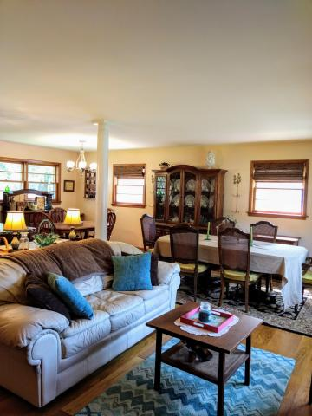
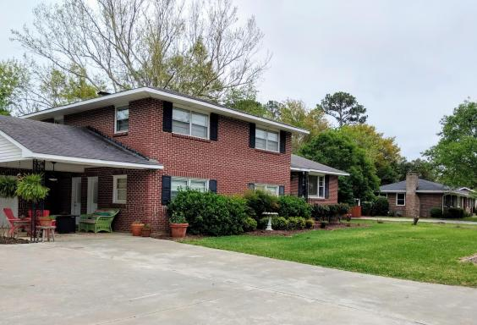
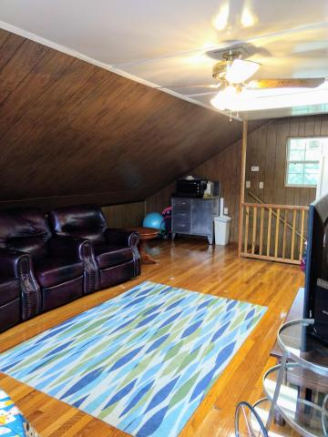
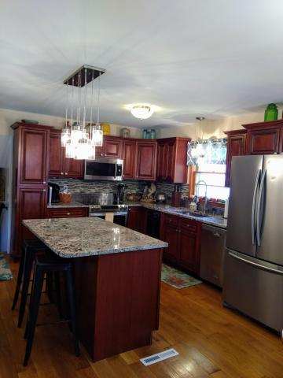
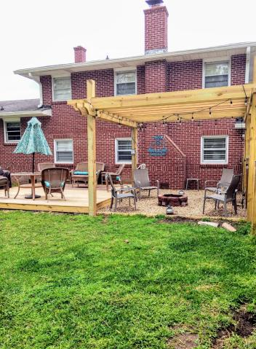
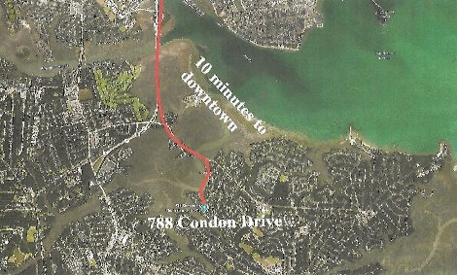
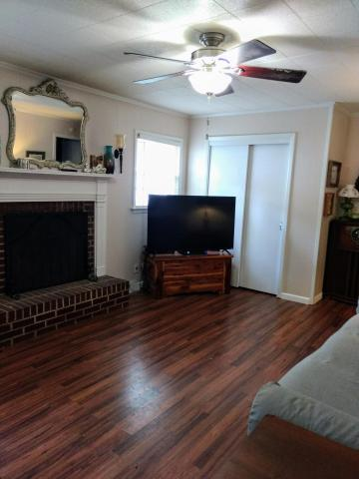
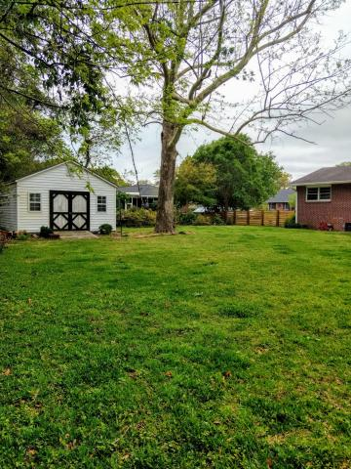

William S. Smith, Broker wssmith@hartnettrealty.com
843-906-5620
Enormous Price Reduction in Family-Oriented Battery Point! 10 Minutes from Downtown!
Price was $595,000 on March 12, 2018
Price now $475,000!
788 Condon Drive
Battery Point ~ Charleston, SC 29412
MLS# 18006731 ~ $475,000
4 Bedrooms/2 Baths/No HOA/10 minutes from downtown.
New hardwood flooring/updated kitchen/wooden-fenced enclosed backyard and more
1156 Bowman Road, Suite 200
Mt. Pleasant, SC 29464

