Slide 1
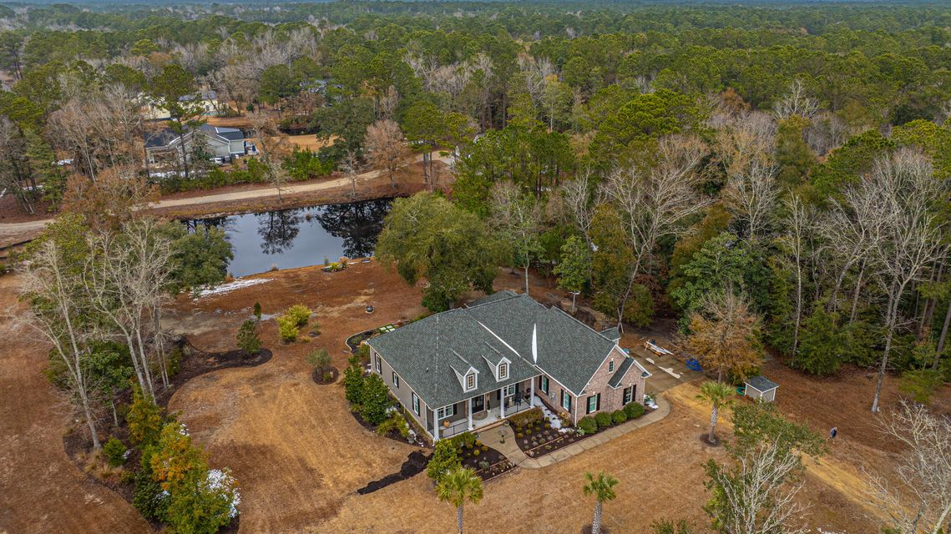
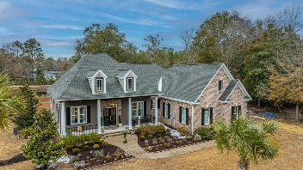
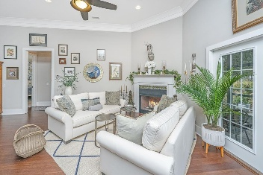
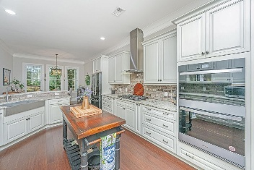
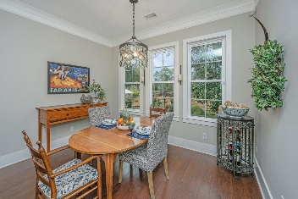
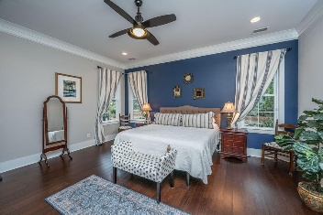
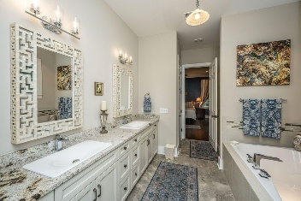
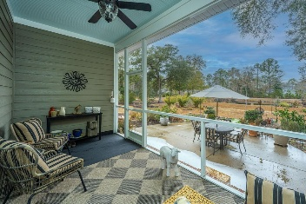

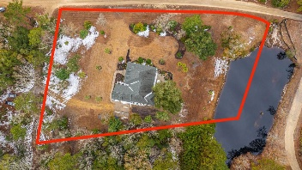


788 Awendaw Lakes Boulevard
Awendaw Lakes | Awendaw, SC 29429 | MLS# 25003227
OPEN HOUSE SATURDAY 1-3
PRICE ADJUSTMENT!
OFFERING 2.5% BUYER'S AGENCY COMPENSATION
PRICED BELOW APPRAISED VALUE
VERY MOTIVATED SELLER
1.72 ACRES
3 BED | 2½ BATH | 2,848 SF
FINISHED FROG
ATTRACTIVELY PRICED AT $865,000
Scan for a virtual walkthrough!
Suzi Baldrick
Mobile 843-442-3149
suzi.baldrick@carolinaone.com
Carolina One Real Estate
1503 Palm Blvd
Isle of Palms, SC 29451-2280

