Slide 1
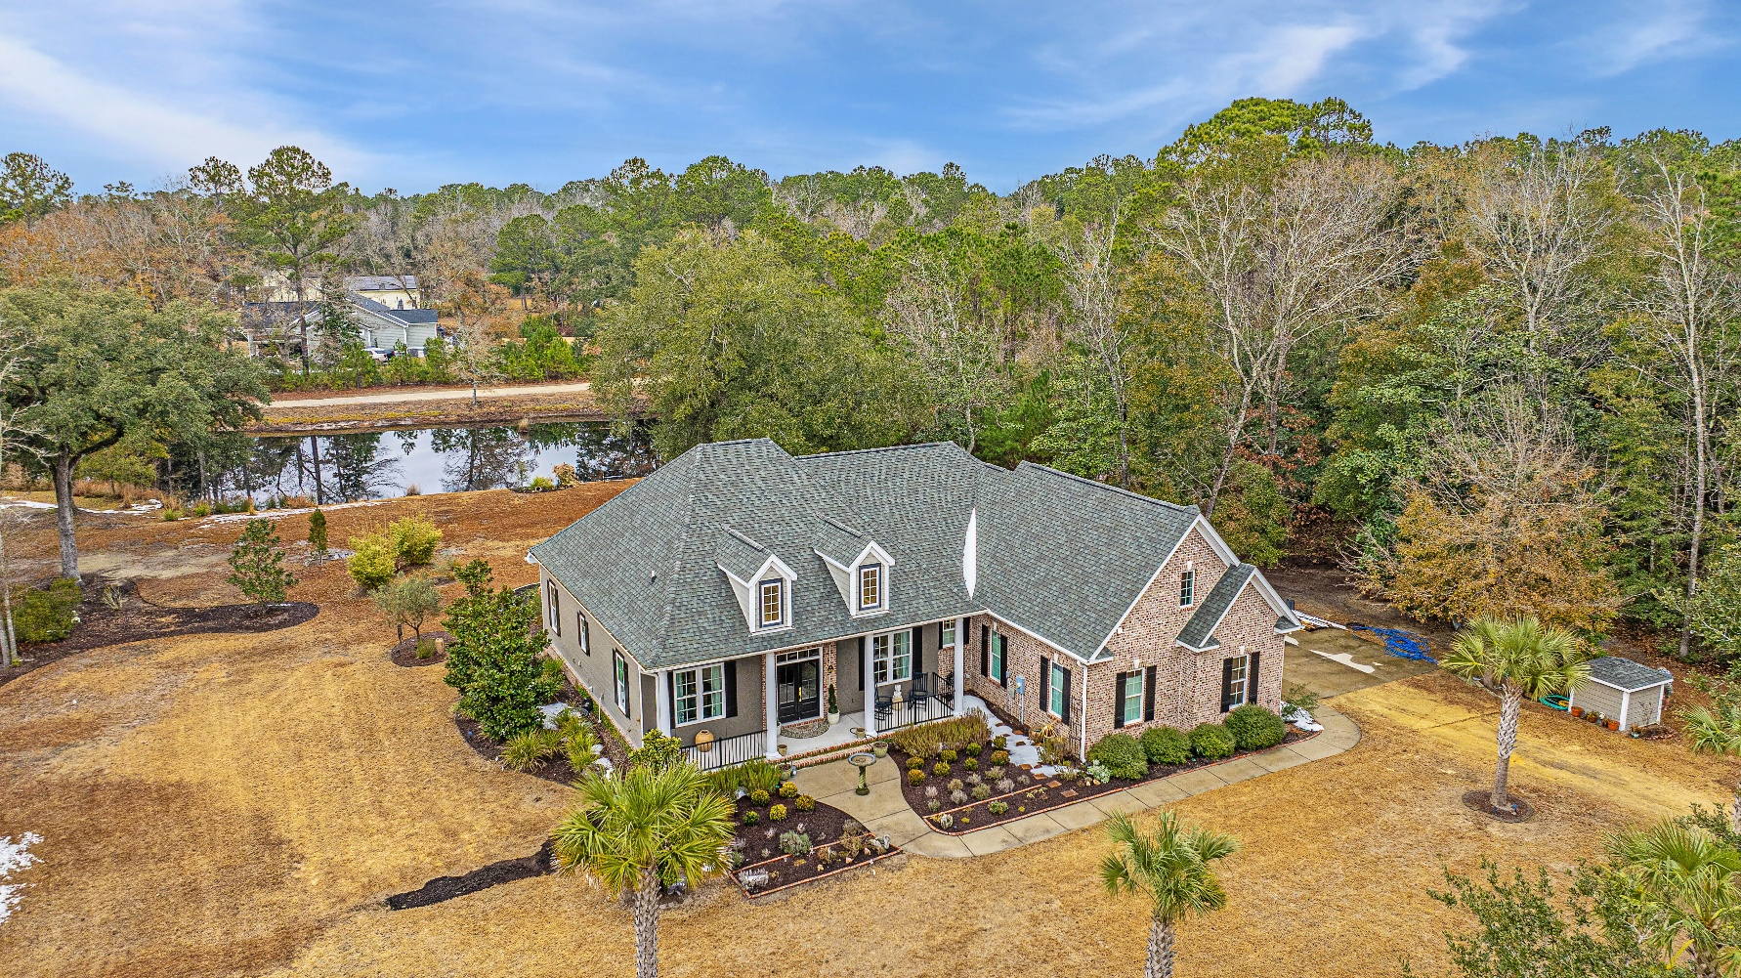
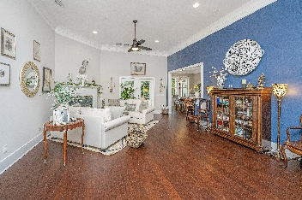
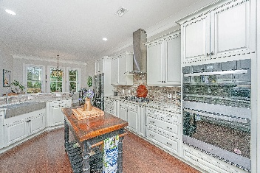
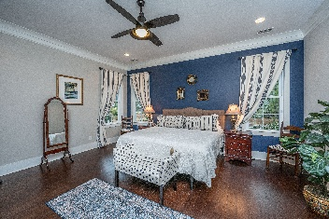
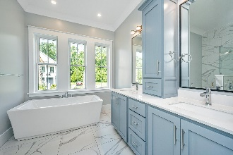
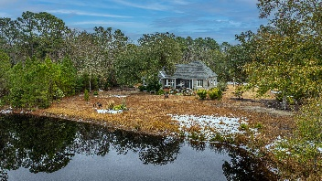


788 Awendaw Lakes Boulevard
Awendaw Lakes | Awendaw, SC 29429 | $929,000
3 bedrooms | 2.5 bathrooms | Custom-built in 2017
Coming to Market February 7th
Open House, Sunday Feb 9th from 2-4
PRICE ADJUSTMENT!
Retreat from the busy city life to this stunning custom home and property in Awendaw! Imagine being only minutes from Mount Pleasant and Charleston, beaches and barrier islands, but being surrounded by lovely, mature and private landscape on a serene pond.
Situated on 1.72 acres of picturesque, natural landscaped beauty, the home is perfectly designed to maximize its private and quiet setting. Refreshing sea breezes can be enjoyed from the nearby Intracoastal Waterway on the backyard patio and front porch. Spend quality time watching wildlife from your screened-in back porch, tend to your backyard garden off the patio, or drop a line in the pond for a fun catch!
Awendaw and its quiet coastal tranquility offers plenty of outdoor experiences like Awendaw Green Barn Jams at the Outpost, youth soccer fields, Buck Hall Rec area/boat ramp, Garris Landing boat ramp/Bulls island Ferry, easy access to the Francis Marion National Forest with its associated bike and hiking trails, and Twin Ponds Rifle Range. Come take a tour and see why this home and Awendaw are the best “secret” worth keeping!
Suzi Baldrick
Mobile 843-442-3149
suzi.baldrick@carolinaone.com
Carolina One Real Estate
1503 Palm Blvd
Isle of Palms, SC 29451-2280

