Slide 1
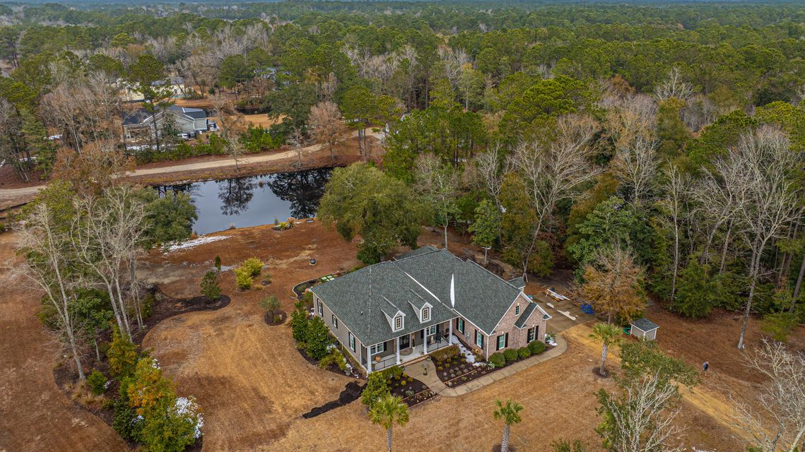
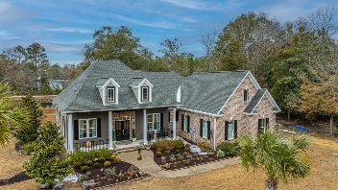
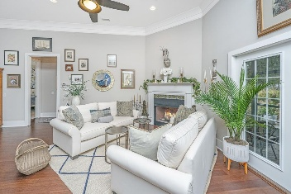
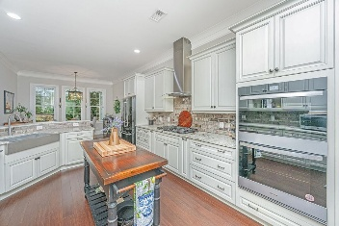
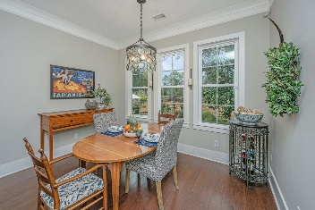
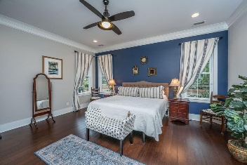
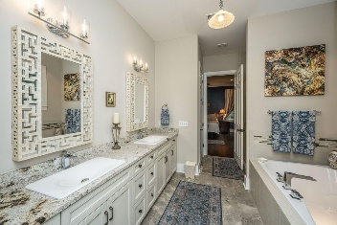
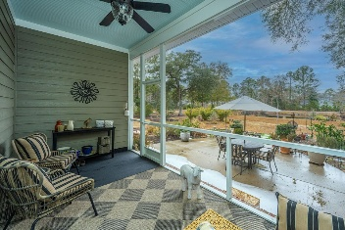
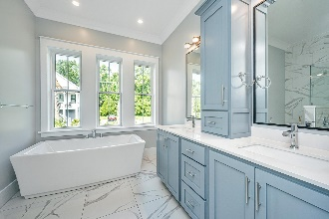
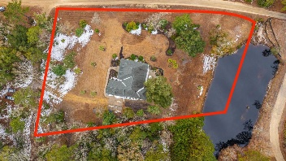


788 Awendaw Lakes Boulevard
Awendaw Lakes | Awendaw, SC 29429
MLS# 25003227 | Now Offering $899,500
Open House Saturday & Sunday 1-3:30
PRICE ADJUSTMENT!
While You’re Here, Enter A Drawing For $100 Debit Card!!
Impeccable European-inspired Custom Home, 2,848 sf with 3 bd/2.5 baths plus frog, 1.72 acres, and a lovely pond
Only minutes from Mount Pleasant and Charleston, beaches and barrier islands
Private serene setting with Intracoastal breezes
Screened-in back porch and patio with gardens
Come and checkout all of the outdoor recreational fun Awendaw has to offer.
Can’t make it? Take a virtual walkthrough!
Suzi Baldrick
Mobile 843-442-3149
suzi.baldrick@carolinaone.com
Carolina One Real Estate
1503 Palm Blvd
Isle of Palms, SC 29451-2280

