Slide 1
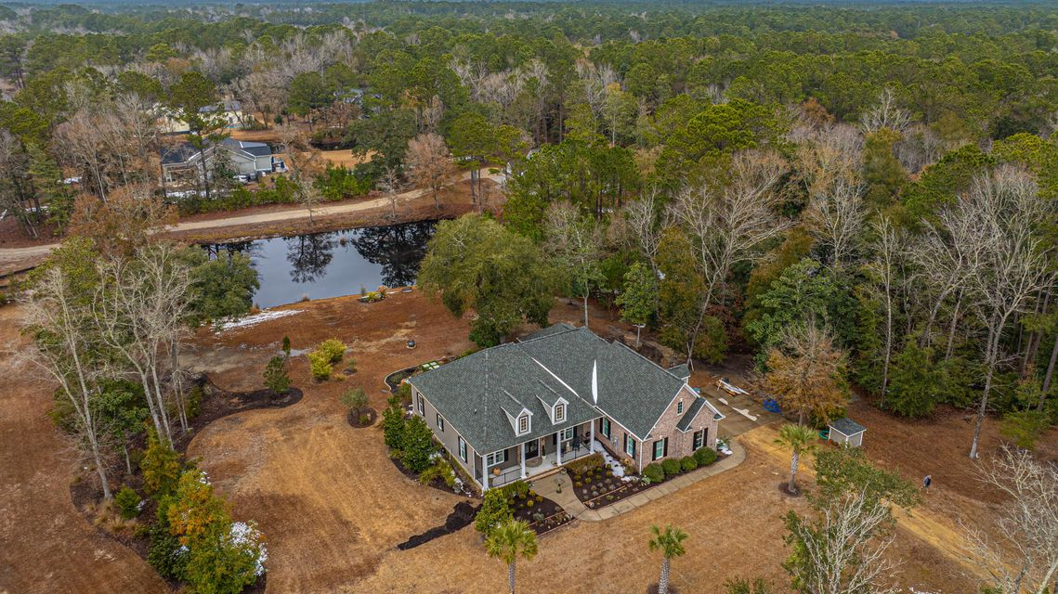
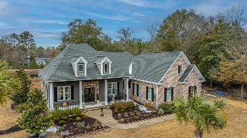
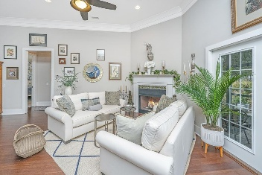

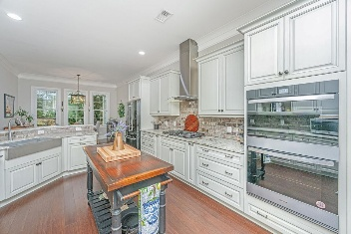
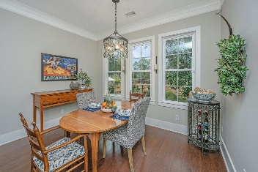
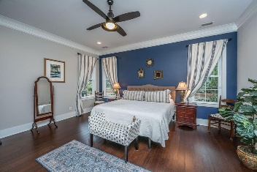
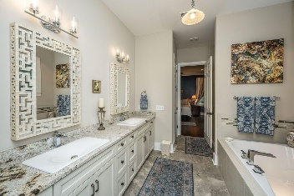
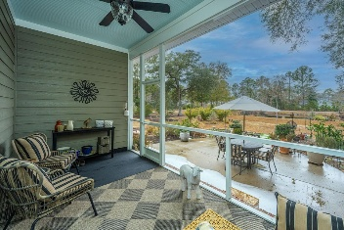
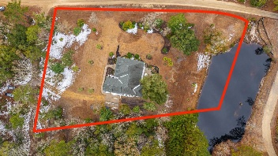


788 Awendaw Lakes Boulevard Awendaw Lakes | Awendaw, SC 29429 | MLS# 25003227
Open House Saturday 2-4pm
PRICE ADJUSTMENT!
Take a virtual walkthrough!
Retreat to coastal tranquility at this impeccable European-inspired custom home in Awendaw! Imagine being only minutes from Mount Pleasant, Charleston and the beaches, but being surrounded by mature, private landscape on sprawling 1.72 acres. Catch the Intracoastal breezes from the relaxing porch or patio that overlooks a serene pond. This home boasts premium finishes, refined craftsmanship, and a thoughtful open plan layout. Any seasoned chef would love to entertain in the sophisticated kitchen which includes a built-in stainless steel air fryer/oven combo, gas cooktop, refrigerator, dishwasher, custom millwork cabinets, granite countertops and a lovely keeping room for extra seating. The large owner’s suite has terrific views of the pond with lovely gardenias just outside your windows!
NEW PRICE $879,900
3 BED * 2.5 BATH * 2848 SF LIVING * FINISHED FROG
Suzi Baldrick Mobile 843-442-3149
suzi.baldrick@carolinaone.com
Carolina One Real Estate
1503 Palm Blvd
Isle of Palms, SC 29451-2280

