Slide 1
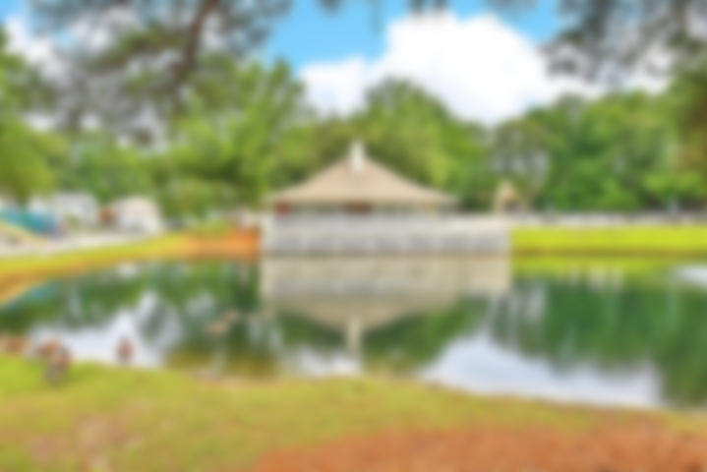
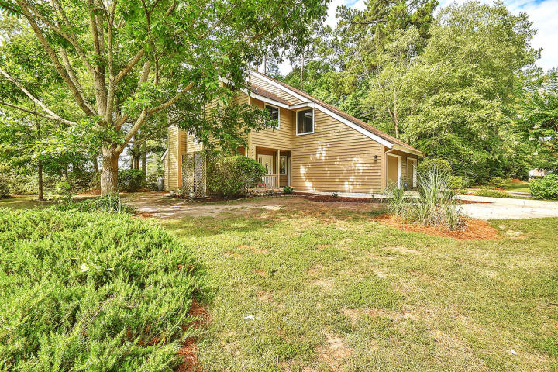

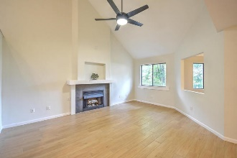
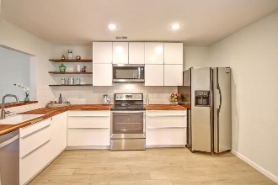
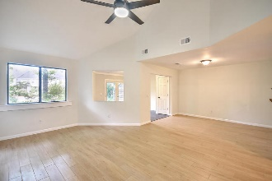
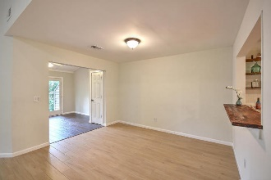
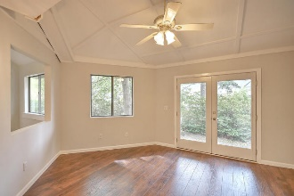
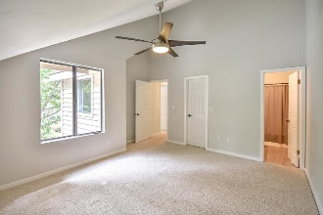
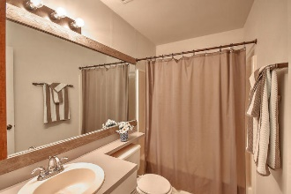
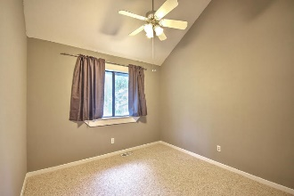
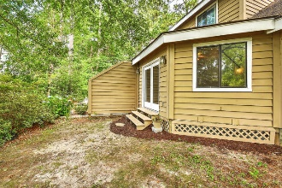
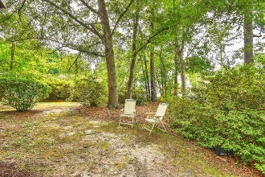


Join Us Saturday from 10a-2p Just Listed – Gated Community
7891 Wilderness Trail A
The Park at Rivers Edge | North Charleston | MLS# 18018277 | $169,775
Adorable renovated duplex on quiet corner lot with secluded backyard with natural wooded buffer in cul de sac. Enjoy the peace and quite of this gate community with GREAT amenities, including pool, clubhouse, tennis courts and play parks. Sellers put a lot of love and energy into updating this home - features include: Spacious open living room with fireplace, 9+ vaulted smooth ceilings, dining room and sunroom with French doors out to backyard**Wonderful completely new kitchen with sleek cabinets, breakfast bar, butcher block counters and s/s appliances**All new, high quality tile and laminate flooring on first floor**Upstairs, you will find the master en suite, 2 additional bedrooms with hall bathroom**LOW HOA FEES!! This low maintenance home is ready for you to call its new owners!
Desiree Maurer Office - (843) 416-2000
Mobile - (843) 327-9010 desiree.maurer1@gmail.com
www.yourcharlestonhousesearch.com
Keller Williams Realty 496 Bramson Ct Ste 200 Mt. Pleasant, SC 29464

