Slide 1
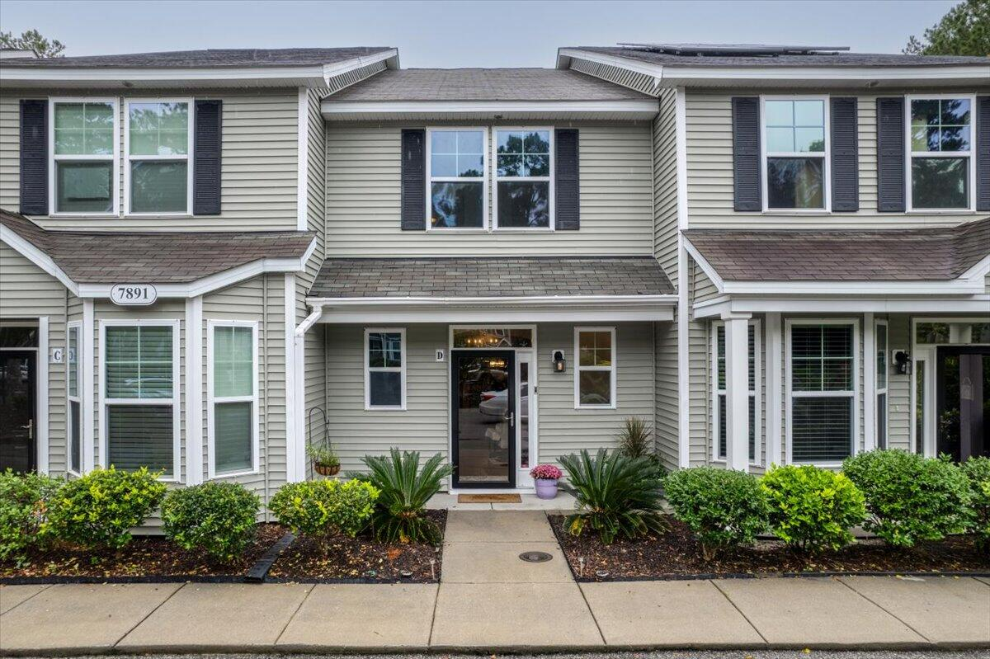
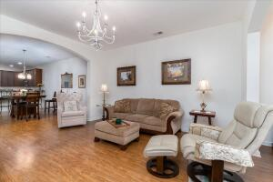
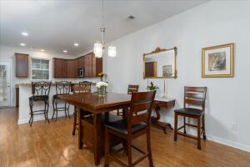
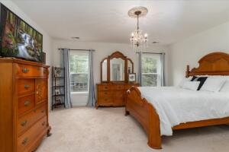
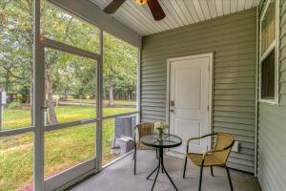
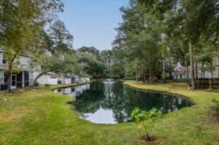
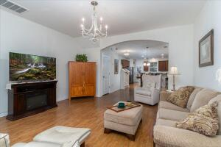
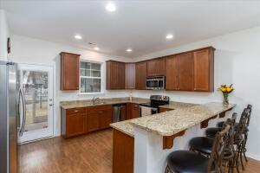
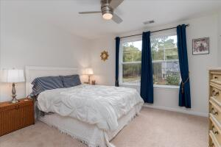
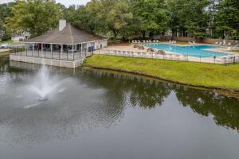


7891 Champion Way D
The Park at Rivers Edge | North Charleston, SC 29418
MLS# 23023558 | $299,900
Move-In Ready
Updated,Spacious 5 Bedroom On Cul-de -Sac!
2 Bedroom
2½ Bath
1568 Sq Footage
Open Floor Plan
Dining Area
Seating For 4 At Counter
Double En-suites Off Bathrooms
Screened Porch
All Appliances To Include Washer & Dryer
Gated Community
Bring your buyers before it’s gone!
Alma Kenneally Certa
843-730-3356
alma@agentownedrealty.com
AgentOwned Realty Co. Preferred Group, Inc. | 824 Johnnie Dodds Blvd | Mt Pleasant, SC 29464

