Slide 1
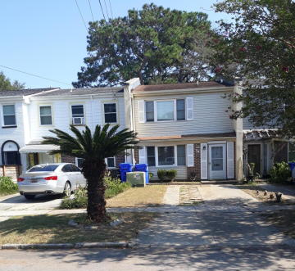
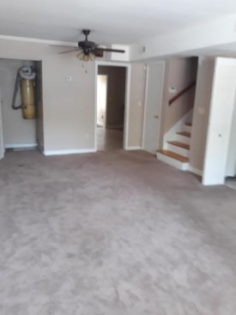
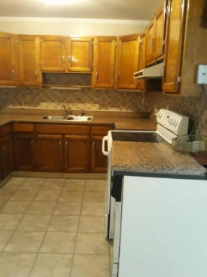
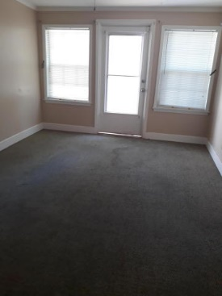
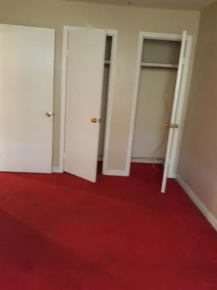
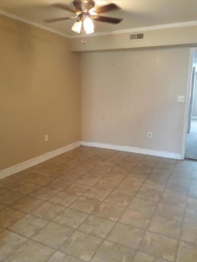
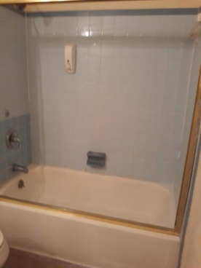

Very Nice Wagner Terrace Townhome
Investors Should Take A Look At This One
Starbucks card to first 10 agents
78 Devereaux Ave #C
Wagener Terrace
Charleston, SC 29403
MLS# 19027966
$379,000
Some updating and painting is all that is needed to make this your oasis.
Homes in the area range from high 400,000 to 600,000 dollars.
Come and see if this is the home for you.
Geraldine Sands
(843) 224-1911
gw.sands67@gmail.com
AgentOwned Charleston Group | 902 Savannah Hwy | Charleston, SC 29407-7802

