Slide 1
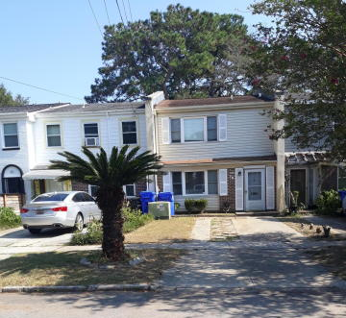
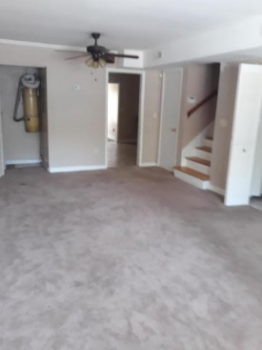
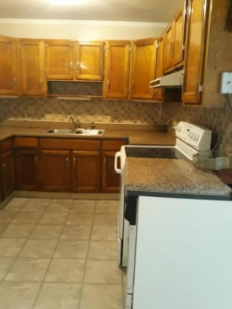
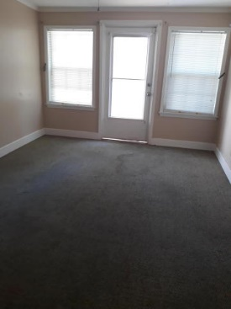
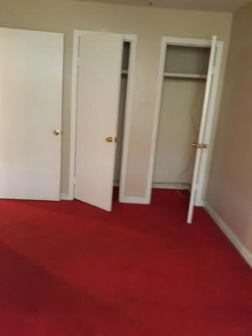
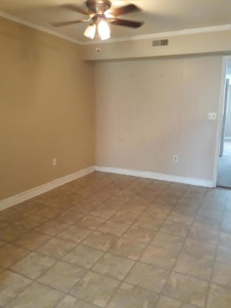
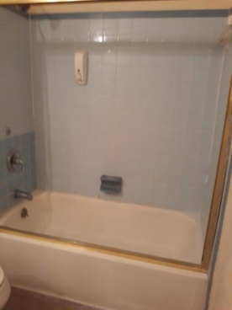

NEW YEARS SPECIAL ~ REDUCED $15,000 Close to water. Well worth a second look.
Starbucks card to first 10 agents
78 Devereaux Ave
Wagener Terrace
Charleston, SC 29403
MLS# 19027966
$350,000
Very nice townhome located in Wagner Terrace.
Some updating and painting is all that is needed to make this your oasis. Investors Should Take A Look At This One. Homes in the area range from high 400-to 600,000 dollars.
Come and see if this is the home for you.
Geraldine Sands
(843) 224-1911
gw.sands67@gmail.com
AgentOwned Charleston Group | 902 Savannah Hwy | Charleston, SC 29407-7802

