Slide 1
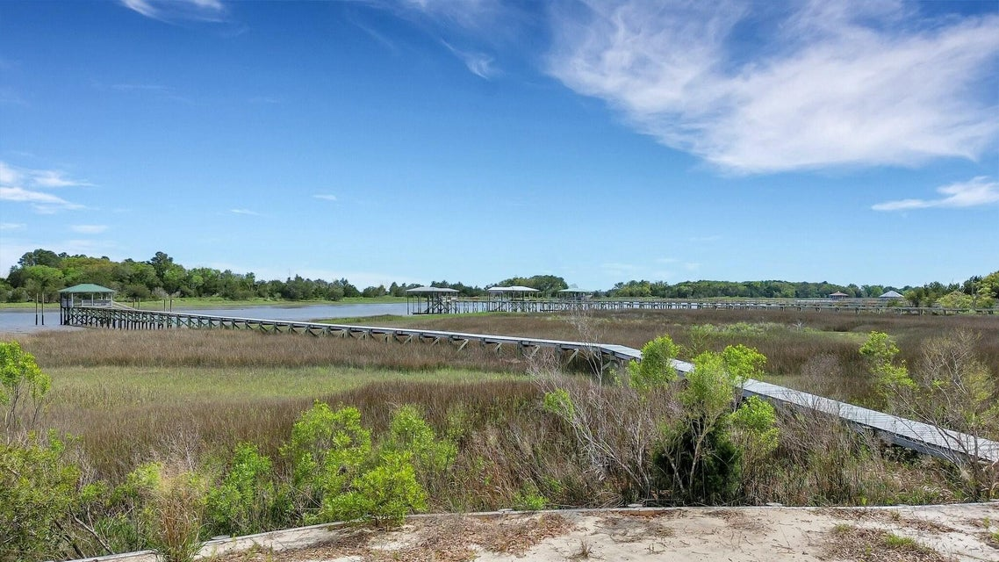
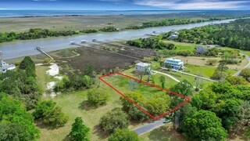
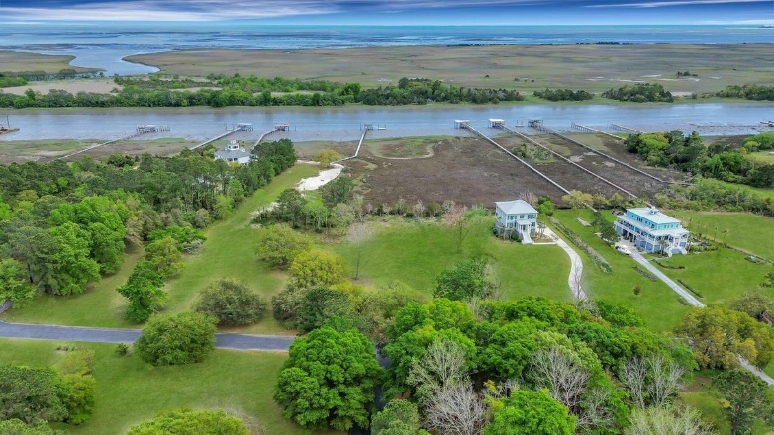
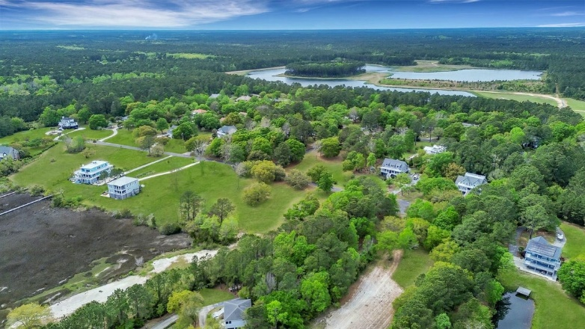
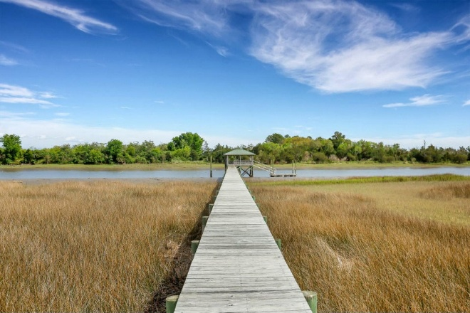
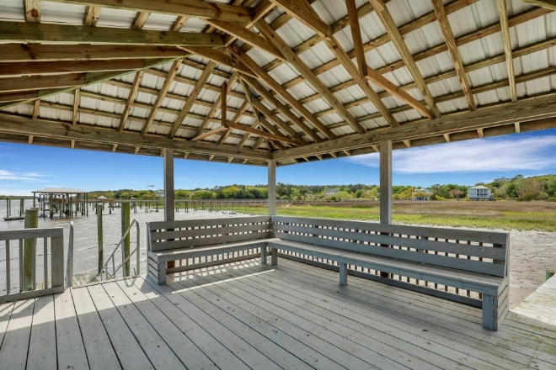


Motivated Seller! Deep Water Awendaw with Permits in Hand!
7909 Pelican Bay Drive
Bulls Bay Overlook | Awendaw, SC 29429 | MLS# 25000132 | $740,000
One of the last remaining DEEP WATER buildable lots, Awendaw! A perfect location to build your Lowcountry retreat and one of the last remaining waterfront lots in the gated Bulls Bay Overlook neighborhood! Dock and septic permits, topo surveys in hand! Neighborhood boat ramp and dock amenities. Located only minutes to Mount Pleasant schools, shopping, dining and beaches!
VIDEO TOUR
Virginia Landon 803-493-9202
vlandon.realestate@gmail.com
The Boulevard Company | 806 Johnnie Dodds Blvd Ste 100 | Mount Pleasant, SC 29464

