Slide 1
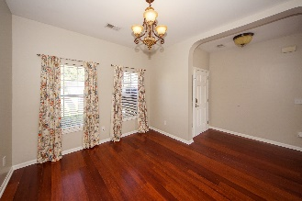
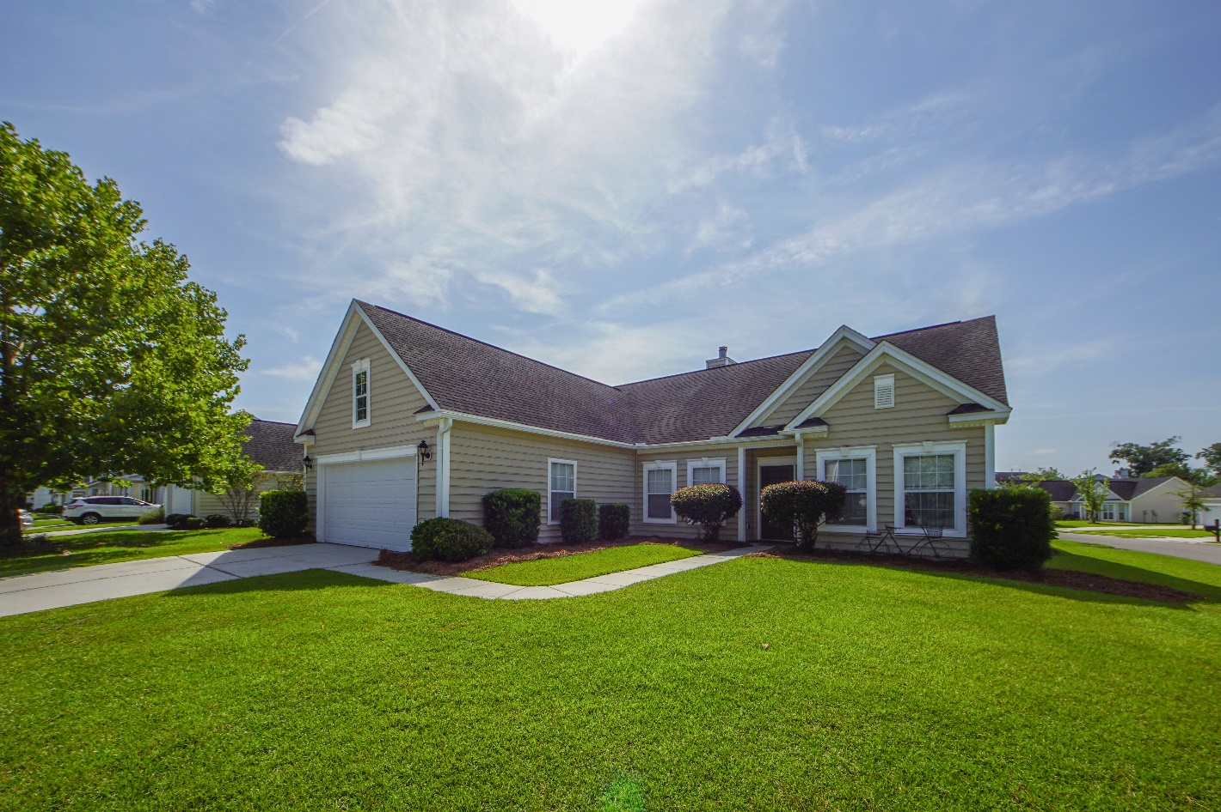
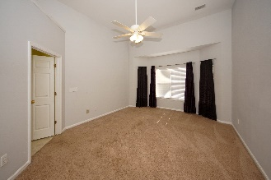
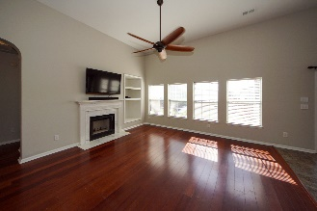
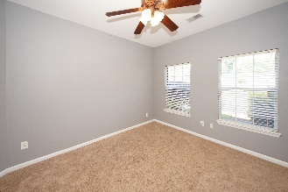
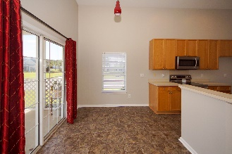
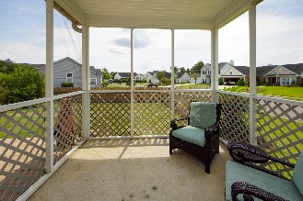
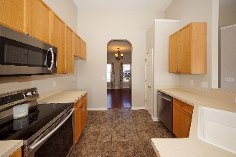
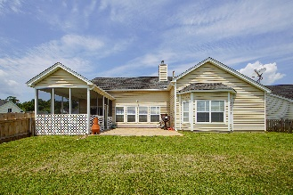
Freshly Painted 1-Story Grand Oaks at an Excellent Price!!
792 Bent Hickory Road
Grand Oaks Plantation | Charleston | MLS# 19022724 | $270,000
1 Story corner lot home within walking distance of the pool in a highly desirable subsection of Grand Oaks. Very close to the hospital. New oversized HVAC system installed in 2018! Brand New stainless stove. Wood burning fireplace with marble surround and wood mantle. Built in bookcases, high ceilings, and nice flowing floor plan. Enjoy your corner lot yard from the privacy of your large screened in porch and massive patio/grilling area. When everyone is ready for a dip in the pool it's just a short walk to one of the largest pools in all of Grand Oaks. Close to Shadowmoss golf course, Walmart, and the new Harris Teeter that is currently under construction in Grand Oaks. The new shopping center will boast numerous highly anticipated restaurants and specialty shops as well!
Johnny Crosby
jcrosby@propertyadvisorsinc.com | 843-270-9407 | www.charlestonhomeproviders.com
Brand Name Real Estate | 4 Carriage Lane, Suite 106 | Charleston, SC 29407

