Slide 1
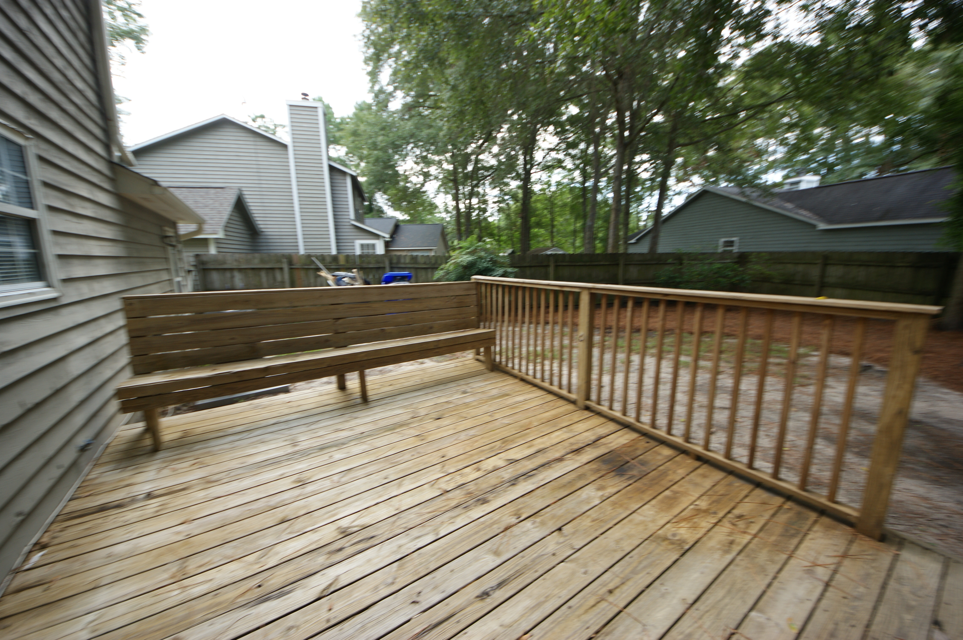
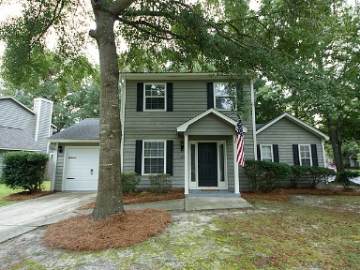
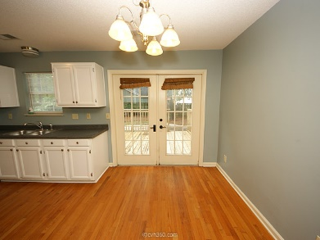
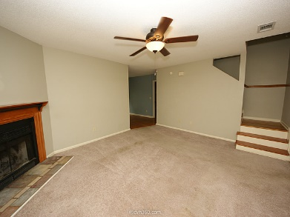
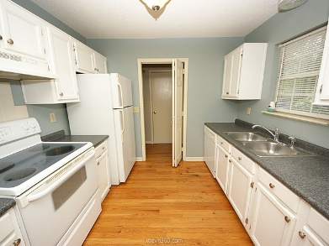
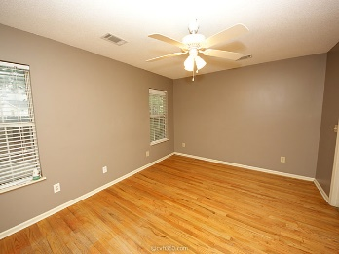
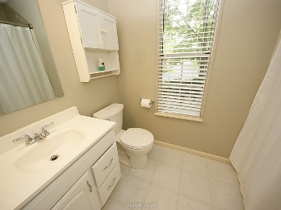
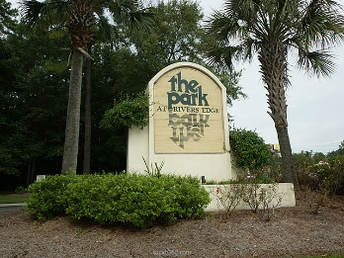
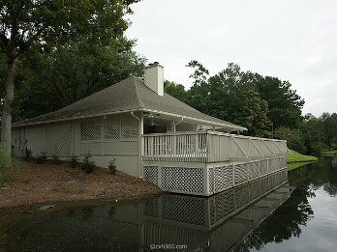
New Listing in Gated Community!
7932 Riverbirch Lane
The Park at Rivers Edge
North Charleston, SC 29418
MLS# 15023749
$129,000
Welcome home to the very inviting and gated community of The Park at Rivers Edge! The neighborhood is in a convenient location off Dorchester Rd. The front gate is manned by security guards making you feel safe to come home! The home is situated on a large corner lot with long drive way. Gorgeous original hardwood floors and new roof (2014) are just some of this home's features. The large master bedroom is located downstairs, with the other 2 rooms upstairs. In the fenced in backyard, you will walk out your French Doors onto your oversized wood deck - great for entertaining! The tennis courts, playground, and gorgeous pool are just a short walk away. The home is move-in ready just for you!
Sean Harrington
(843) 226-9652
sean@milerproperties.com

