Slide 1
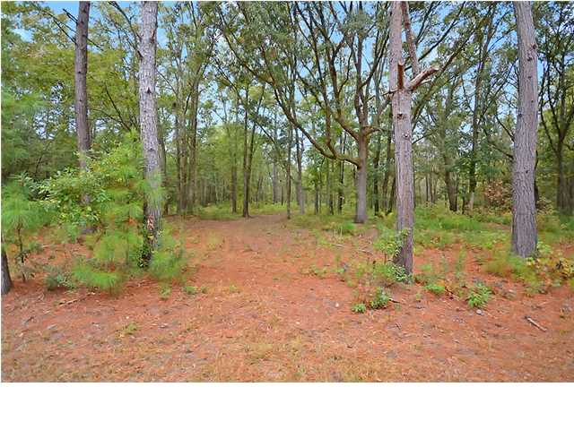
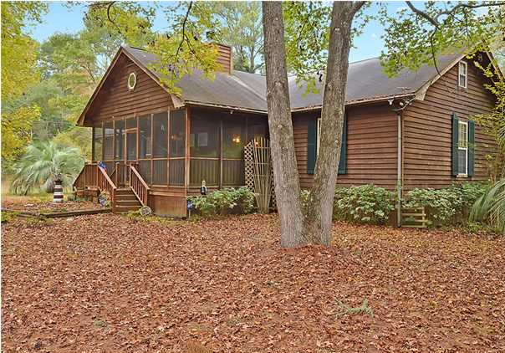
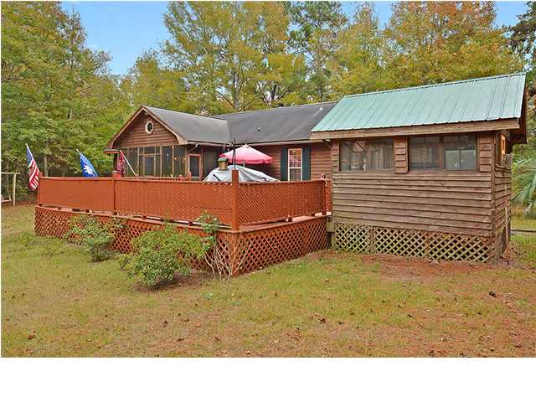
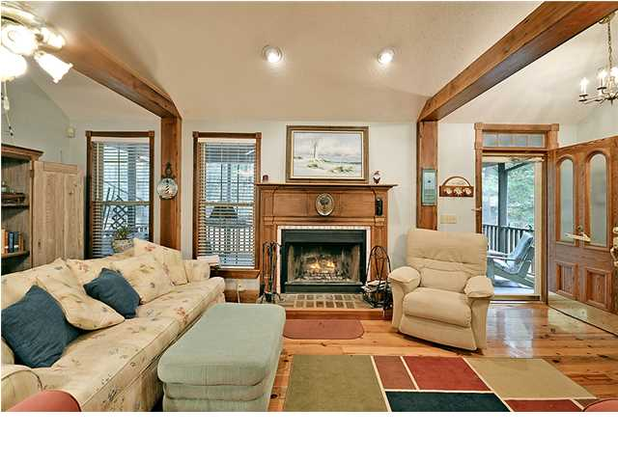
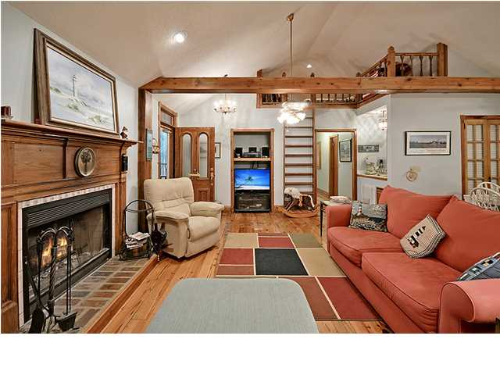
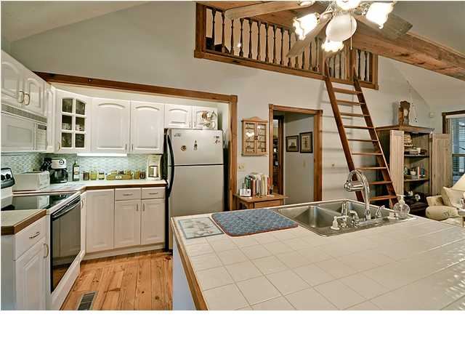
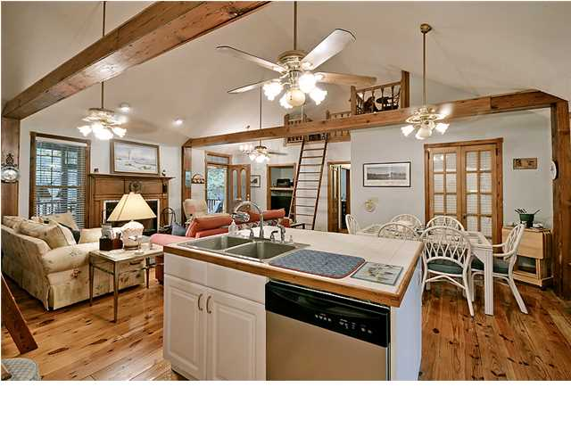
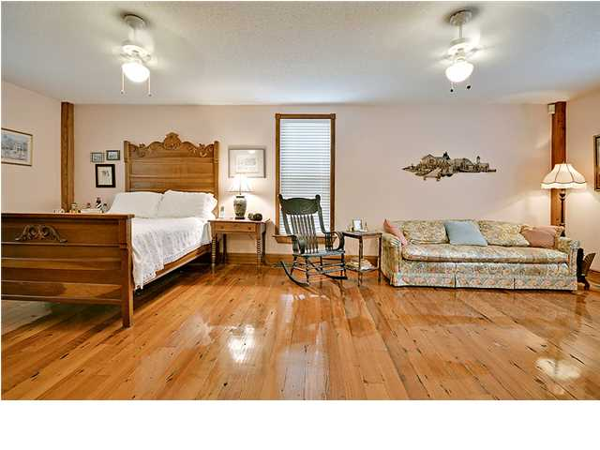
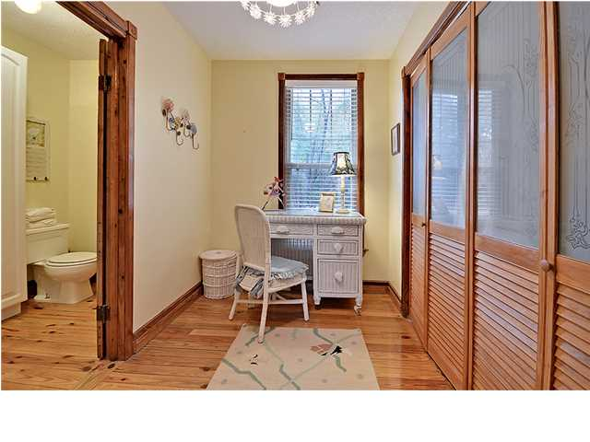
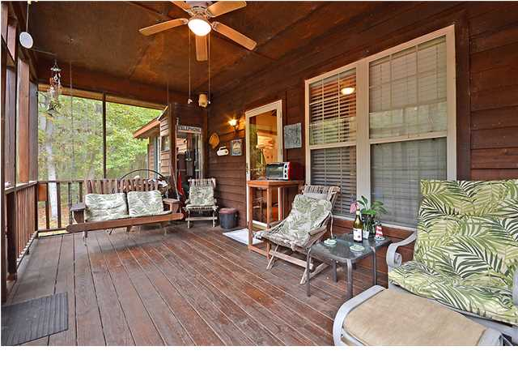
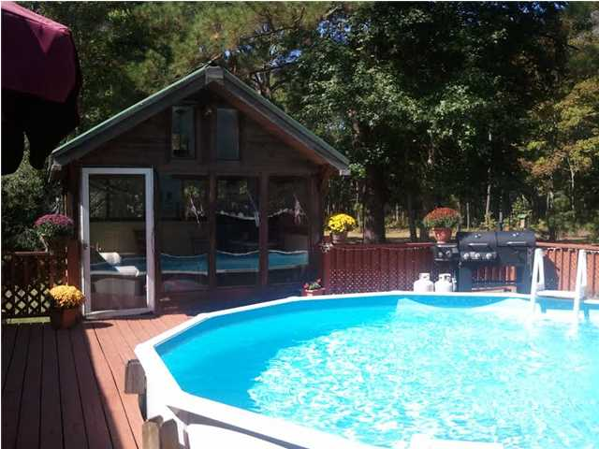

Parkshore Marshfront
Edisto Retreat!
7946 Averyt Dr ~ Edisto Island ~ MLS# 1328060 ~ $349,000
Looking for privacy and serenity? Enjoy a beautiful, turn-key, fully furnished custom home ($25K worth of furniture conveys)tucked peacefully away on Edisto Island. You'll find a perfect balance in this setting where deer and wildlife abound while still being only a 6 minute drive to Edisto Beach or the boat landing. You'll also enjoy access to the Intracoastal Waterway, Kiawah, and Seabrook. This wooded retreat is a great place to relax with a spacious back deck, glistening swimming pool, and air conditioned wooden cabana just a few steps away. There are so many extras to appreciate in this well maintained home! The floor plan is open and easy for entertaining friends and family. There are beautiful 5" planked heart pine floors, door frames, antique doors and a wood burning fireplace. This gem of a home also boasts TWO Master Suites, a third bedroom and 2 lofts that could easily be modified into an office, play room, or whatever your imagination can envision. You'll love the easy and relaxed flow of the living/dining/kitchen areas found in this home. The kitchen has an attractive tiled island and tile splash, which offer extra counter space. Enjoy watching birds from screened porches found in the front and the back of the house, or listen to your favorite music throughout the whole house with the home stereo system. There are two attics for storage as well as an outdoor storage building with a screened potting shed and sink. The icing on the cake? It's an easy drive to Kiawah Island, Seabrook Island, and historic Charleston, one of the country's most popular cities. If you desire a peaceful vacation home or a hutting/fishing lodge, this hidden treasure is it!
Call or email for details: (843) 654-7777 or Ben@MattOneillTeam.com

