Slide 1
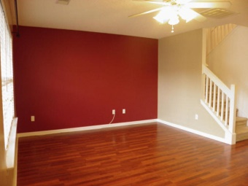
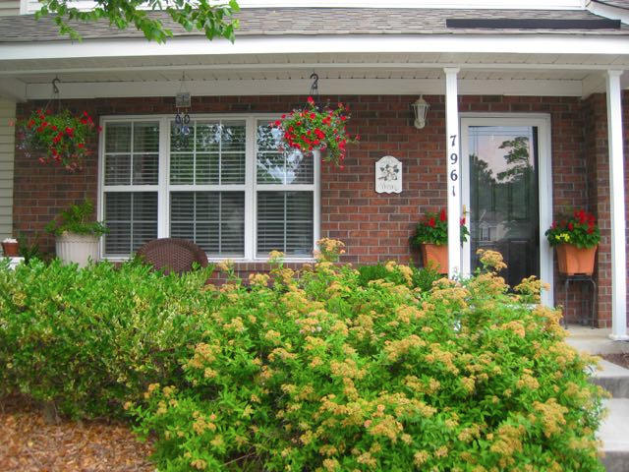
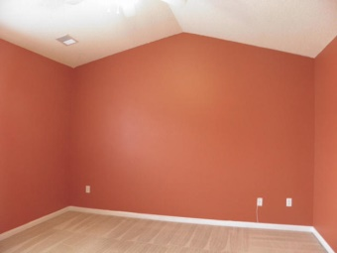
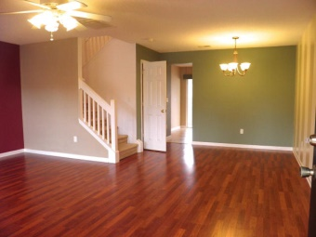
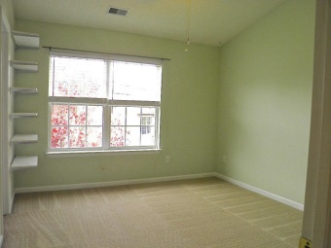
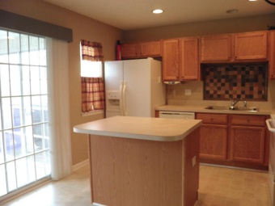
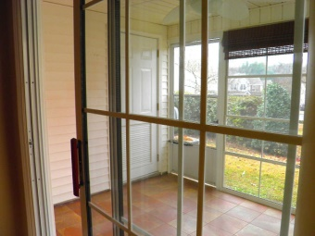
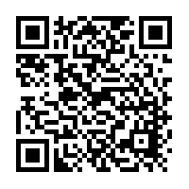

Oak Bluff
7961 Shadow Oak Dr, North Charleston
MLS# 14029183 - $108,500
Don't miss this upgraded townhome
in convenient Oak Bluff Subdivision.
Cherry laminate floors have been added to the living and dining rooms. The open nice-sized kitchen has an added tile backsplash over the sink and a wonderful island with extra storage.
The built-in microwave is less than 1 year old. Off of the kitchen is a back porch that has been turned into a year-round sunroom with 12'' tile floors and screens that have clear vinyl panels that can close out the exterior when needed.
Both master bedrooms are located upstairs and each has its own en-suite bathroom with double vanities and tub/shower combo and walk-in closets.

