Slide 1
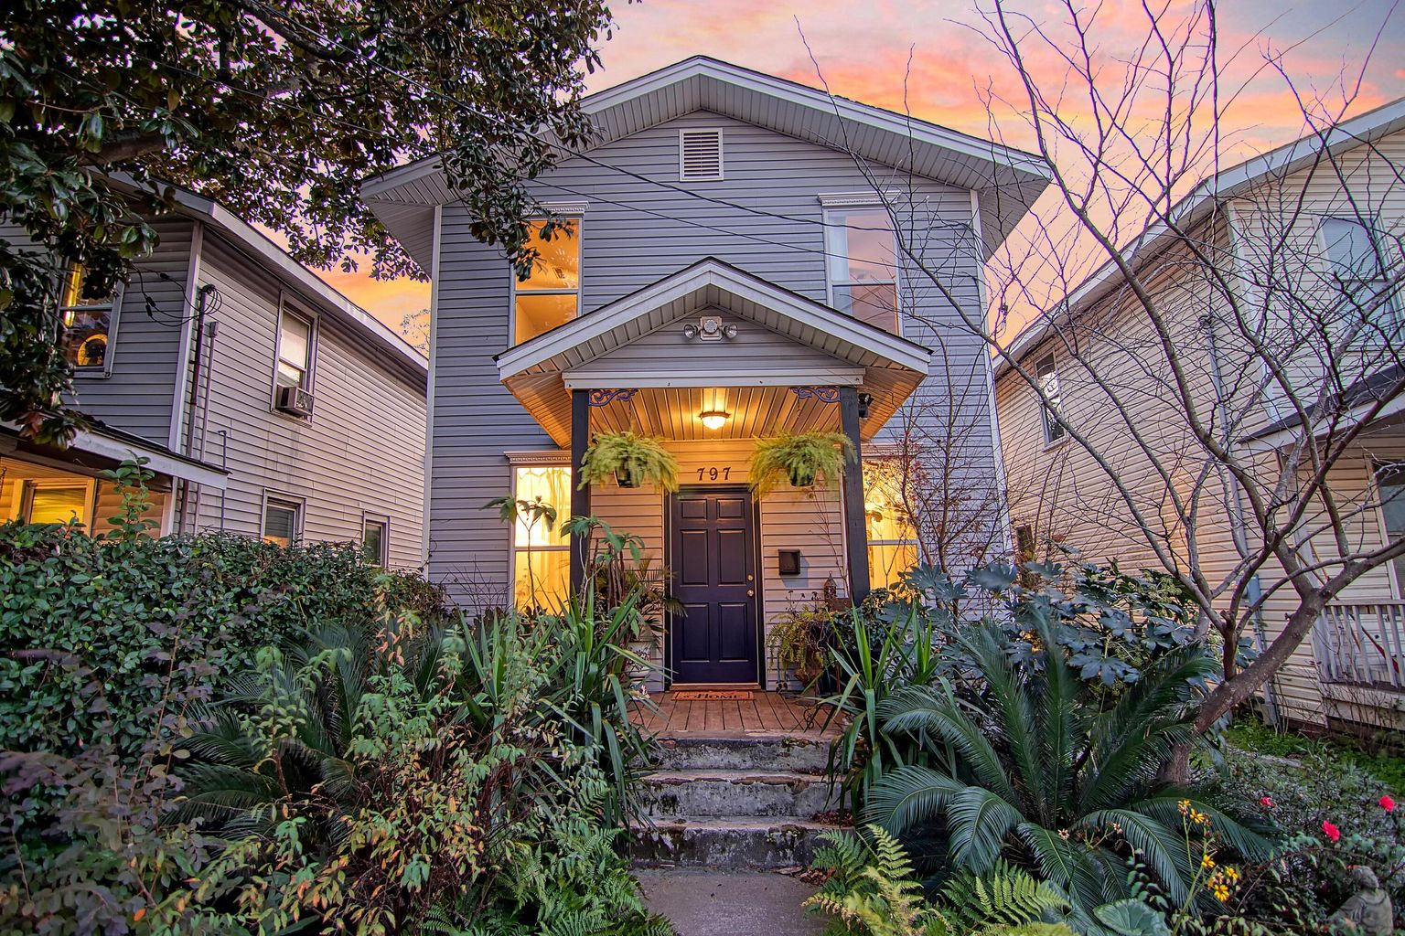

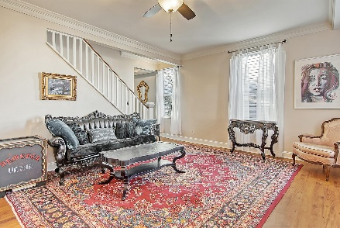
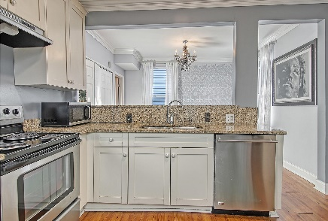
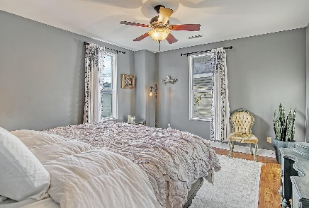
Price Adjustment
OPEN HOUSE
SATURDAY 12-3
Open House Saturday 12-3
797 Meeting Street
North Central ~ Charleston, SC 29403 ~ MLS# 22000205 ~ $499,000
Located in historic downtown Charleston, this charming home is move-in ready and puts you at the center of it all! Talk about a great location...here you are close to many dining options including Butcher and Bee and Edmund's Oast (two blocks), Home Team BBQ and Lewis BBQ (0.3 miles), and Revelry Brewing (0.5 miles).
Beautiful landscaping and a welcoming front porch greet you as you enter to find gorgeous hardwood floors, crown molding, a spacious living room and renovated kitchen with stainless steel appliances, granite counters, white cabinets, and a breakfast bar. The dining area off of the kitchen is the perfect spot for your meals and has access to the half bath. Upstairs are three bedrooms that share a stunning, fully renovated full bathroom that has a step-in tile shower. The screened-in back porch looks out to the backyard and garden area. Don’t miss out!
Book your showing today!
Book your showing today!
Katie Wishneff kwishneff@mattoneillteam.com 843-870-8784

