Slide 1
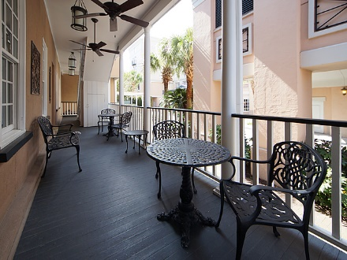
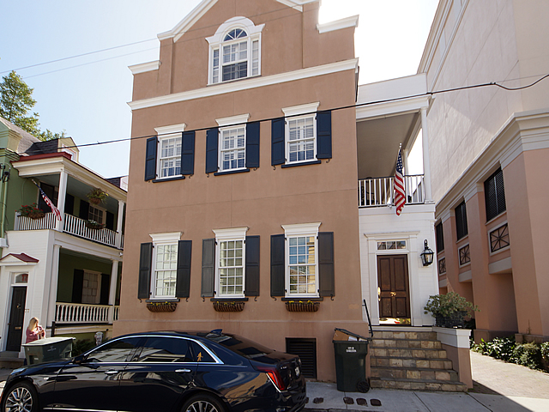
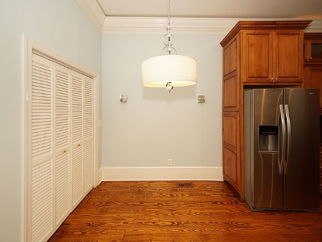
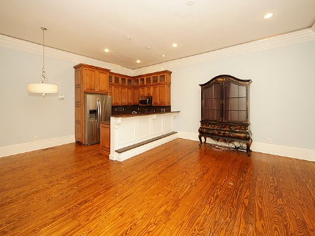
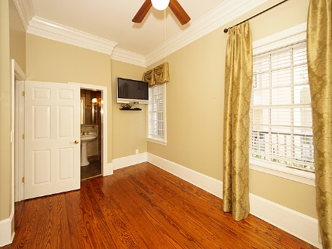
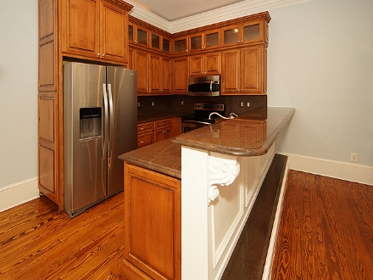
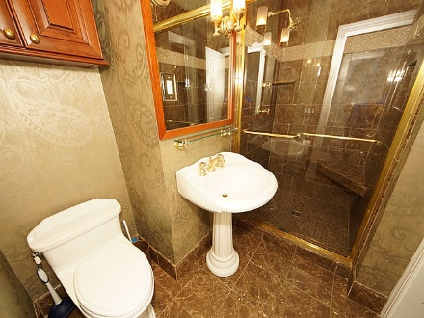
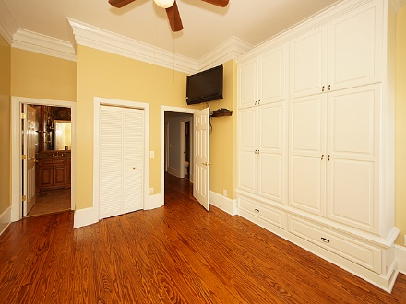
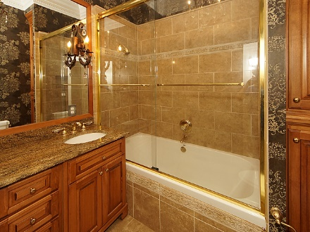
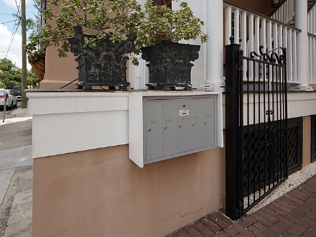
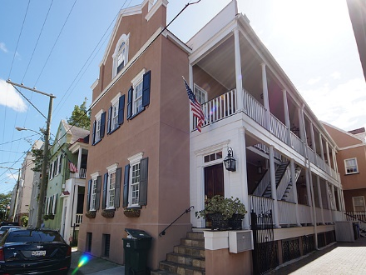

Open House November 7th ~ 11:00a-1:00p Light Hors D'oeuvres By Private Chef Vince Dodson Of Love Bites. $2,000 Closing Bonus If Closed By December 15, 2017 Drawing For $100 Starbucks Card
79 Society Street A
Charleston, SC 29401
MLS# 17019744
$690,000
Immaculate 2 bedroom 2 bath unit in the heart of downtown Charleston. Walking distance to King St. where you can enjoy the famed shopping, dining and all the historical qualities of downtown Charleston. This charming, elegant and upscale unit features granite countertops, custom cabinetry, crown molding, indirect up-lighting, sound insulating double plastered ceilings in both bedrooms and so much more. Enjoy simplified living with this deferred maintenance high quality home. A must see! This unit includes one off street stacked parking space.
Kim Adinolfi
843-452-9923
kim.adinolfi@yahoo.com
Armada Realty Group | 7301 Rivers Ave. Ste 182 | N Charleston, SC 29406

