Slide 1
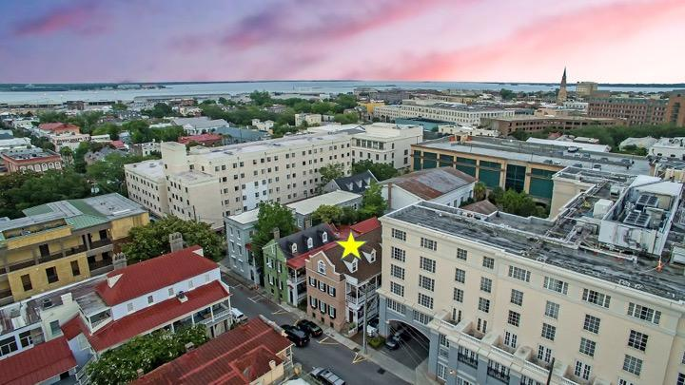


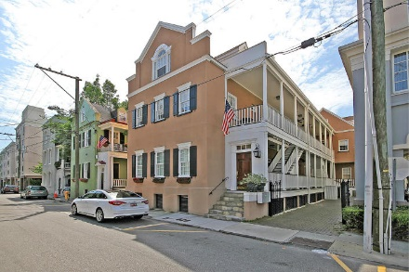
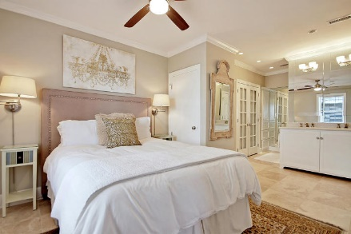
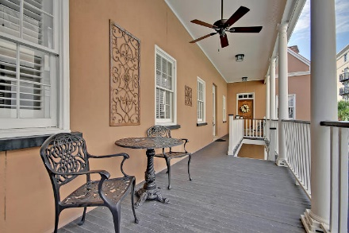
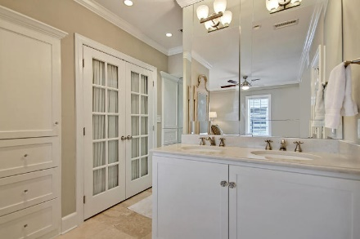
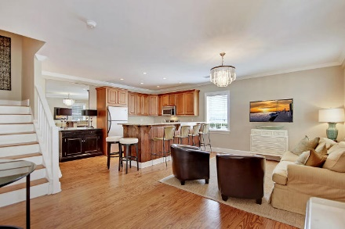
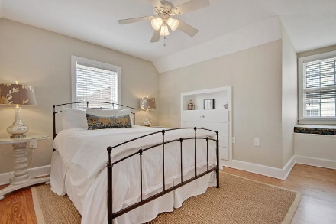
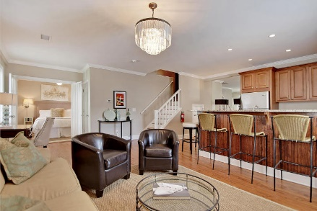
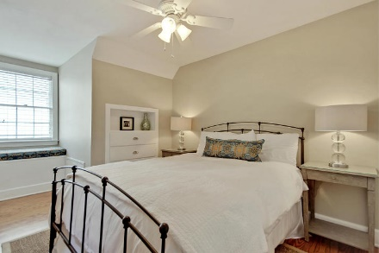
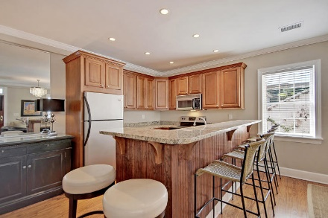
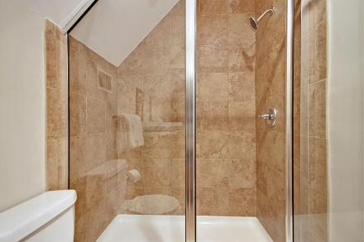
Parkshore Marshfront
Incredible Downtown Location!
79 Society Street D
Downtown ~ Charleston, SC 29401 ~ MLS# 18017267 ~ $669,000
Luxurious, fully furnished, maintenance-free living in downtown Charleston is where its at with this amazing second and third level unit.
This renovated historic Charleston single with the classic side porches is set to impress with gorgeous hardwood floors, a granite kitchen with a breakfast bar and an en-suite bath with a walk-in shower in the owner's retreat. There's great use of the space with plenty of built-in storage.
Two bedrooms each with a built-in seat by the window, a full bath with a walk-in shower and a laundry area complete the upper level.
You are literally just steps from delicious dining and amazing shopping on King Street. The relaxing Marion Square, city market and waterfront park at all are within walking distance. This unit shows like a model. Incredible Location!
Home comes fully furnished including both TVs!
Christopher Smith christopher@mattoneillteam.com 843-267-0735

