Slide 1
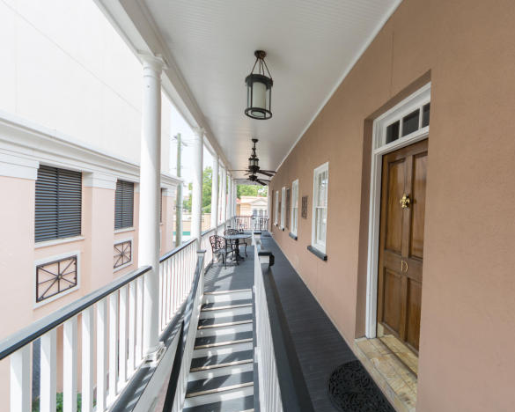
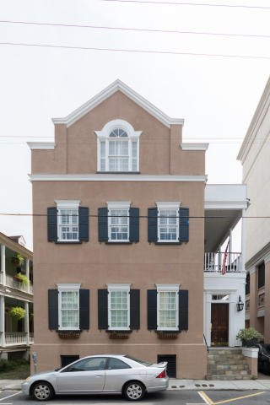
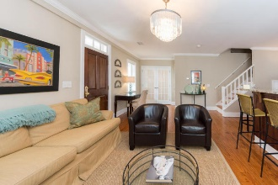
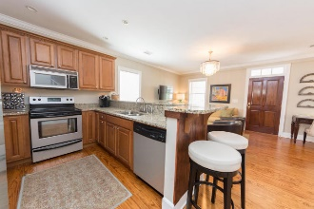
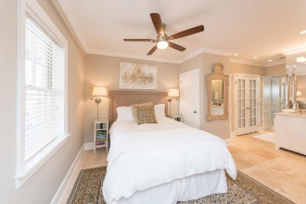
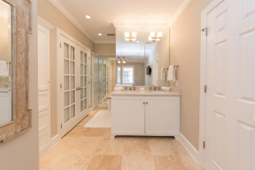
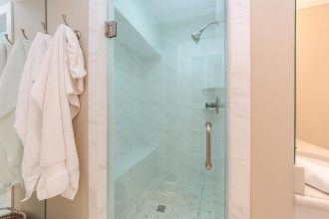
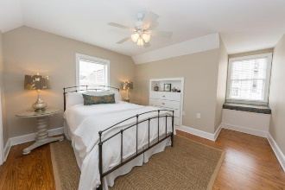
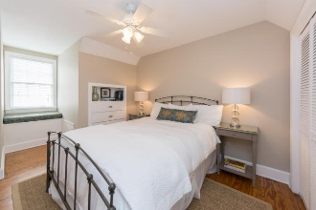
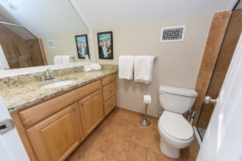
Just Listed on Daniel Island
Price Reduced $15,000!
Bring All Offers!!
79 Society Street D Charleston, SC 29401
MLS# 17025265 ~ $695,000
Welcome to the King Street Historic District of downtown Charleston. This beautiful condo is steps from the action on King Street without the noise. Built in 1990 and remodeled in 2015, this condo has the location and charm of old Charleston with the modern conveniences of new construction. It features a beautiful living space open to the kitchen with stainless appliances, granite counters, gorgeous master bedroom suite with new AC and water heater. This is a 3 bedroom 2 bath condo located within walking distance of everything that defines Charleston.
Mary Shannon Swanson
(843) 296-6565 | maryshannon@sellyourwayrealestate.com
Sell Your Way | 1170 Folly Rd | Charleston, SC 29412
http://sellyourwayrealestate.com

