Slide 1
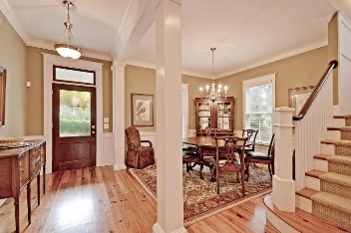
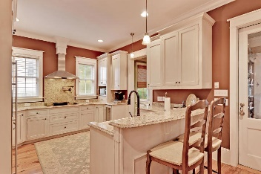
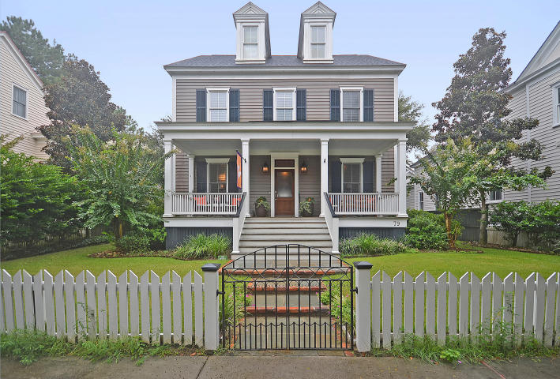
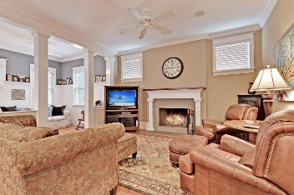
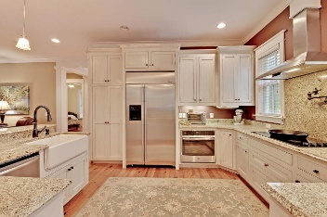
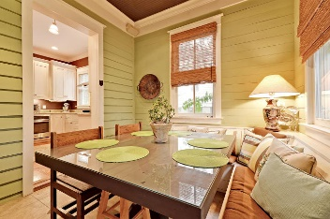
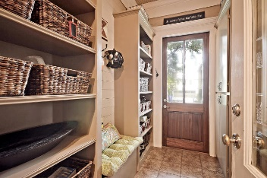
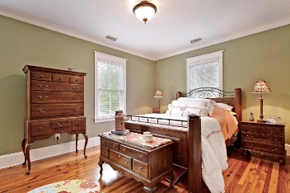
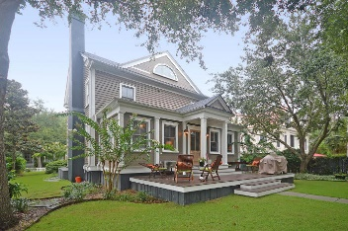
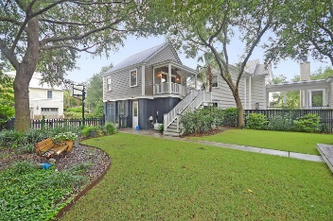
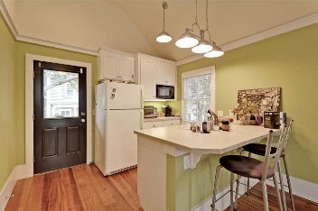
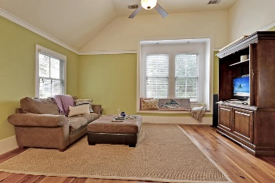

79 Secession Street Ion · Mount Pleasant, SC 29464 · MLS# 16004007 · $1,195,000
Price reduced $60K ~ Seller Motivated
Price reduced $60K ~ Seller Motivated
Gorgeous 4 bedroom, 4.5 bath custom built home with a carriage house in desirable Ion! Features: gourmet kitchen, separate living and dining room, open floor plan, handsome heart pine floors, custom kitchen cabinets, granite counter tops, high end appliances, farm sink, an abundance of natural light, heavy crown molding, and many high-end extras. The owners have added a cozy breakfast nook off the kitchen and a wonderful mud room at the rear entrance with lots of storage. Upstairs has the master bedroom, walk-in closet, spa-like bath with separate shower, garden tub, dual sinks and 2 additional large bedrooms and a full bath. The third floor offers a large flex room-media/office/playroom/bedroom and full bath. This perfect home is located on a quiet street near a play park and Westlake.
In addition, there is a wonderful deck overlooking fenced in back yard. One of the best carriage houses in I'ON (400 square feet included in footage above) with mother in law suite includes kitchenette, den, bedroom and full bath over the two car garage. Ask your agent about the rental possibility of the carriage house. Ion in Mount Pleasant, SC is a wonderfully landscaped community with its own shops and restaurants, amphitheater, boat ramp, dock, play park, walking trials, green space, community pool and a clubhouse! The neighborhood is close to local shopping and grocery stores and is a short drive to downtown Charleston with 5-star restaurants, world class shopping and iconic history as well as a short drive to the beaches, the airport, Boeing and Daniel Island. Come take a look because you will not find another home and community that offers as much.
Stan Huff
843-670-2835 stan.huff@agentowned.com
Jill Marcacci
843-297-5590 jill@agentowned.com
www.agentownedrealty.com
AgentOwned Realty Co. Preferred Group, Inc. | 824 Johnnie Dodds Blvd | Mt Pleasant, SC 29464

