Slide 1
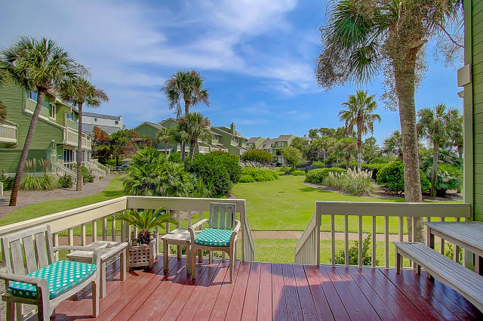
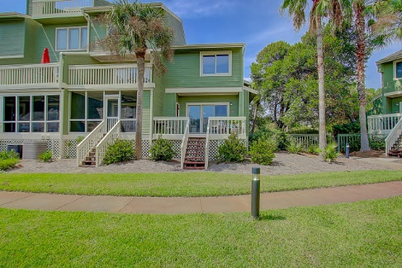
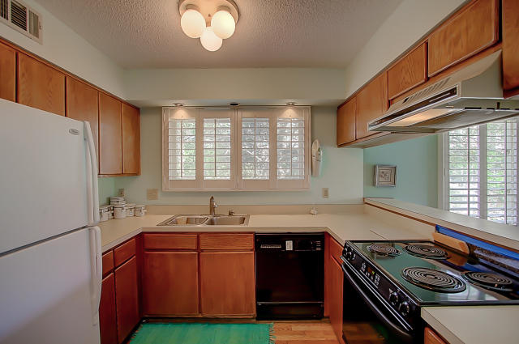
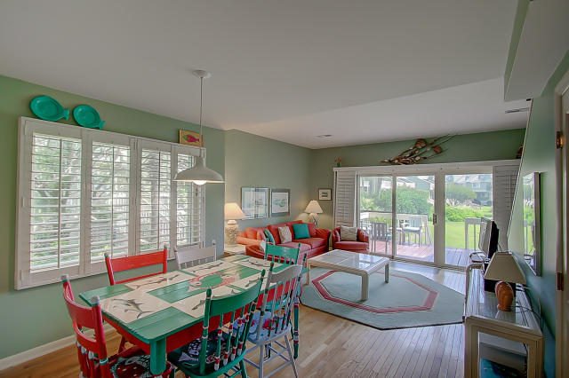
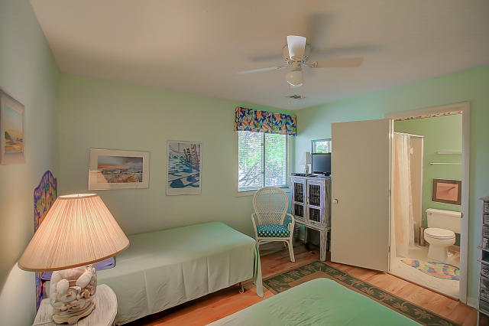
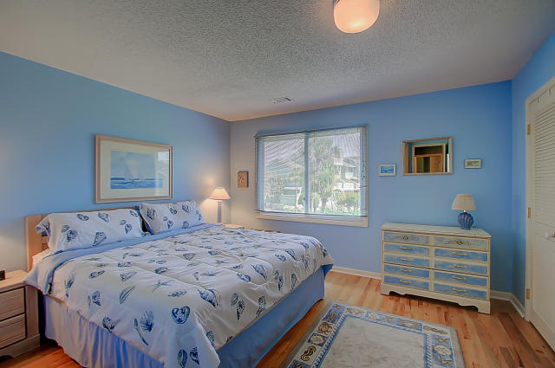
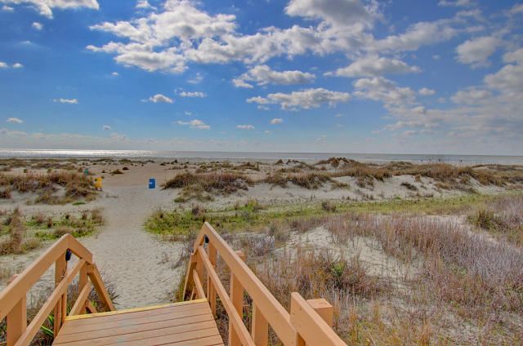


7A Mariners Walk Wild Dunes ~ Isle of Palms MLS# 17007674 ~ $429,000
Mariners Walk, Priced to Sell, End Unit, Great Rental Potential
Great Location in an Oceanfront Mariners Walk community. This end 2bd/2ba unit sells fully furnished with tons of streaming light throughout with beautiful plantation shutters and wood floors.
The deck space off the open living area offers fabulous views--all just steps to the beach and pool. Excellent rental potential, a great 2nd home or primary residence. Currently the lowest priced in Mariners Walk Oceanfront community.
Darlene Smith Office - (843) 886-8110
Mobile - (843) 696-7824
darlenesmith@carolinaone.com
DarleneSmithTeam.com
Carolina One Real Estate
1503 Palm Blvd Ste
Isle of Palms, SC 29451

