Slide 1
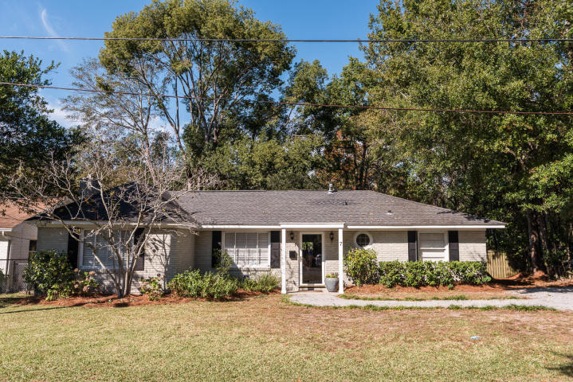
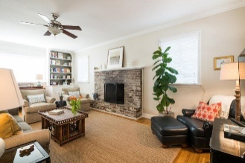
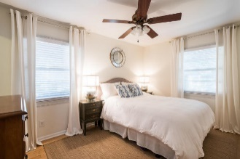
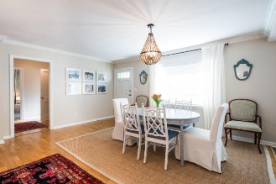
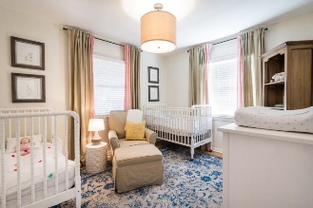
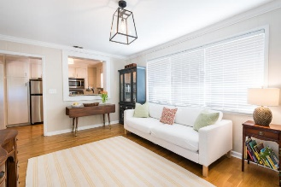
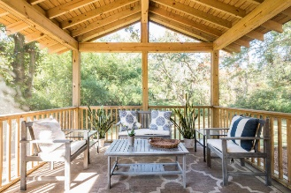
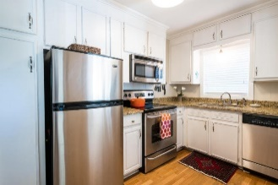
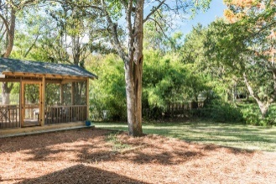


7 Arcadian Park
Avondale ~ Charleston, SC 29407
MLS# 17030834 ~ $385,000
Just Reduced
$785,000!
Open House
Sunday 2-4 PM
Must See! Great location!
Among the many attractive features of this home is its convenient location! Just minutes from downtown Charleston, hospitals and the airport and within walking distance of restaurants and shopping in the most popular Avondale area. The spacious living & dining rooms are filled with natural light and provide a great first impression upon entering the home!
The kitchen has granite counter tops, stainless appliances, white cabinets and a pass-through opening in wall to den which expands the view to the large den and beautiful new screened porch beyond. This charming home is great for entertaining, indoors or out. Not only is there a screened porch but also a patio, perfect for grilling or eating outdoors.
Mac Jenkinson
M (843) 224-0210
mac@carolinaone.com
Beth Moore
M (843) 532-4892
bmoore@carolinaone.com
www.jenkinsonandmoore.com
Jenkinson & Moore, LLC | Carolina One Real Estate | 1503 Palm Blvd | Isle of Palms, SC 29451-2280

