Slide 1
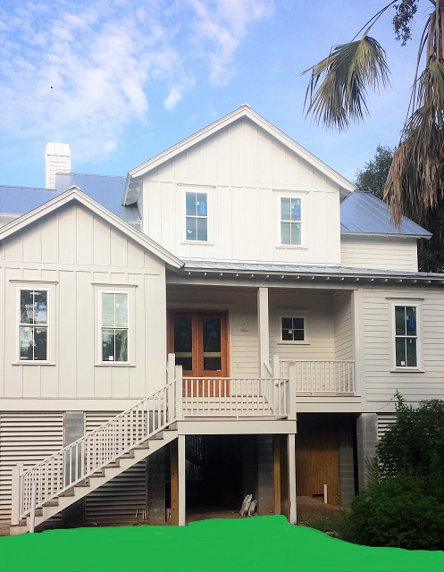
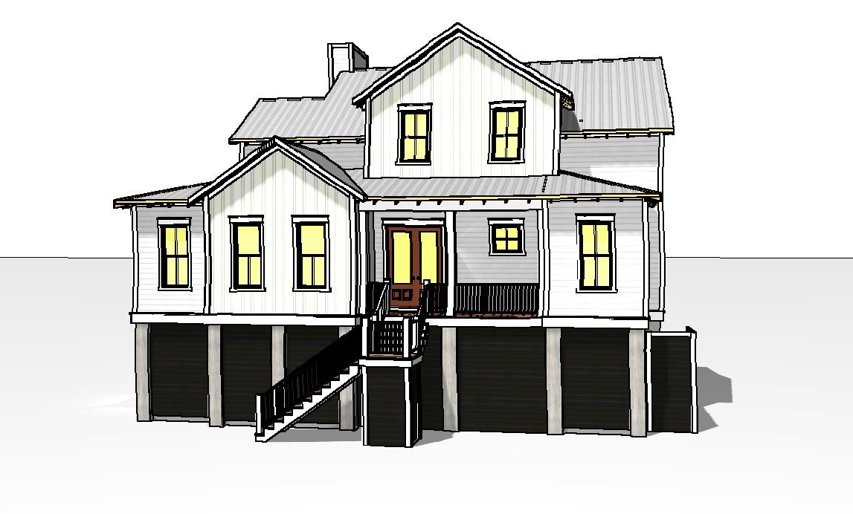
Open Floor Plan, 4 Bedrooms 4.5 baths, First Floor Master, First Floor Den. All High End Finishes. Large Outdoor Entertaining area, Pool with Hot Tub, Fenced in yard, 3 Car Garage. Quiet Street, Easy Access to the Beach and the Marina. Estimated Completion November 2016. Call for more Details. 7 Live Oak Dr ~ $1,499,000
~ Pocket Listing ~ New Construction Isle of Palms!
Neil Schneider
843-200-8902 | neil@charleston.info

