Slide 1

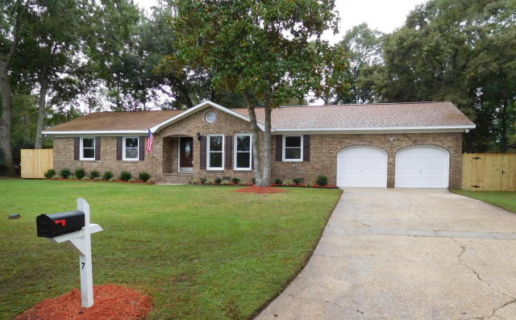
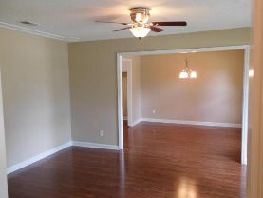
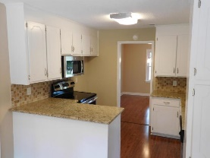
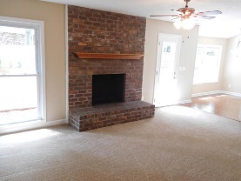
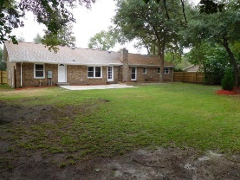
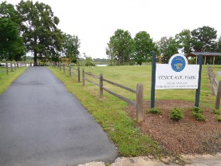
Don C Mason
(843) 364-9090
nibsc@aol.com
Gorgeous brick home on a quiet cul-de-sac
7 Venice Avenue
Otranto | Hanahan, SC 29410 | MLS# 15024083 | $249,900
WOW!!
Like new, Fresh & clean move in ready. New paint inside & out. New 30 yr. arcitectural shingled roof. New vinyl double hung windows. New A/C New heat pump and all duct work. New Insulation. New 12mm Harwood laminate floors in living , dining, kitchen and hallway. All new carpet & padding in bedrooms. All new 6 panel doors through out and all hardware. All new light fixtures & ceiling fans are new. All new faucets, toilets, mirrors. New modern tiled showers in bathrooms. All new stainless appliances in kitchen. New granite counter tops & tiled back splash. Freshly poured huge 20x15 patio. New privacy fence with double gate. Professional landscaped yard. This is a gorgeous 4 bed 3 bath all brick on a quiet cul-de-sac. On this street is a nice family park on the Goose Creek reservoir.
Real Estate Advocates
Palm Beach Gardens, FL 33418
www.realestateadvocates.com

