Slide 1

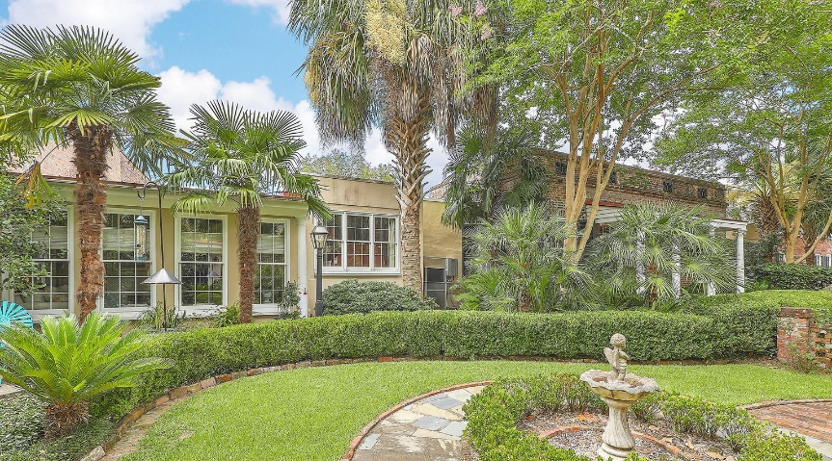
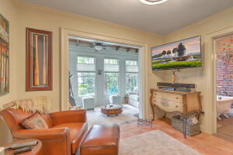
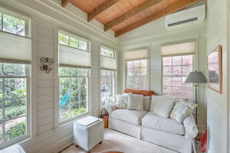
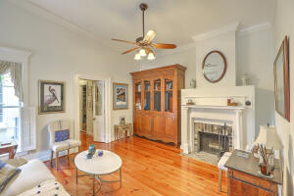
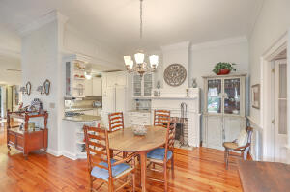
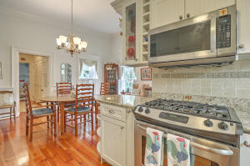
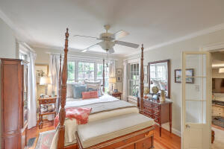
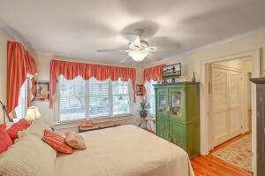
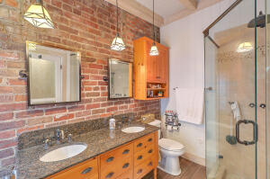
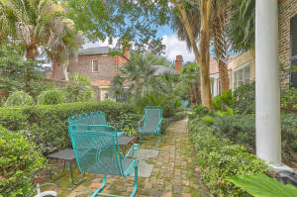
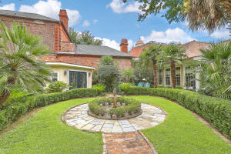

Stunning and Unique Downtown
7 Pitt Street 2
Charleston, SC 29401
MLS# 22019171
$1,600,000
2 Bed | 2 Bath | 1,683 SF
Occasionally you find a true hidden gem downtown. 7 Pitt Street Unit 2 is exactly that! Fantastic location in the heart of Charleston; mostly one-level living; HEAPS of private outdoor/garden space; and no HOA/Regime fee! One of three units in the 7 Pitt Street Horizontal Property Regime, this particular unit was originally built by Acadian Basile Lanneau in 1840 to serve as the neighborhood school house. Today, this unit takes full advantage of the entire rear portion of the property, and offers tremendously quiet and private living away from nearby streets. The current owners have lovingly modernized it over the last two decades while keeping much of the historic charm. A remote controlled gate welcomes you to the 7 Pitt Street HPR, and two designated parking spots are situated directly in front of the unit and it's very own garden! The sprawling home is mostly one-level, and you are welcomed in to the large central part of the building. Its open living room and dining room each have wood-burning fireplaces, and a very functional kitchen is located on one side, open to the dining area. High ceilings and large windows make for a very bright and spacious living space. Do you have guests or family staying over? The guest wing off one side of the building provides them their own comfortable bedroom, a loads of closet space, and a private full bath. The Main Bedroom has it's own wing off the opposite side of the building, and features a walk-in closet, washer/dryer/utility closet, a spacious bedroom, and a large bathroom complete with dual vanity, shower and separate small tub next to the windows overlooking the garden. The Main Bedroom wing even has a private Den and Sitting Room/Sunroom overlooking the garden, complete with it's own mini-split HVAC unit!
The HUGE garden is perfect for those with a green thumb or anyone who just loves being outdoors. It has been beautifully crafted by the current owners with lots of thoughtful details including several gathering spaces, a grassy area, and even a shed for yard equipment.
*Please note - some items shown in photos Do Not Convey. Please inquire with your agent or listing agent for details*
Video Tour: http://vimeo.com/728447373

