Slide 1
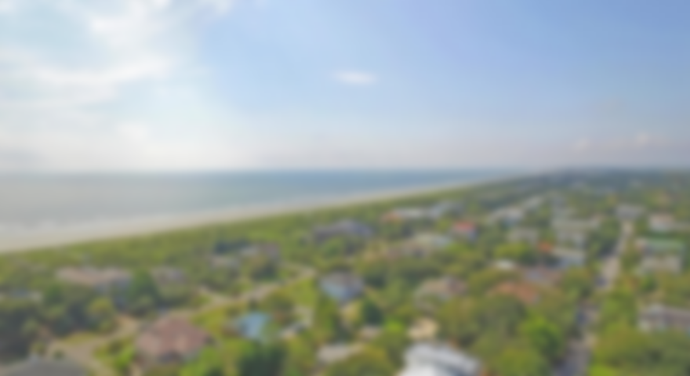
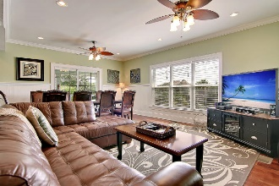
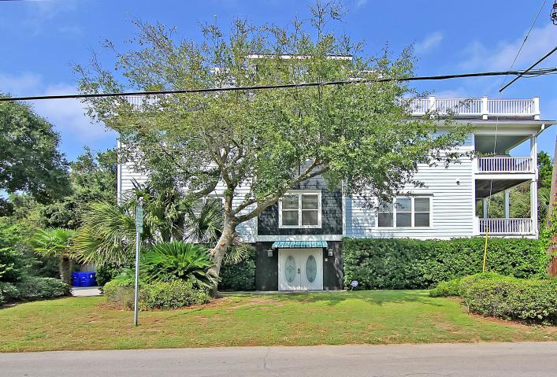
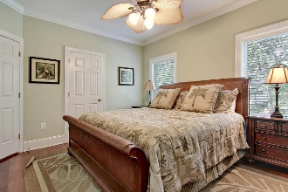
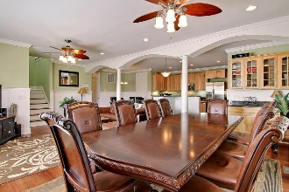
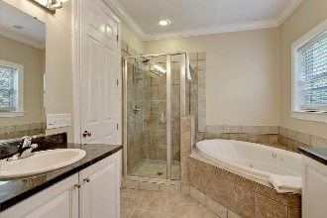
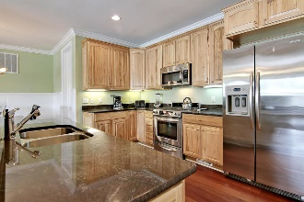
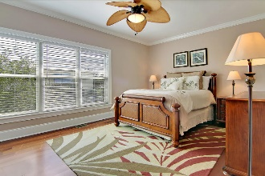
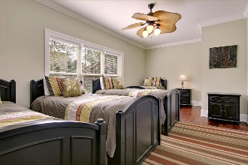
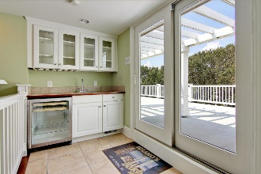
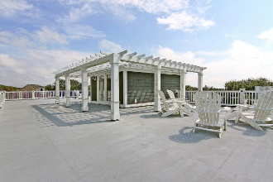
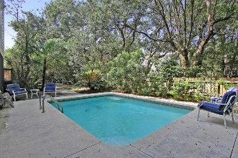
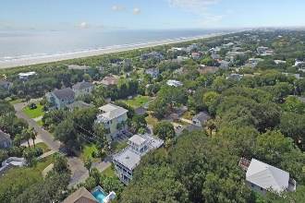
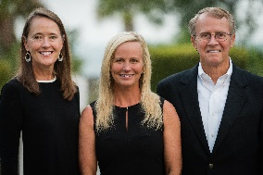

7 33rd Avenue Isle of Palms, SC 29451 ~ MLS# 18027512 ~ $1,145,000
Major Price Reduction! Strong Rental Income!
Welcome to the beach house that has it all! Whether you are looking for a second home, an investment with rental income or a permanent residence on the beautiful Isle of Palms, this home can't be beat! Just steps away from the beautiful beaches and Atlantic Ocean, this beach retreat offers more than ample space to entertain your entire family. Six bedrooms and six full bathrooms are complimented by the gourmet kitchen with island and breakfast nook, multiple living spaces, a formal dining area and a HUGE 800+ soft rooftop sundeck. Just off the sundeck is a wet bar with beverage refrigerator, perfect for entertaining friends while enjoying the ocean views and watching the sun dip below the horizon. The outdoor enjoyment gets even better back down on the ground level.
You'll cool off in the sparkling in-ground pool or challenge your family to a friendly game on your private putting green. The elevated style of home offers an abundance of space underneath to park your cars as well as store your beach toys and essentials. An elevator makes accessing all floors a breeze!
Asking $1,200,000
MLS# 17023051
3,692 SqFt
4 Bed/3½ Baths
Short Drive to Historic Downtown Charleston & Beaches
Don Dawson 843-514-0452 ddawson@carolinaone.com Carolina One Real Estate • 2713 Highway 17 North • Mount Pleasant, SC 29466
www.TeamDawsonSC.com

