Slide 1
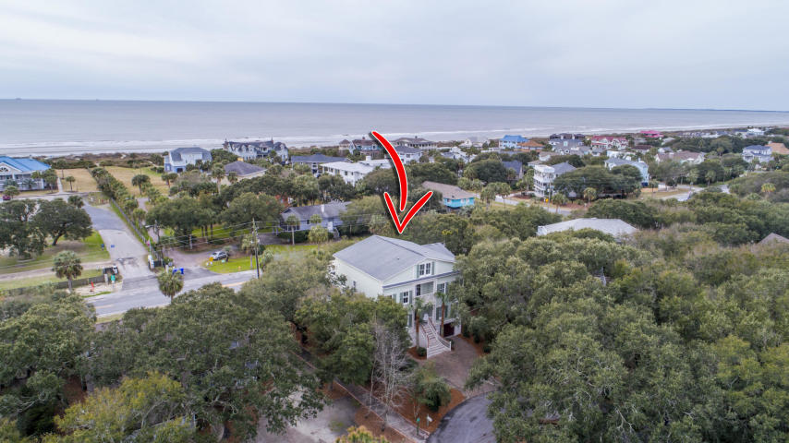
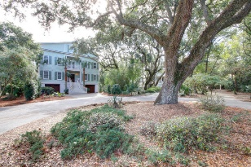
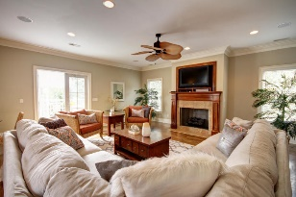
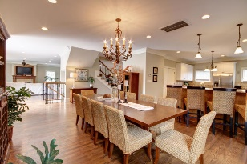
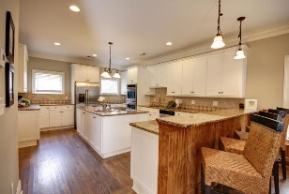
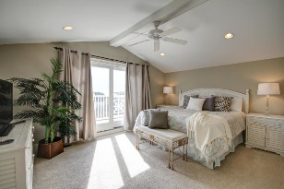
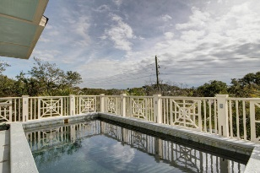
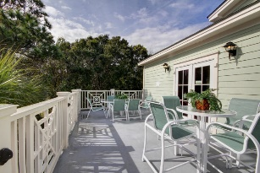
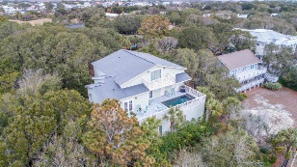
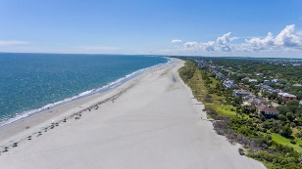


7 Abalone Alley Wild Dunes :: Isle of Palms, SC 29451 MLS# 19003340 :: $1,750,000
Vacation or Investment Opportunity
First Time On The Market!
Custom-built home in cul-de-sac in Wild Dunes with ocean views and a short walk to the beach. Inverted floor plan features a very spacious living area with large kitchen, dining room, living room, and a wet bar area with recreation space including pool table.
The pool is on this level with large deck with plenty of seating and sunning area. Master Suite encompasses the entire third floor and is accessible by elevator. All of the 6 first floor guest rooms are spacious and have a full bath.
This is a fine home for anyone interested in resort living close to the beach. Furnishings convey with exception of some wall art and accessories.
Clay Cunningham
O (843) 886-8110
M (843) 345-4647
clay@carolinaone.com
www.claysre.com
Carolina One Real Estate
1503 Palm Blvd Ste
Isle of Palms, SC 29451

