Slide 1
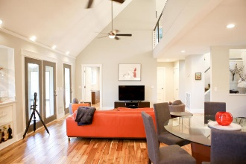
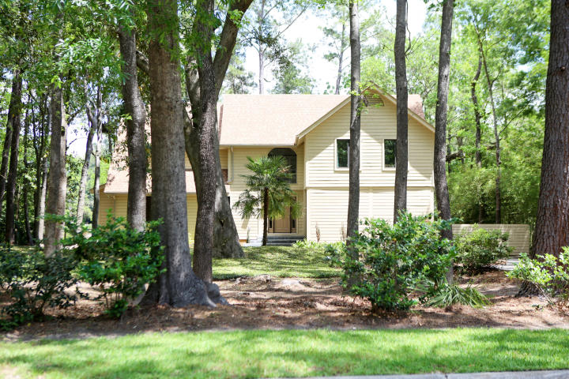
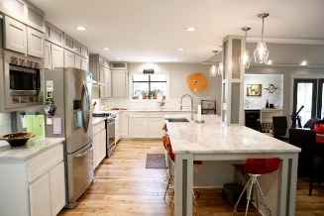
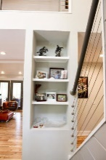
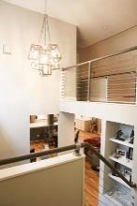
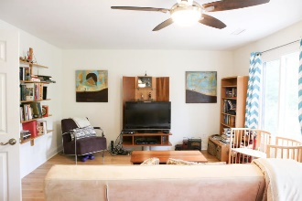
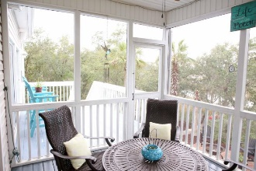
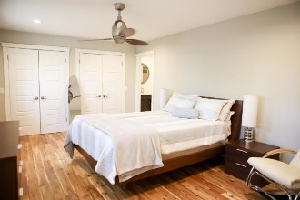
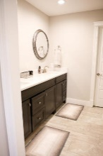
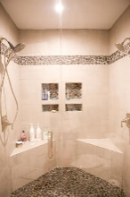
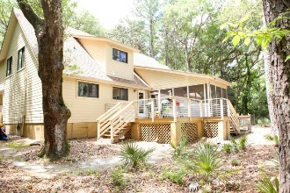
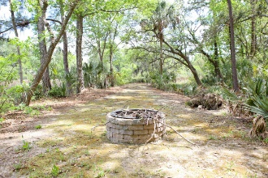


Marshfront Listing! $20k Reduction!
7 Arabian Drive
Marsh Cove | Charleston, SC 29407
MLS# 19019611 | $549,500
Stunning views and unforgettable sunsets are yours from almost every room in this contemporary home located in the established neighborhood of Marsh Cove! From the moment you arrive, this expertly designed and well-appointed property is perfectly sited to take advantage of this spectacular Lowcountry setting. Talk about privacy...The house sits on ½ acre marsh front lot with mature landscaping. Upon entering this home, you will be greeted by gleaming hardwoods & an open floor plan that flows nicely for entertaining throughout. The immaculate kitchen is a dream, thoughtfully designed so the chef can enjoy guests as well as views of the marsh while cooking! Anchored by newer appliances, marbled quartz, beautiful cabinetry, breakfast bar, and custom backsplash, it doesn't get more inviting than this! Retreat to the spacious master suite conveniently on the main floor that boasts amazing views! Attention to detail wasn't spared here...granite countertops, his and her sinks, custom closet, massive shower makes it the perfect place to unwind. Rounding out the main floor is the large family room, dining area, powder room, breakfast area. Want to take advantage of Charleston's outdoor year round living? How does a screen porch, fire pit, and expansive decking with amazing views of the marsh sound? Three additional oversized bedrooms, bathroom, and laundry are also found on the second floor still allowing you to enjoy the views and marsh wildlife. This is the best priced Marsh front home in West Ashley! Don't forget about tennis court and a sparkling swimming pool. This home is a must see! Schedule a showing today, Your private oasis is awaiting!
Robert Jacoby 843-455-7075
Billy D'Elia (843) 478-3869
billy@charlestonpropertyexperts.com
www.charlestonpropertyexperts.com
Charleston Property Experts
812 A Johnnie Dodds Blvd | Mt Pleasant, SC 29464

