Slide 1
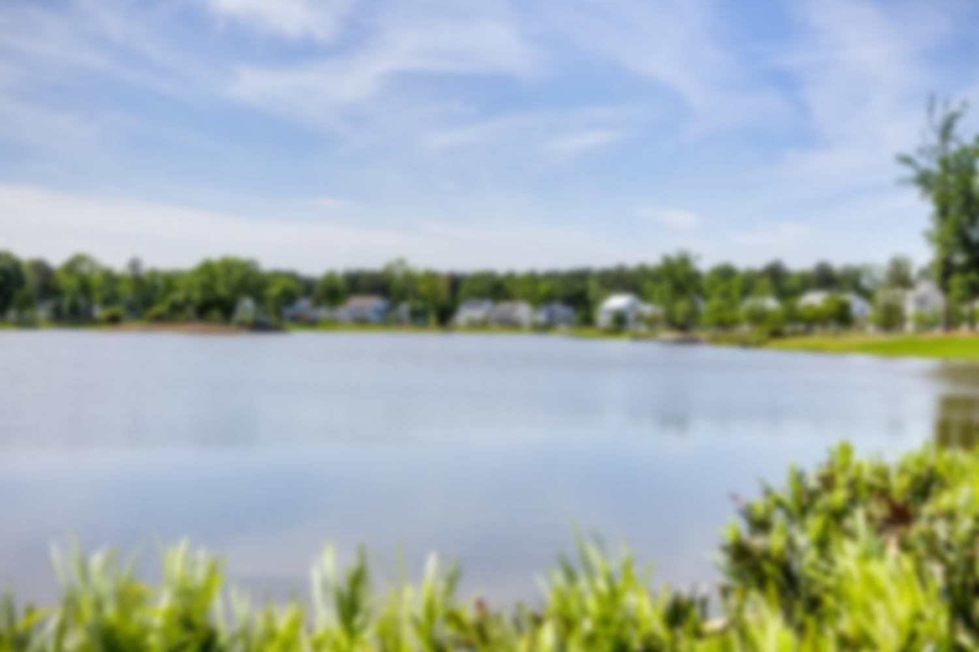
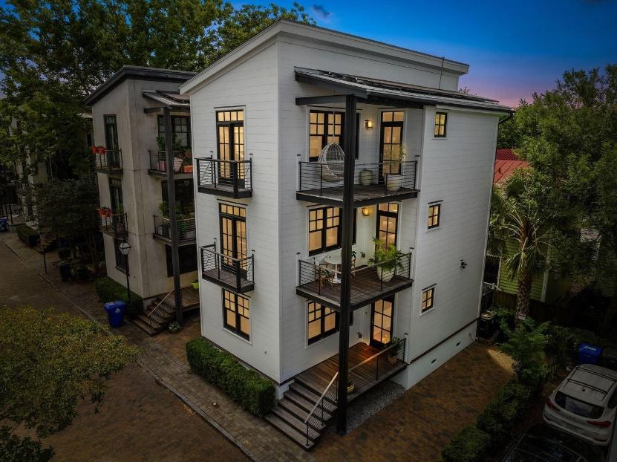
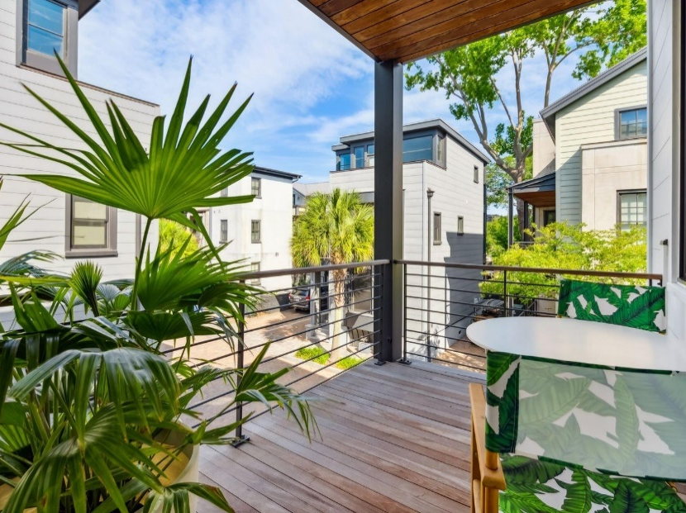
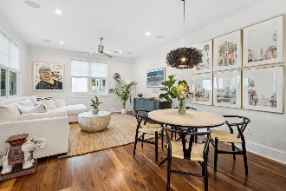
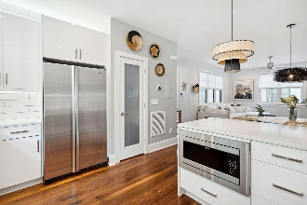
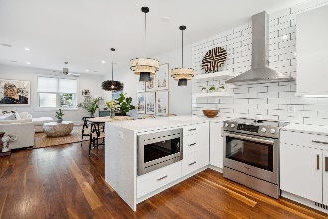
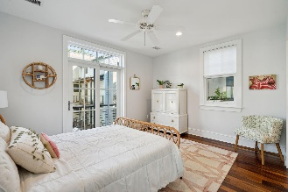
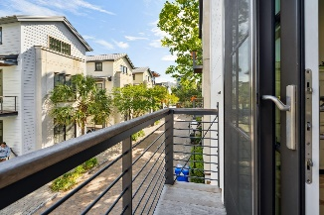
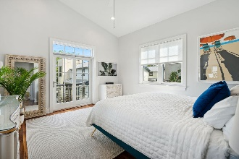
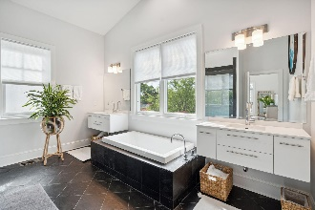
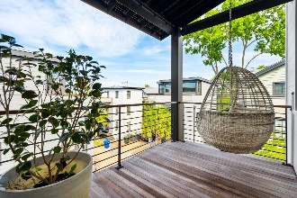
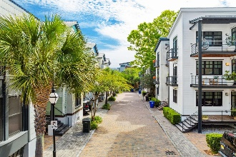
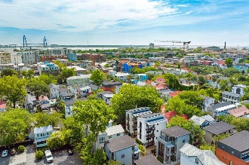


Open House Friday May 26th, 12-3 PM
7 Brewster Court
Midtown | Charleston, SC 29403 | MLS# 23011075 | $1,550,000
Lowcountry city living at it's finest! Welcome to 7 Brewster Court, a sophisticated and luxurious contemporary home, that is located in the heart of the Peninsula. Taken down to the studs in a full renovation in 2021, this home offers a unique opportunity to live in a pristine, one-block private community, Midtown, that is only 2 blocks to Upper King Street's popular shopping and dining. The Midtown community is located in the Cannonborough/Elliotborough neighborhood of historic downtown Charleston. The streets of this neighborhood have great energy and is home to a number of top restaurants, flower shops, bakeries, and other small boutiques.
Walk to some of Charleston's favorites for a coffee and breakfast at Brown's Court Bakery, bites at Babas on Cannon, happy hour at Hotel Bennett, Sunday brunch at Halls Chophouse, or dinner at Chubby Fish and Chez Nous.
You will notice the abundance of natural light as you enter the home as well as the open concept design that is perfect for entertaining. The kitchen offers many custom features to include a sleek quartz countertop, new cabinetry, pantry, and counter-to-ceiling backsplash tiling. Refinished hardwood flooring extends throughout along with high-end finishes.
You will find two generous sized bedrooms with a jack-and-jill bathroom to include custom finishes, and the laundry room. The master suite is located on the third floor that features a large bathroom complete with a walk-in shower and garden tub overlooking the Peninsula's skyline. The shower has a slate finish and a KBRS drainage system. There is also a walk-in closet with a closet system. All three floors have covered porches and the top two floors have balconies that are perfect places to use to enjoy al fresco dining as well as a nice Charleston breeze and sunset. The second and third floors offer a generous landing space that work perfectly for a desk if working from home or a reading nook.
The home features impact-rated siding, doors, and windows, all new LED lighting, and solar panels installed on the roof. Don't miss this rare opportunity, as these homes do not come on the market often!
Virginia Landon 803-493-9202
virginialandon@kw.com
Keller Williams Realty | 496 Bramson Ct Ste 200 | Mt. Pleasant, SC 29464

