Slide 1
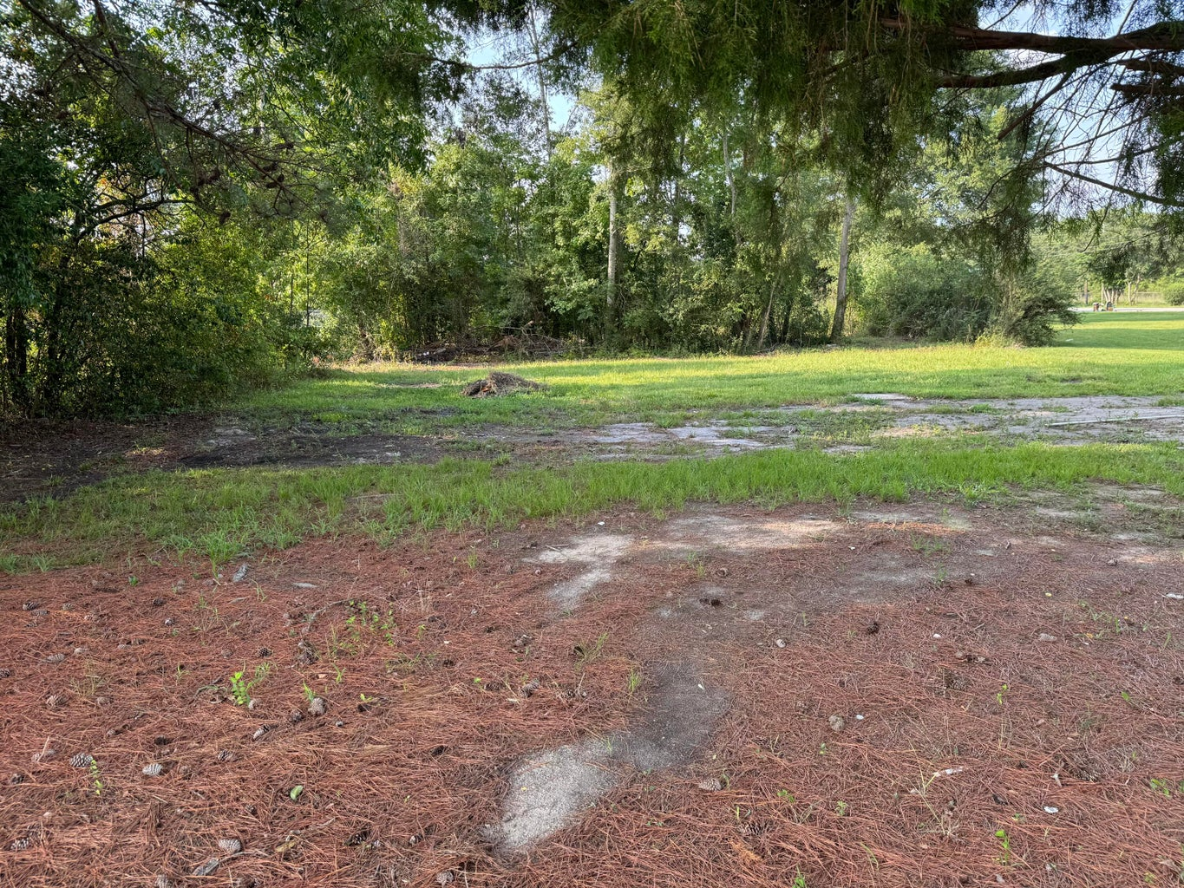
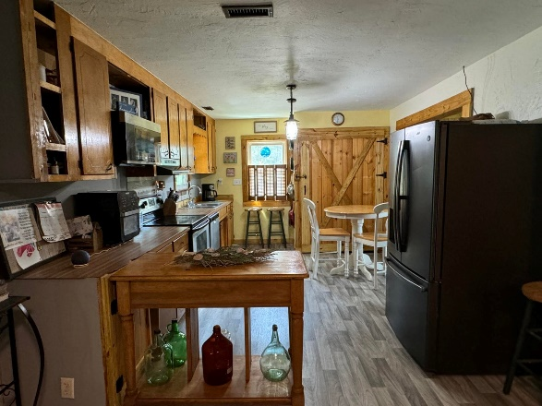
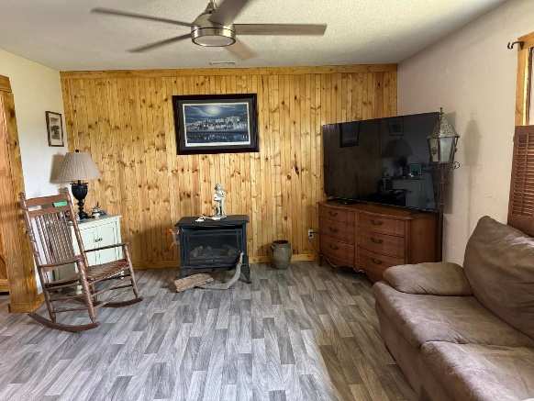
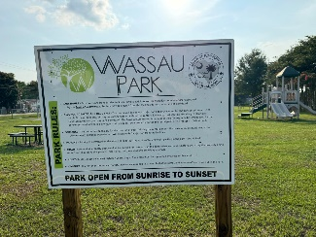
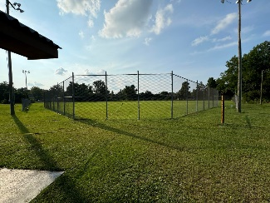
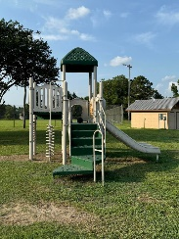
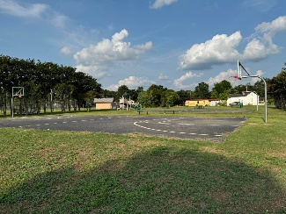
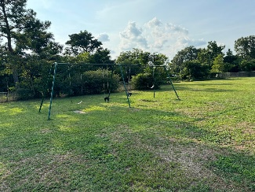


ROOM TO BUILD…AND PLAY!
CHARLESTON SINGLE STYLE HOME
4 BEDS/2.5 BATHS/LOFT
MASTER BEDROOM DOWN
YARD W/PRIVACY FENCE
HARDIPLANK SIDING
HOME ONLY 2 YEARS OLD
QUARTZ COUNTERTOPS
STAINLESS APPLIANCES
REFRIGERATOR INCLUDED
COVERED PORCH
PERFECT JOHNS ISLAND LOCATION
1 MILE FROM SEVERAL RESTAURANTS/SHOPS
BLINDS AND WASHER/DRYER INCLUDED
LESS THAN 10 MILES TO DOWNTOWN CHARLESTON
12 MILES TO KIAWAH OR FOLLY BEACH
7 J Street
Summerton, SC 29148 | MLS# 24019199 | $19,900
THIS VACANT LOT HAS WATER AND ELECTRIC RAN TO THE PROPERTY.
LOT SITS NEXT TO THE BALL FIELD AND WASSAU PARK.
Carla Davis
843-437-4873
gaweber@tds.net
Adler Realty
518 Parrot Point Dr
Charleston, SC 29412
www.adlerrealtychs.com

