Slide 1
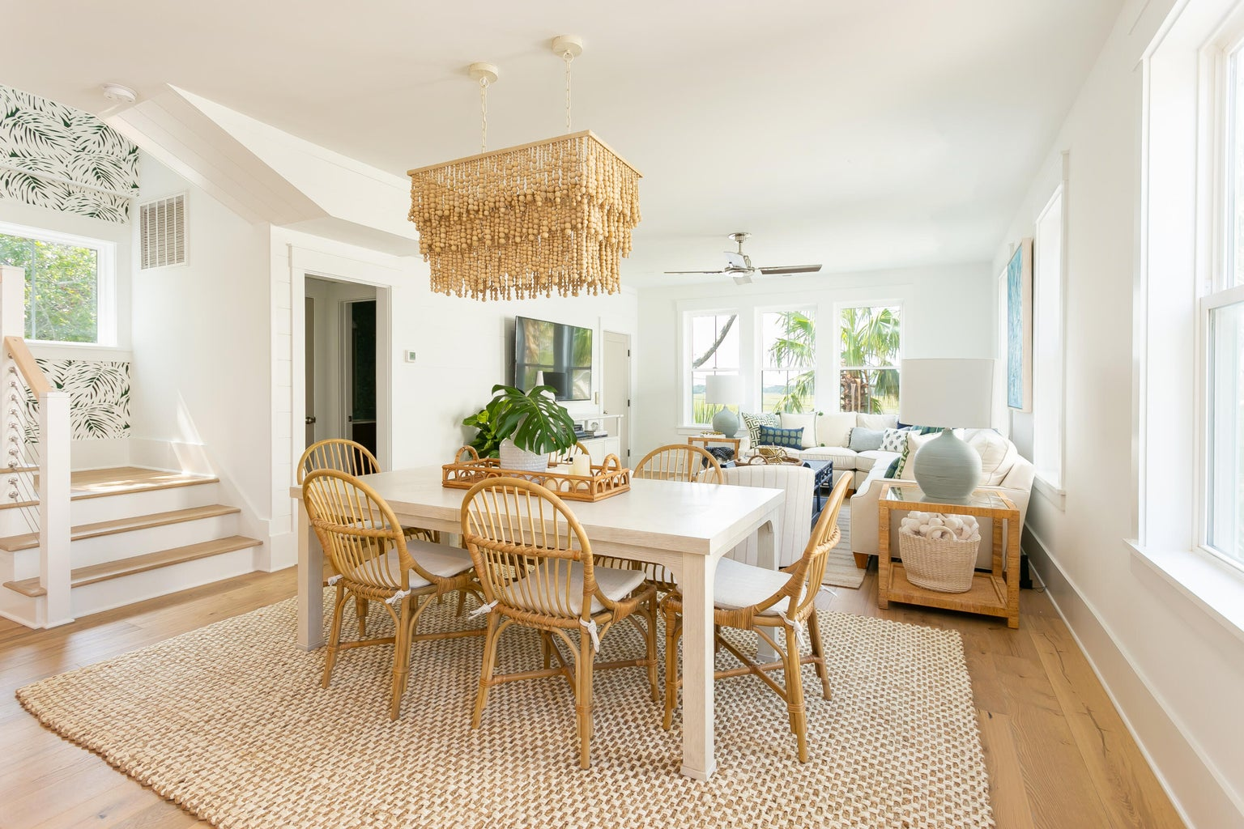
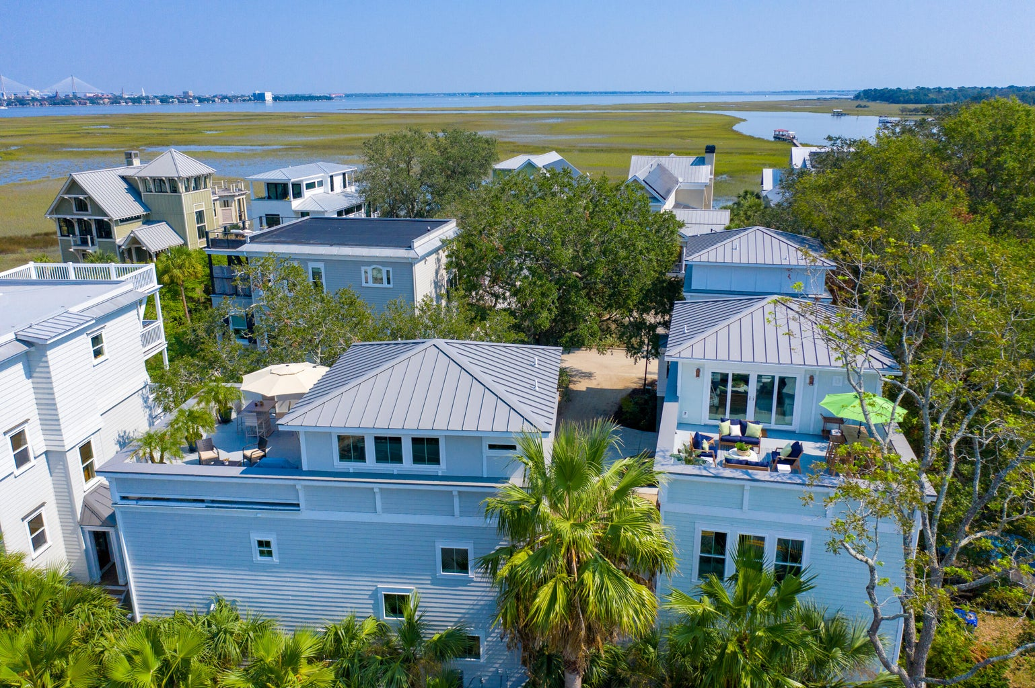

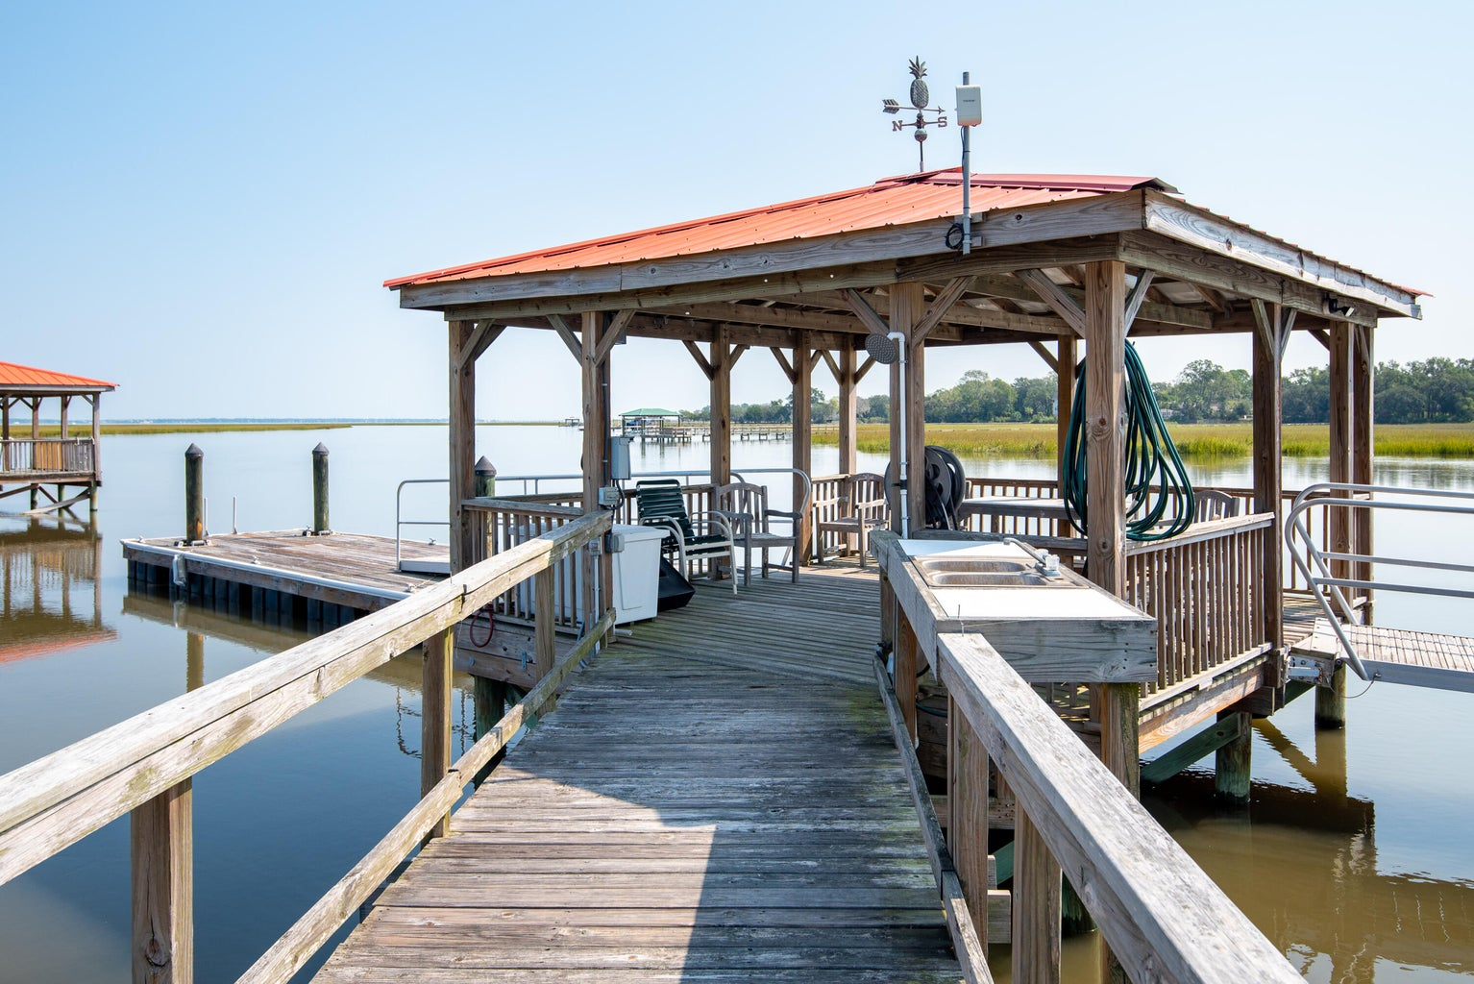
DEEP WATER ACCESS
ROOF TOP TERRACE & AMAZING VIEWS!
7 Old Summer House Road
Point Verona | Charleston, SC 29412
MLS# 24003920 | $1,489,000
Spectacular views, stunning architectural design, and DEEP-water boat access...this home has it ALL!! Located in the exclusive Point Verona neighborhood, this gated community is 5 minutes from the heart of the City, with truly, one of a kind views. This home features a community deep water dock so privacy and southern living are at your fingertips! This 3 bedroom, 3.5 bath luxury custom home features all the modern features you'll need to enjoy the Lowcountry and exudes serenity in every way!
Make your way to the master retreat complete with long marsh views, a custom master bathroom with full tile surround and high-end plumbing and lighting fixtures with a walk-in closet. Finally, escape to the 3rd floor with a full wet bar and vaulted ceiling that opens up onto the expansive roof top deck. From the 3rd floor roof top deck you will enjoy long marsh view of Ellis Creek as well as pristine sunsets. This home has all the features of a luxury home with the exclusivity of the gated community and easy access to downtown Charleston.
Other interior and exterior finishes include Hurricane Impact windows, prefinished floors throughout, cement plank exterior siding, custom paint colors, up-graded lighting options, trim package, Energy efficient natural gas tank-less hot water heater, Low E windows, recessed lighting and much more! This home is a MUST see...schedule your showing today!
Kara Delpino
(843) 860-4166
kara@hbrtwn.com
www.karadelpino.com
Harbourtowne Real Estate
672 Marina Drive, Ste 110
Daniel Island, SC 29492

