Slide 1
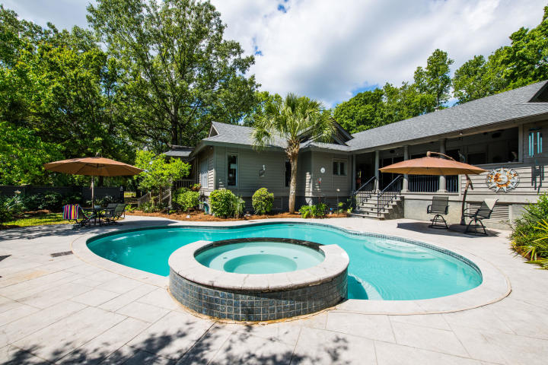
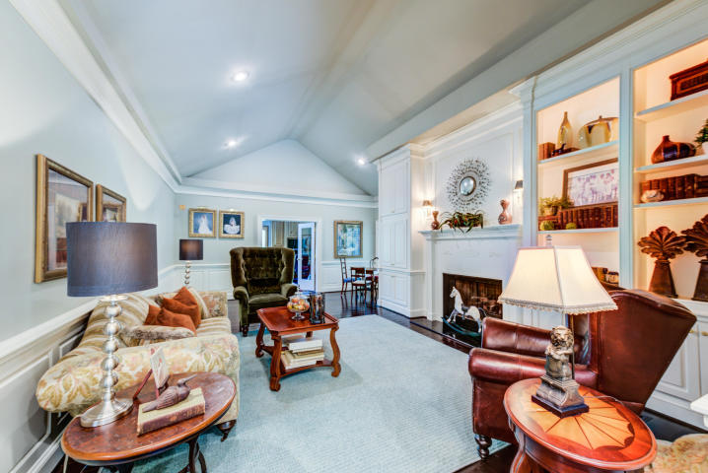
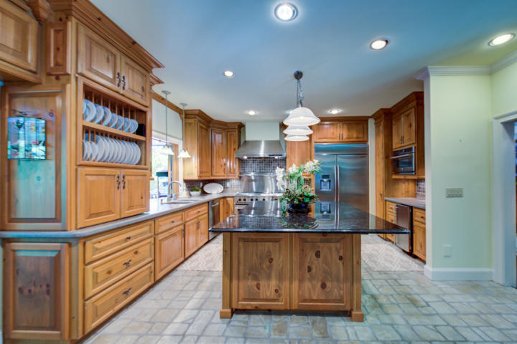
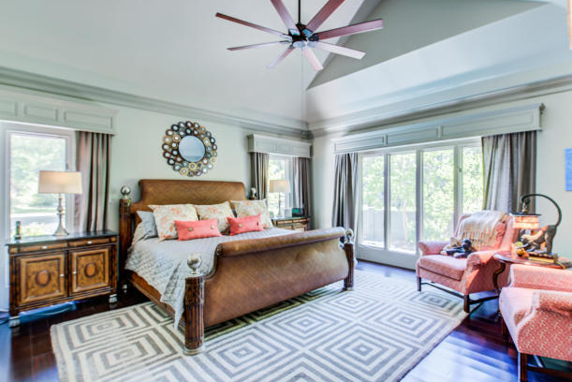
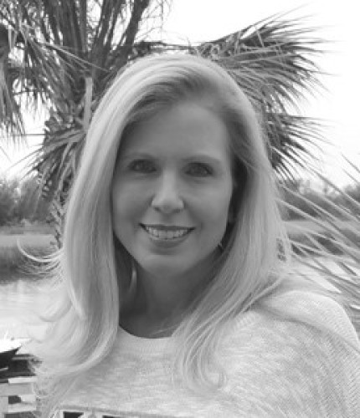

Agent Open House Shadowmoss
Friday, August 14
from 1:00 - 2:30
Light refreshments
and beverages
Attend for a chance to win a $50 Total Wine gift card
7 Trail Hollow Drive
Shadowmoss ~ Charleston, SC 29414
MLS# 20013168 ~ $795,000
Lori Bates
843-224-4597
lori@beresfordrealty.com
www.beresfordrealty.com
Beresford Realty, LLC | 672 Marina Dr Ste 206B | Charleston, SC 29492

