Slide 1
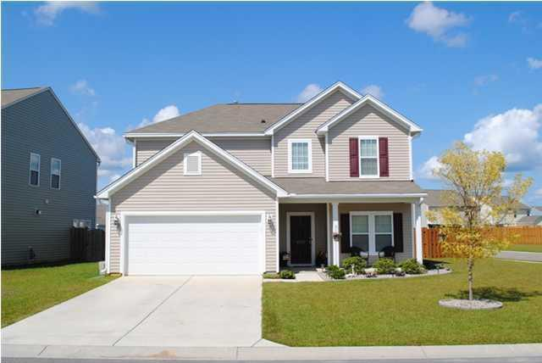
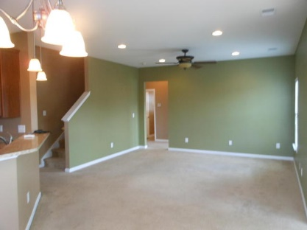
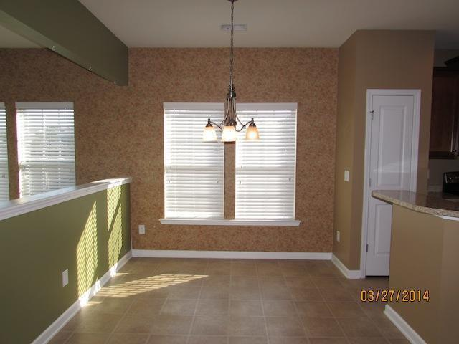
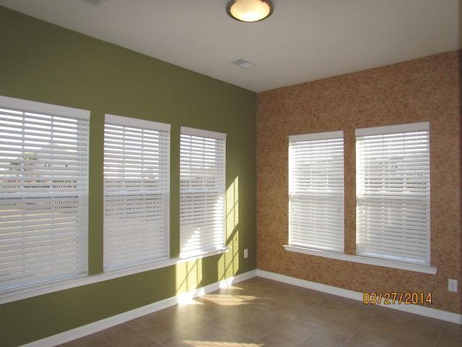
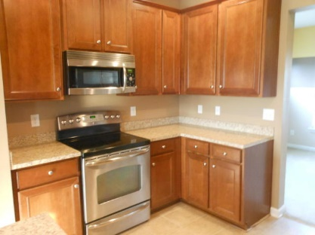
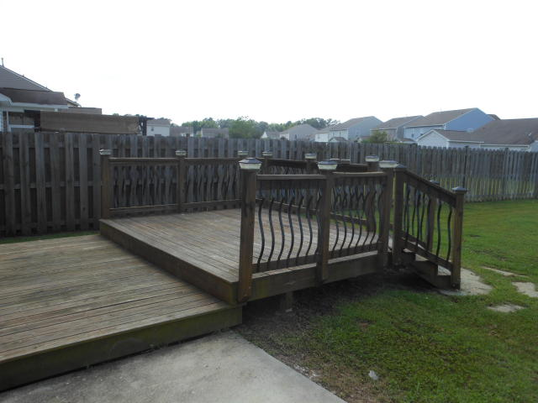
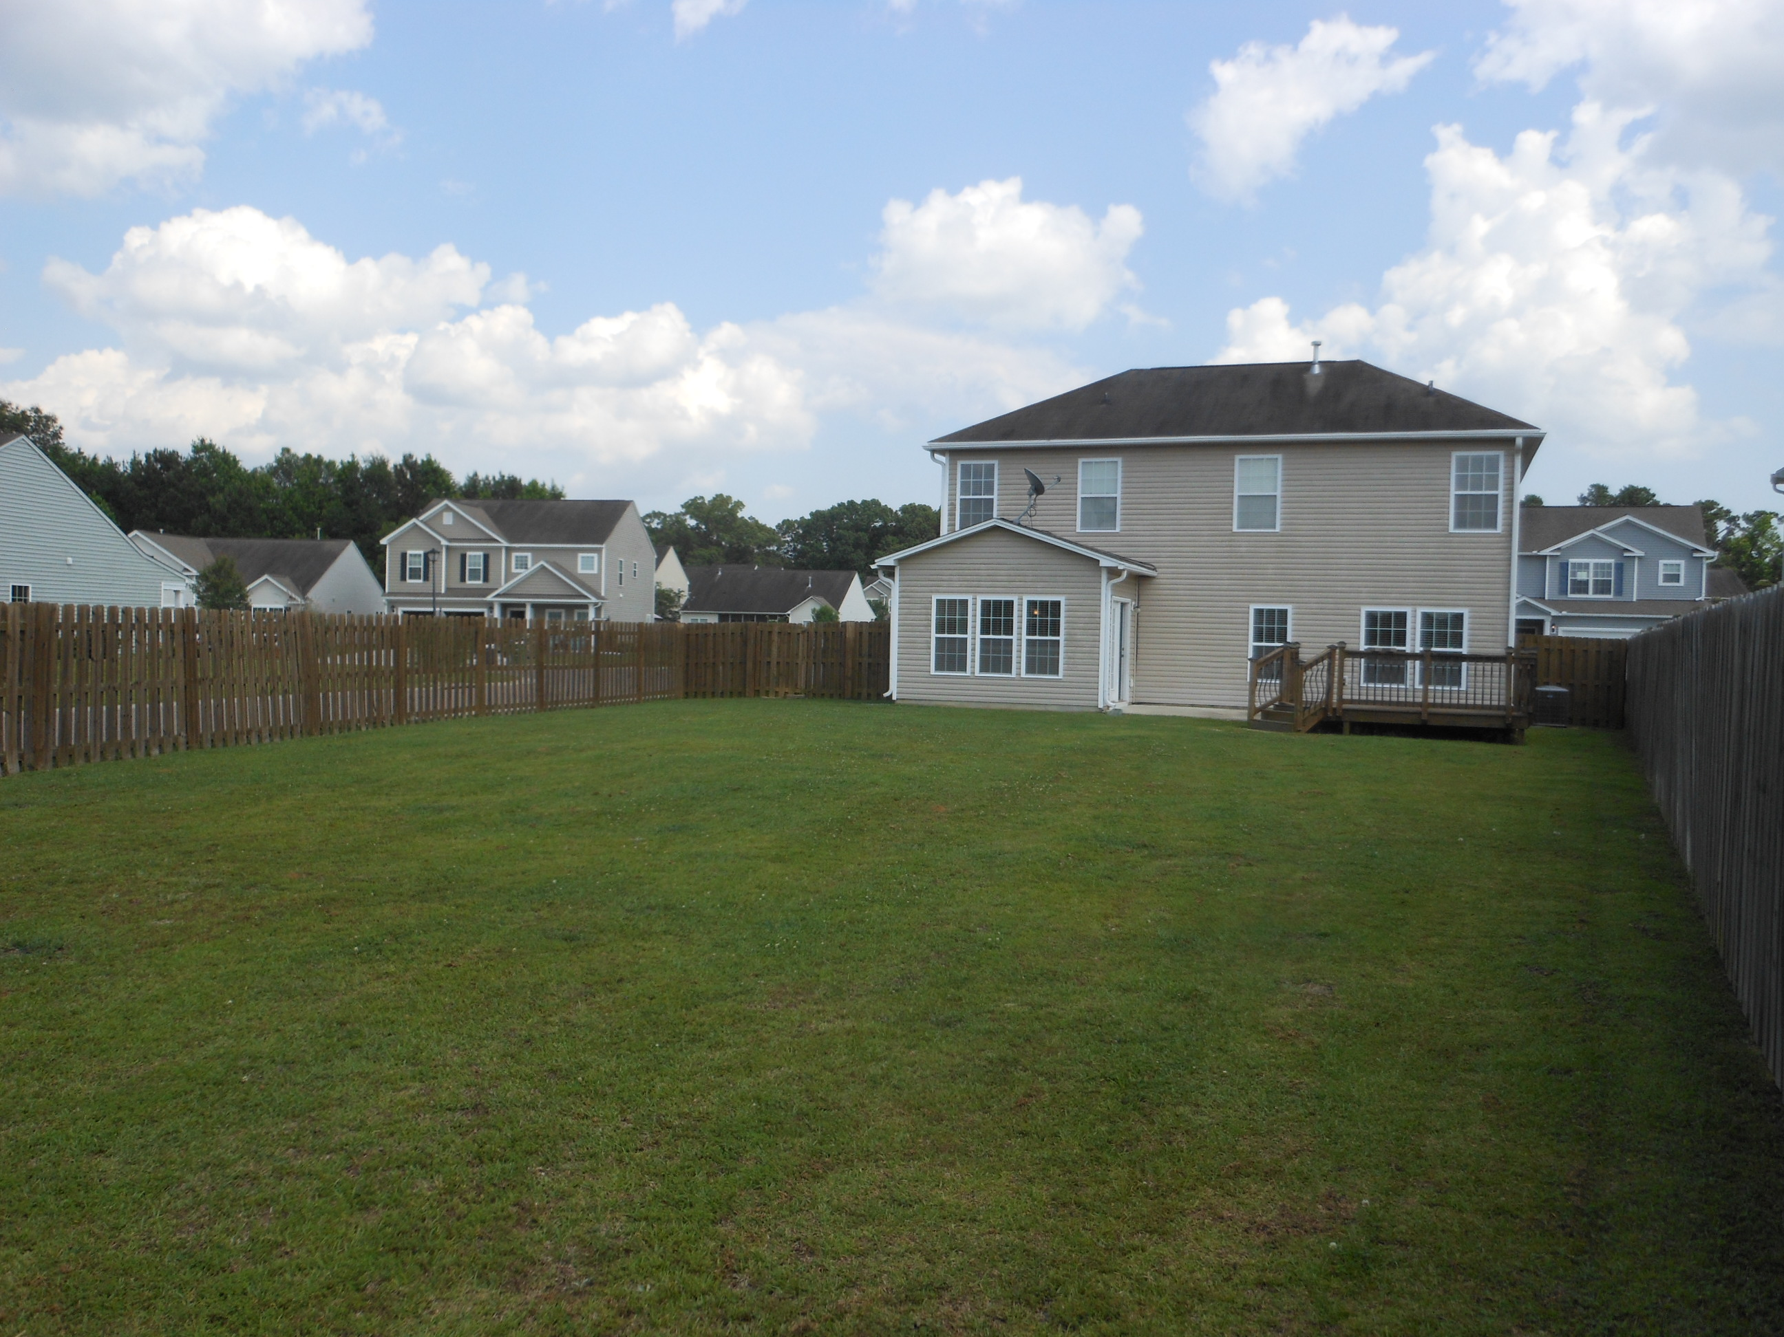

8000 Henderson Road
Myers Mill
Summerville, SC 29483
MLS# 16014593 $214,900
3 Bedrooms | 2½ Baths
Ready for quick close
Well maintained 3 bedroom 2.5 bath home located on a corner lot with a huge fenced in backyard. 2 story foyer, formal dining room off the foyer. Eat in kitchen with stainless steel appliances overlooks the open family room. Sun room off the back of the house leads out to the beautiful deck in the back yard. Additional den tucked away off the back of the family room is great for an office or play room and Downstairs office could easily be converted to 4th bedroom. All 3 bedrooms, 2 bathrooms and laundry room are located upstairs with lots of closet space and storage closet and most have ceiling fans. Master suite has large walk in closet, 2 sink vanity over sized shower and linen closet. Great sub-division with community pool and cabana.
Bill Milo
843-412-0052
bill@weichertrealtorspc.com
www.charlestonareahomesforsale.net
Weichert Palmetto Coast
1035 Johnnie Dodds, Ste B2
Mt. Pleasant, SC 29464

