Slide 1
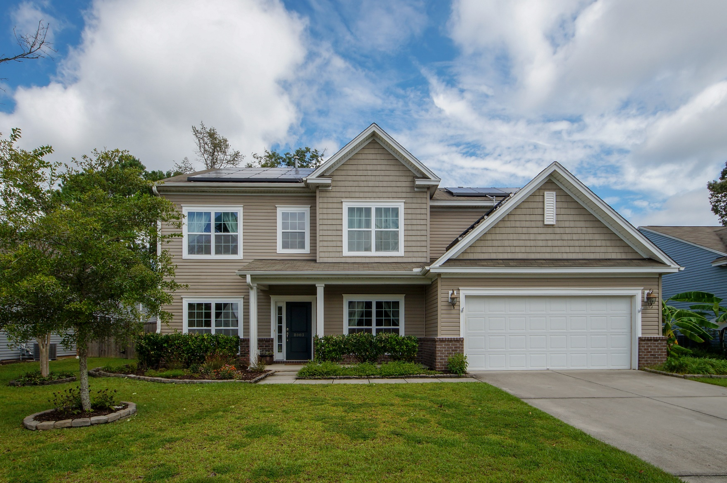
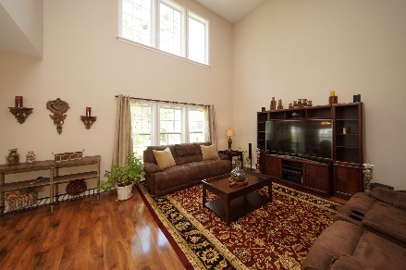
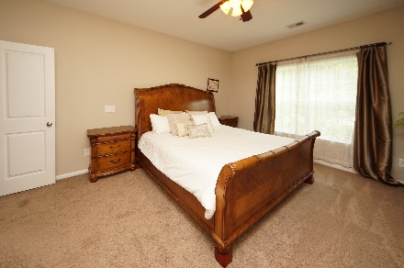
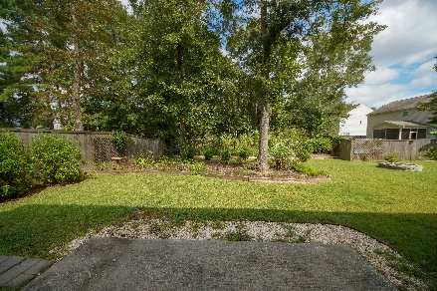


8003 Hydrangea Lane Hanahan, SC 29410 MLS# 18025740 :: $327,950 5 Bed / 2½ Bath
Just Reduced in Tanner Plantation
Just Reduced!
Executive 5 bedroom home with master bedroom down stairs is priced to sell in desirable Tanner Plantation! The new owner of this home will take advantage of the regal style and upgrades the seller chose during new construction. Elegant wood floors, professional paint, and a soaring family room ceiling capture your attention as you walk through the foyer. Wrought iron railing on the stair case and cat walk compliment the executive look as you stand in the living room. Enjoy cooking on a gas stove with plenty of counter and cabinet space. Upgraded fixtures, spacious bedrooms and professional design make this regal home a must see and must own. Back yard is fenced, professionally landscaped with a fire pit and offers plenty of privacy and space for entertaining.
Connie White, Broker
843-532-3356
connie@chrepros.com · conniewhiterealestate.com
Charleston Homes · 597 Old Mt. Holly Road · Suite 301 · Goose Creek, SC 29445

