Slide 1
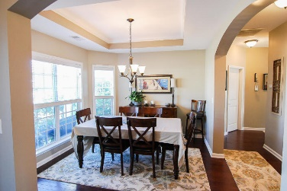
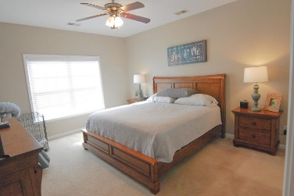
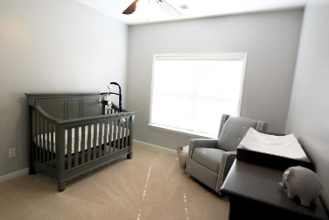
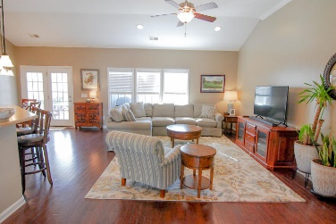
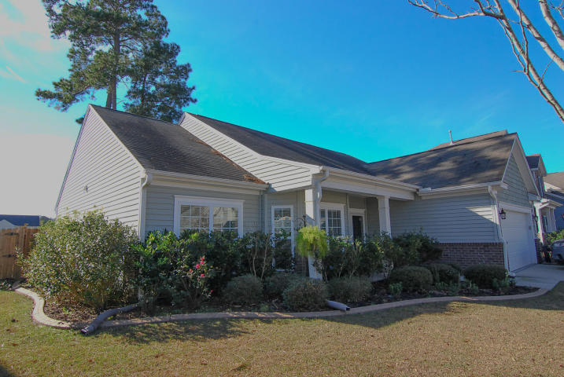
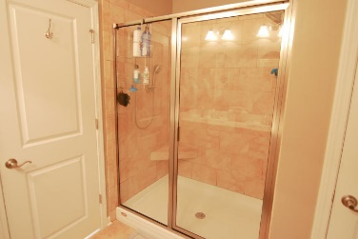
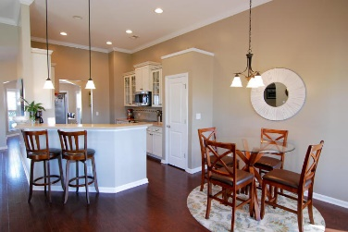
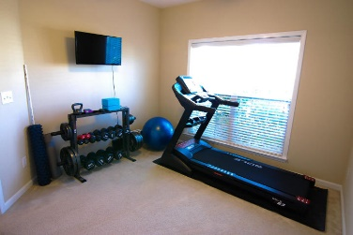
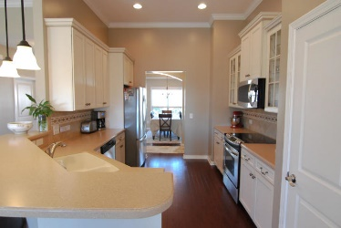
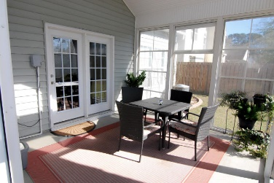



8004 Hydrangea Lane Hanahan, SC 29410 MLS# 19001220 ~ $279,990
Just Listed in
Tanner Plantation
Just Listed!
Under $280,000
This home is only about seven years old, and is located in one of the most popular communities in the Tri-Counties, Tanner Plantation! You'll love this one-story floorplan with details that you don't find in this price range in new construction anymore. There is extensive hardwood flooring throughout less bedrooms and baths. The dining room is stunning with a tray ceiling, arches and bay window. The kitchen, breakfast area and family room are very open and have dramatic vaulted ceilings. The kitchen is a chef's kitchen (literally) with solid surface counter tops, upgraded cabinets with crown molding and glass fronts on several doors. The custom backsplash is beautiful and there is a smooth top range! The master suite is located on one side of the home and includes an en suite bath with an enormous custom tiled walk-in 5' shower with double sided shower heads. The raised double sink vanity has plenty of storage, yet you'll find another storage linen closet plus a huge walk-in closet. This is a true split bedroom plan, as the secondary bedrooms are located on the other side of the home and share a full bathroom that is equally upgraded with tile flooring, upgraded cabinets and a raised vanity. The screen porch also doubles as a year round sunroom with special all weather panels and overlooks a gorgeous pond. The backyard is also fenced. There is an irrigation system, as well.
Beth Moore
M (843) 532-4892
bmoore@carolinaone.com
Meg H. Kandik
M (843) 814-5137 | O (843) 603-4659
Meg@HolyCityRE.com | www.holycityre.com
Bennett Construction & Realty | 804 Tennent Dr | Charleston, SC 29412

