Slide 1
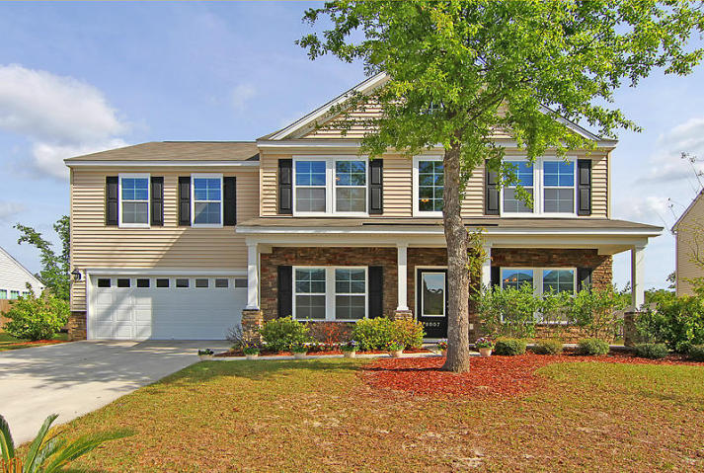
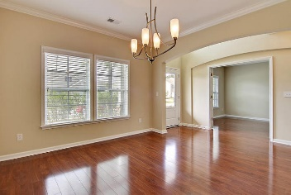
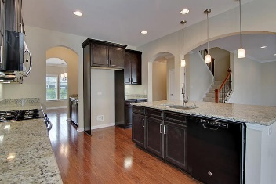
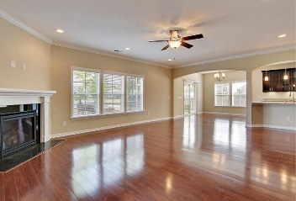
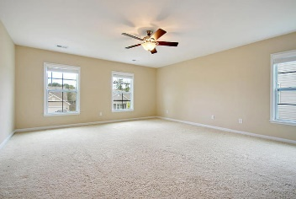
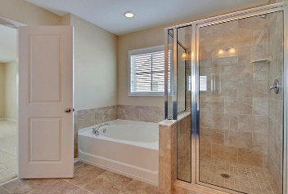
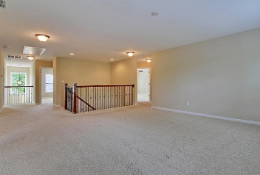
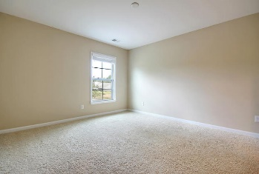
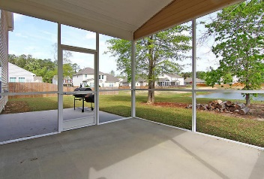
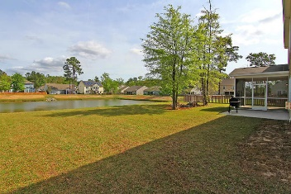
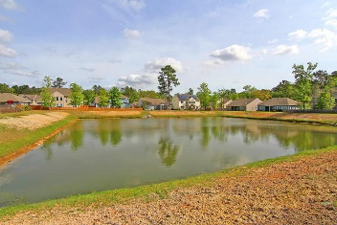

8007 Indian Hill Drive
Tanner Plantation · Hanahan, SC 29410 · MLS# 17009757
Gas Card Give Away
Price Reduced Again!
Now Offering at $369,900
Beautiful HUGE 4 bedroom 3.5 bath house on a pond lot with THREE CAR TANDEM GARAGE!! Features: gorgeous gourmet kitchen with stainless appliances, 42'' designer cabinets, expansive granite counter tops, butlers pantry, high efficiency natural gas heat, hot water, fireplace and stove, recessed can lights, laminate flooring throughout the downstairs, and tons of natural light. Large master suite with spa-like bath including soaking tub, separate shower with luxuriously tiled surround, dual sinks, granite counter tops, and MASSIVE master closet. Jack and Jill bathroom between two big bedrooms and fourth bedroom shares the hall bath making for a wonderful guest suite. OVERSIZED game room/media room completes the upstairs. This home is perfect for entertaining or getting lost in! Will not last!
Stan Huff
843-670-2835
stan.huff@agentowned.com
Jill Marcacci
843-297-5590
jill@agentowned.com
www.agentownedrealty.com
AgentOwned Realty Co. Preferred Group, Inc. | 824 Johnnie Dodds Blvd | Mt Pleasant, SC 29464

