Slide 1
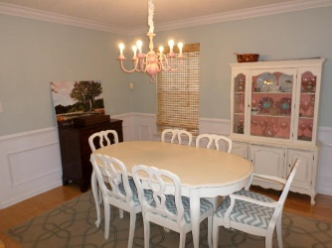
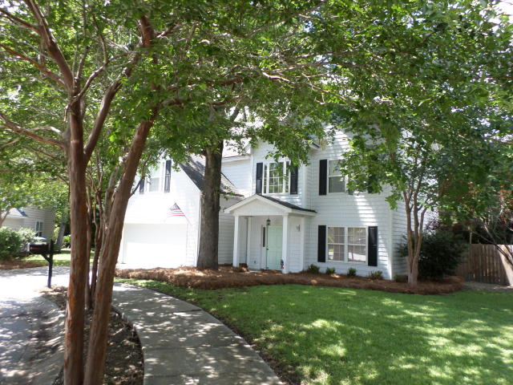
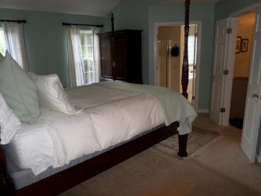
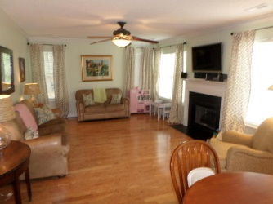
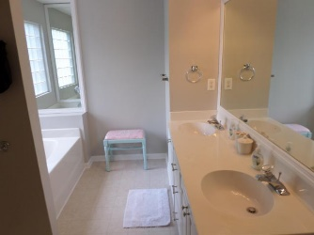
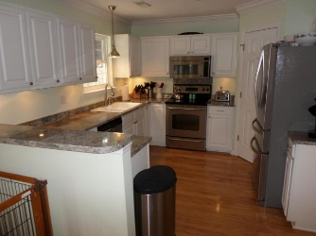
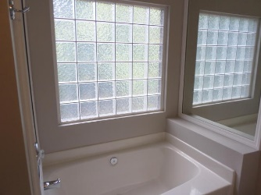
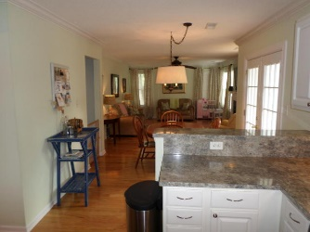
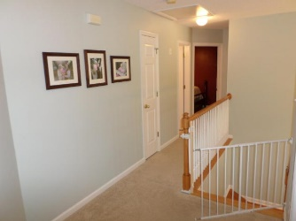
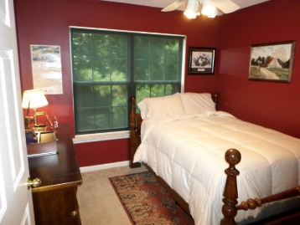
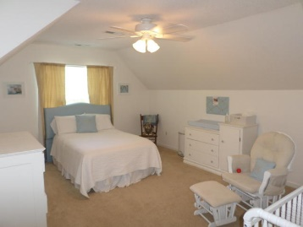
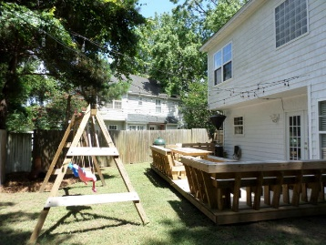
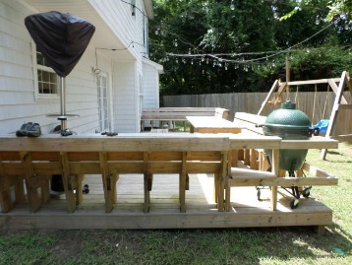
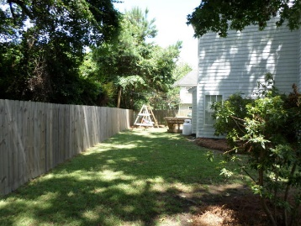


New Listing in Lawton Harbor
Just Reduced!
800 Heyward Cove Place
Charleston - MLS# 16017787 - $375,000
Enjoy the convenience of living in desirable Lawton Harbor on a cul-de-sac that also backs up to a wooded area. Additionally, there is a wood fenced back yard. Walk in front door to foyer and on right is formal dining room-with wains coating- that leads into kitchen-that has stainless appliances. Hardwood floors grace the entire first floor (along with crown molding) and wall to wall carpet upstairs. Just off kitchen is breakfast area and family room with fireplace. Upstairs are four bedrooms-all good size- with master suit having vaulted ceiling, bath with dual vanities, tub and separate stand up shower and large walk in closet. All the above and be walking distance to Stiles Point Elementary and minutes from JI connector to downtown. Folly Beach is also just minutes away.
Jerry Wise, Realtor
843-442-7633
jwise@eratidesrealty.com
ERA Wilder Realty, 125-F Wappoo Creek Dr, Charleston, SC 29412

