Slide 1
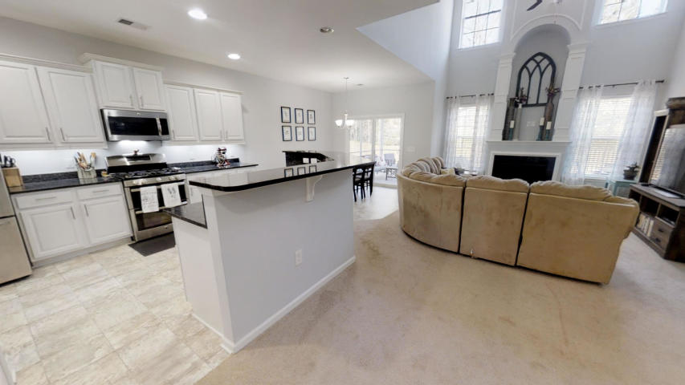
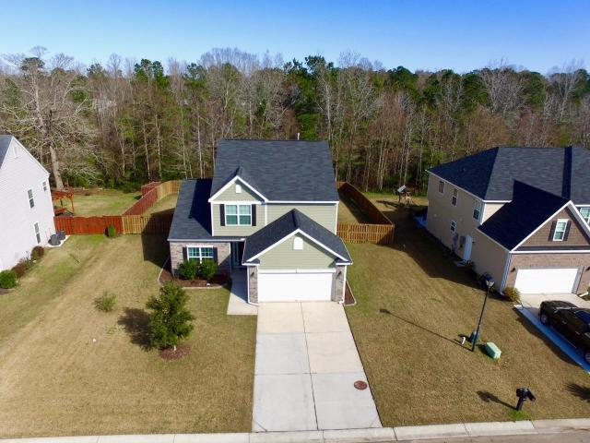
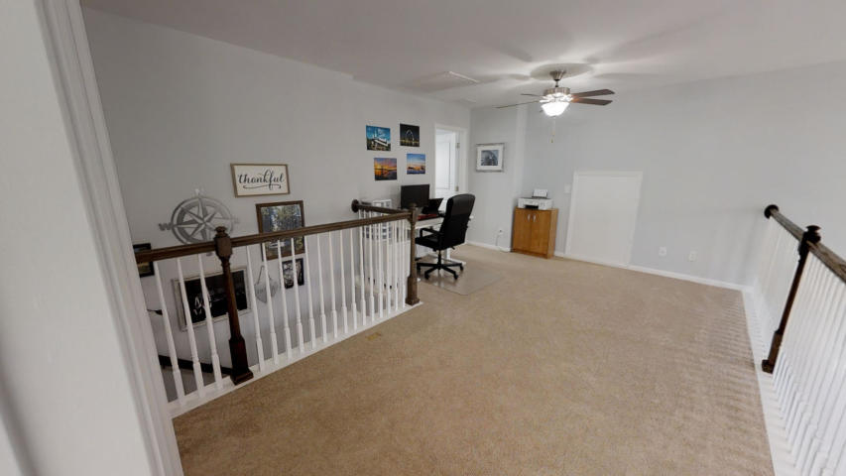
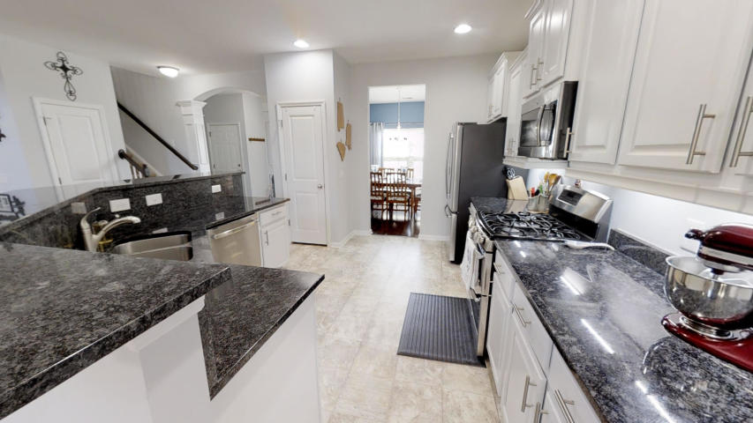
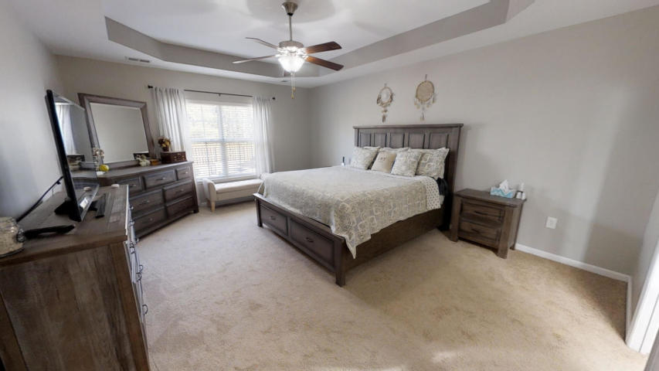
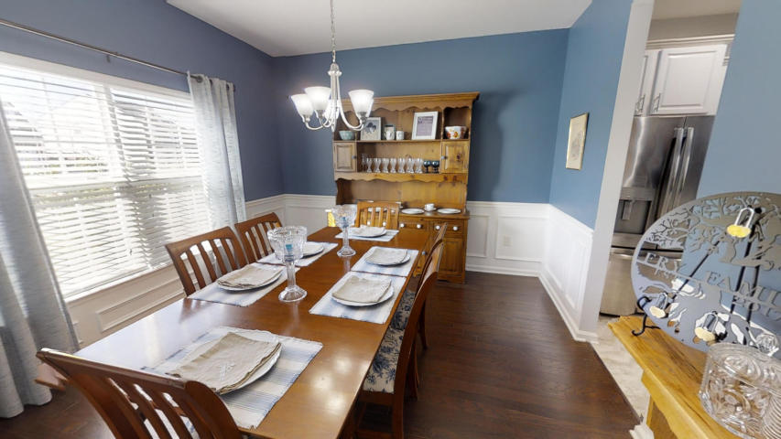
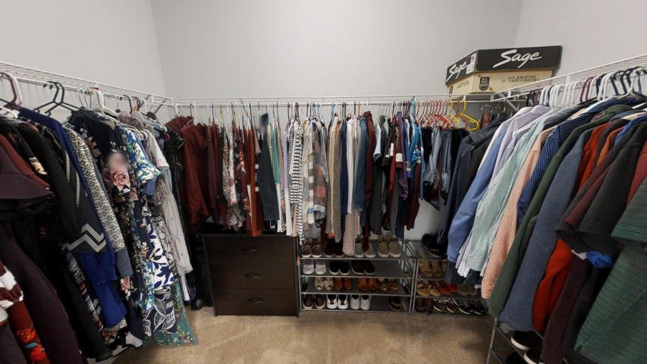
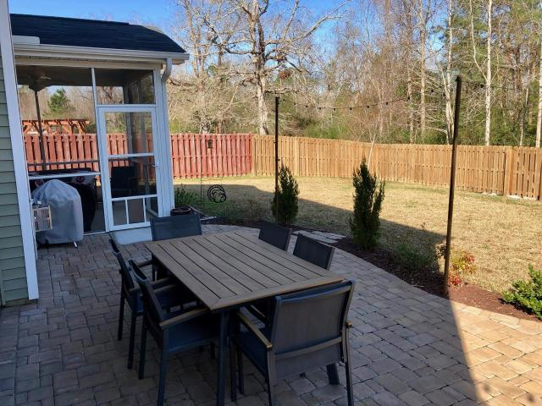
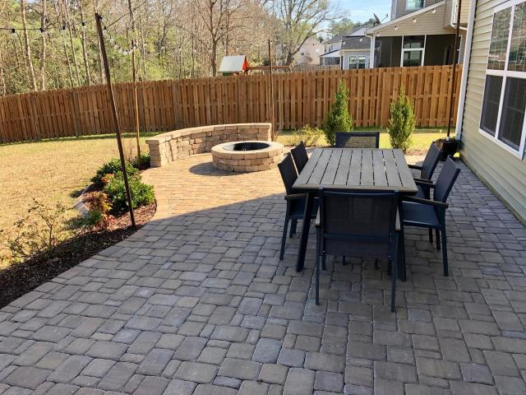
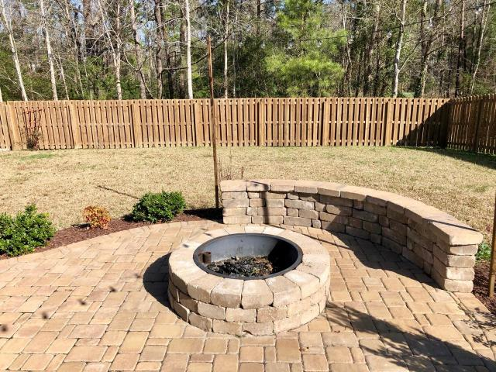
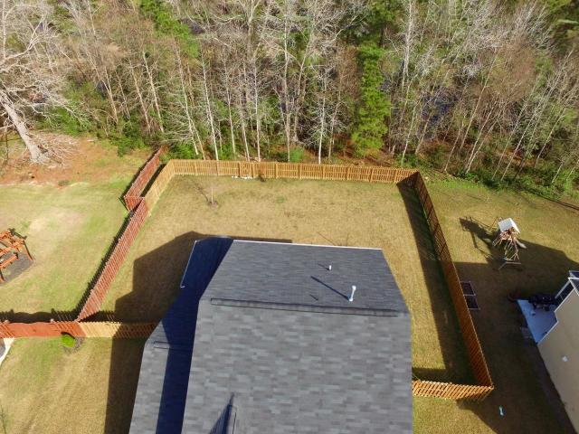
Better Than New in Myers Mill
8017 Mckayla Road
Myers Mill
Summerville, SC 29483
MLS# 20002112
$295,000
BETTER THAN NEW - this 4 year old home has it all with loads of Builder Upgrades! Open floor plan with Grand entrance. Curved archways lead to formal dining room with wainscotting, and to the family room with 18 ft ceiling, and a lovely gas logs fireplace. Upgraded kitchen with granite counters, stainless steel appliances, gas range, and high bar top in sink island that overlooks family room, and screened porch off breakfast area. Master is on first floor - with tray ceiling, large walk-in closet, and upgraded master bath with 5 ft walk-in shower and dual shower heads! Upstairs has 3 bedrooms and a loft overlooking 2 story family room. Fenced yard, new patio and fire pit for outdoor entertaining. Property backs to Bird Sanctuary - so no homes will ever be built behind this home!!
Note that the back property line is about 10 feet beyond fence. Landscaping has drip irrigation system. Rinnai tankless water heater. Walk to pool and great walking/nature trail. Note that the sun sets at the front of the home, so the backyard and screened porch area are shaded in the evening - so you can enjoy wonderful Summer evenings outdoors! Great neighborhood! Come take a Look!!
Randy Espeseth
843-743-1025 | Randy@RandyEHomes.com | Carolina Elite Real Estate

