Slide 1
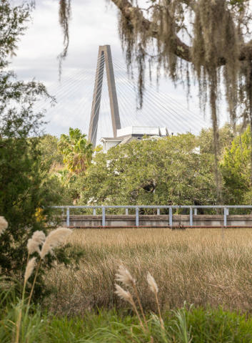
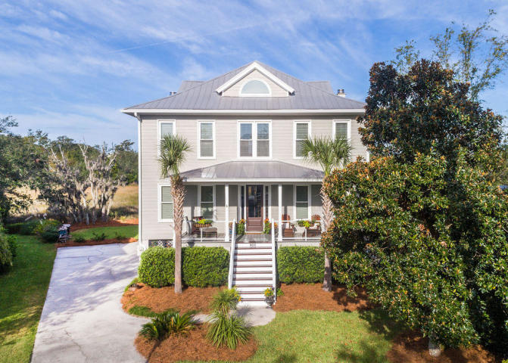
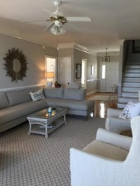
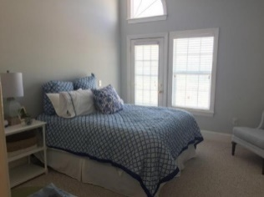
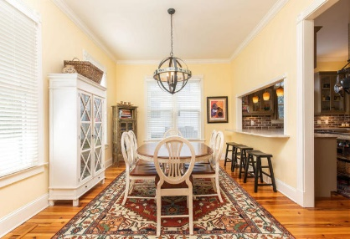
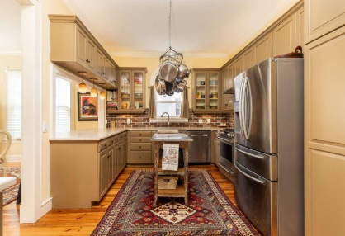
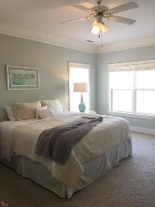
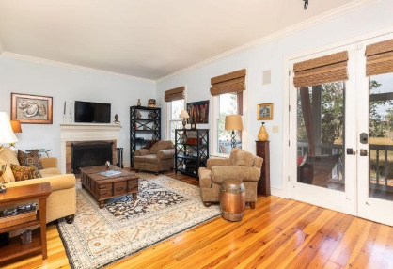
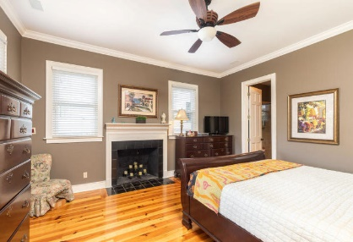
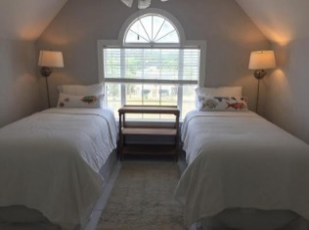
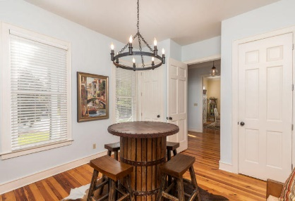
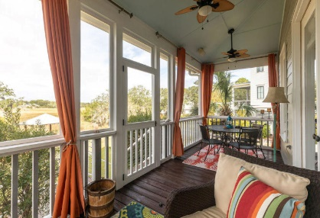
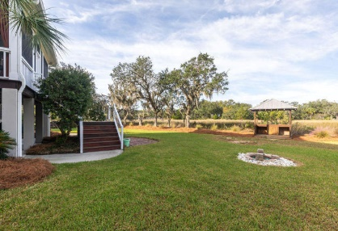
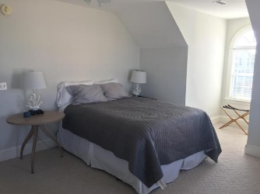
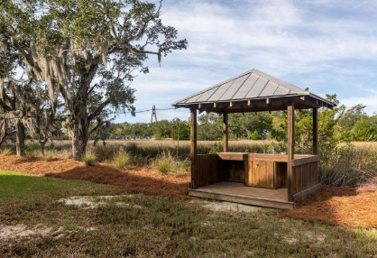
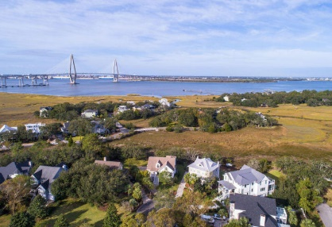
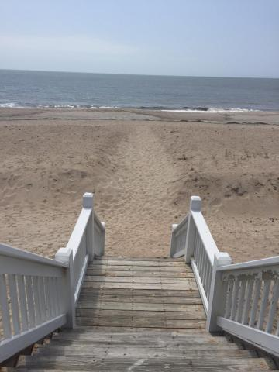

Open House Thursday 11a-2p Check Out This Beautiful New Home And Enjoy A Light Lunch
Perfection could easily be used to describe this custom home tucked away on a quiet cul-de-sac overlooking the salt marsh of the Wando River and the towers of the Ravenel bridge. Welcome to 801 Fiddlers Point Lane located in the subdivision of Harbour Watch just off Wingo Way in Mt. Pleasant with easy access to the bridge, downtown Charleston (5 minutes) and all points beyond. Entering the home you will see the gleaming pine floors and bright interior. To your left is a spacious dining area with plenty of room for a large table. The room opens to the kitchen and features bar stools for counter top dining. The updated kitchen features quartzite countertops, a brick backsplash, and a gas range complete with pot filler. To the right of the front door is a versatile room that could be used as a formal dining room, a study, or a playroom. The hallway opens to a bright family room with a wood burning fireplace and French doors opening to a screened in porch that overlooks the large back yard, tranquil marshes and Lowcountry sunsets. To the right of the French doors is the downstairs master bedroom which contains a walk in closet and a renovated bathroom with a large walk in shower. Up the stairway are 4 large bedrooms with a bath between each. Upstairs also features a large hall area that could be used as an office or study area. From the upstairs hall take the full walk up stairs to the climate controlled attic complete with spray foam insulation and stand up head room. No more pulling down steps to access the attic. Other upgrades to this home include a metal roof, gutters, new HVAC in 2012 and 2019 and new modern ductwork. This gem is not to be missed and will not be on the market long.
801 Fiddlers Point Lane
Harbour Watch
Mount Pleasant, SC 29464
MLS# 19030249
$845,000
Perfection could easily be used to describe this custom home tucked away on a quiet cul-de-sac overlooking the salt marsh of the Wando River and the towers of the Ravenel bridge.
Welcome to 801 Fiddlers Point Lane located in the subdivision of Harbour Watch just off Wingo Way in Mt. Pleasant with easy access to the bridge, downtown Charleston (5 minutes) and all points beyond.
There are too many amazing details to mention here.
This gem is not to be missed and will not be on the market long.
Frank Thornhill
(843) 224-7997
frank@askfrankrealestate.com
The Boulevard Company, LLC
35 Broad Street
Charleston, SC 29401 www.askfrankrealestate.com

