Slide 1
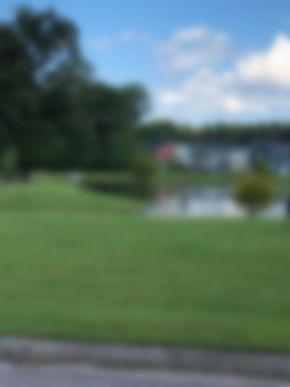
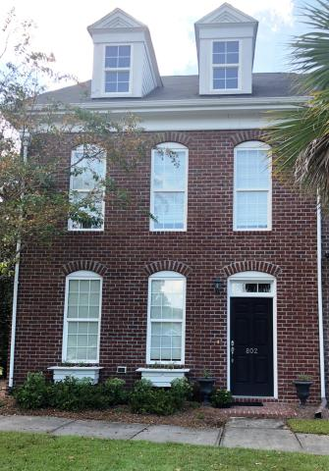
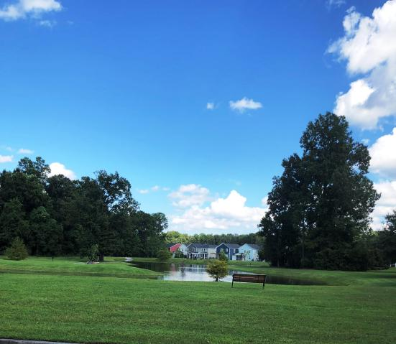
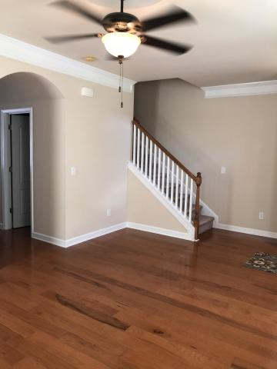
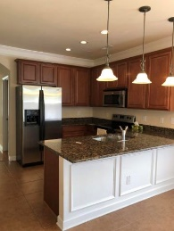
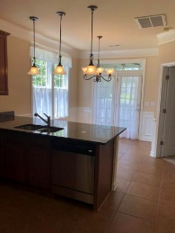
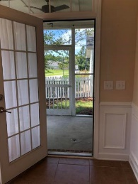
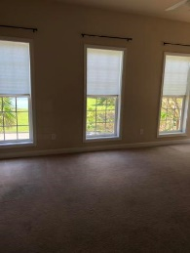
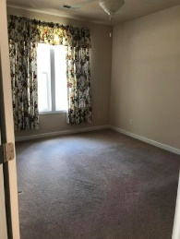
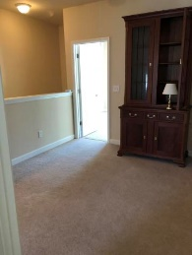
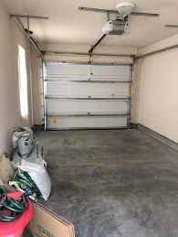


Buyers Agent Bonus Offered
PLUS 1-Year AHS Warranty
802 Rue Drive
Grand Oaks Plantation • Charleston, SC 29414 • MLS# 18022517 • $289,000
This home was once the model home for this section.
Fully upgraded. First floor master bedroom and bath with large walk in closet, separate tub and shower, dual sinks.
First floor laundry room. Crown molding throughout.
Upgraded cabinets and flooring. Detached garage.
Convenient location. Close to I-526 and Hwy 17, shopping and hospital.
Christina Garvin
(843) 270-7667 | cgarvin63@gmail.com
Elaine Brabham and Associates, LLC • 1890 Sam Rittenberg Boulevard, Suite 217 • Charleston, SC 29407

