Slide 1
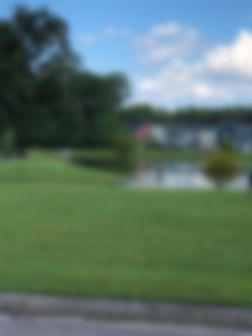
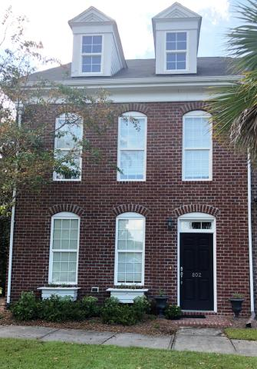
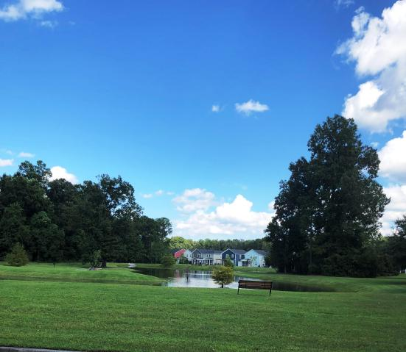
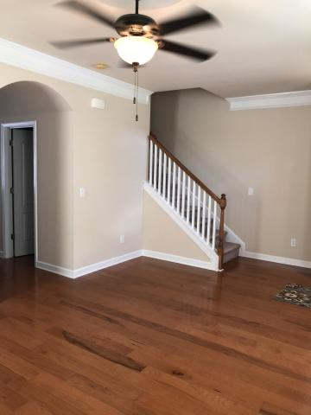
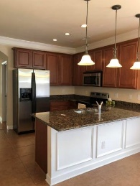
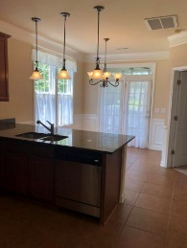
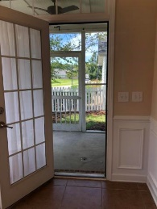
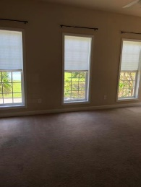
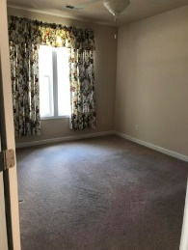
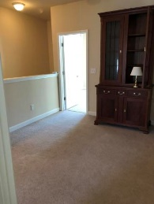
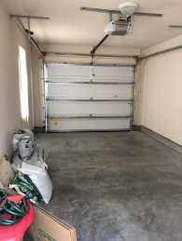


Fully Upgraded End Unit Townhome First Floor Master Bedroom And Full Bath
802 Rue Drive
Grand Oaks Plantation • Charleston, SC 29414 • MLS# 18022517 • $310,800
This home was once the model home for this section.
Fully upgraded. First floor master bedroom and bath with large walk in closet, separate tub and shower, dual sinks.
First floor laundry room. Crown molding throughout.
Upgraded cabinets and flooring. Detached garage.
Convenient location. Close to I526 and Hwy 17, shopping and hospital.
Christina Garvin
(843) 270-7667 | cgarvin63@gmail.com
Elaine Brabham and Associates, LLC • 1890 Sam Rittenberg Boulevard, Suite 217 • Charleston, SC 29407

