Slide 1
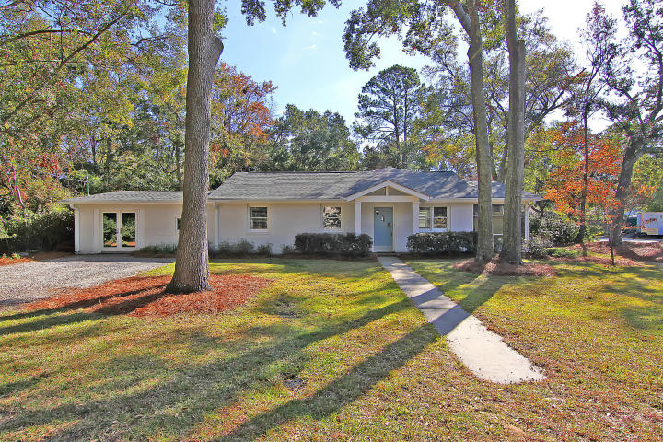
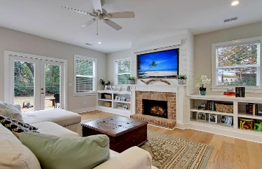
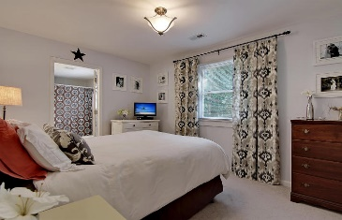
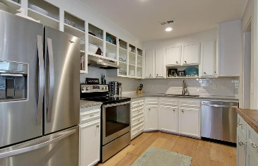
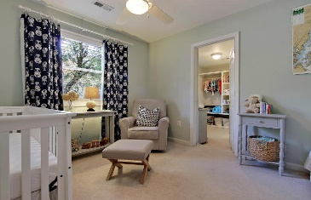
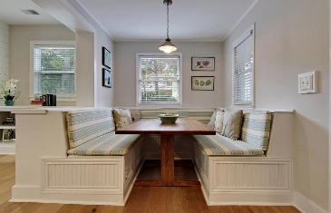
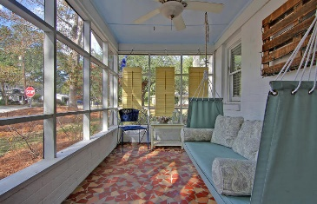
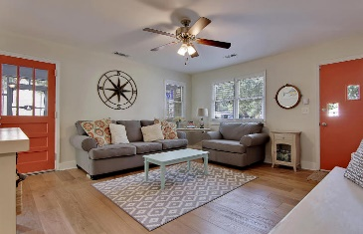
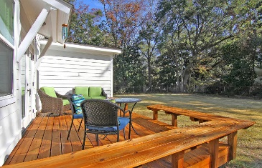
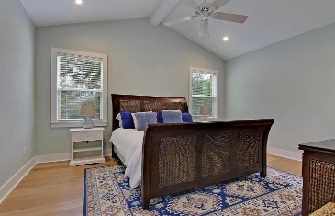
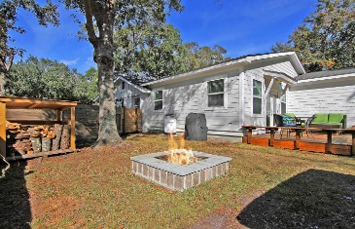
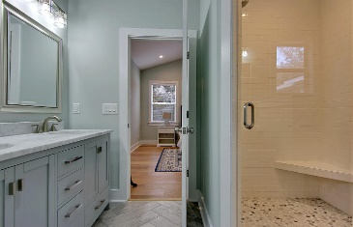
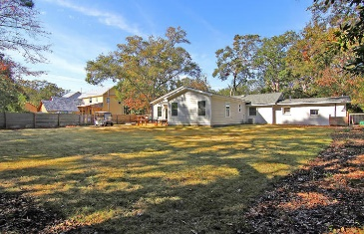

Price Reduced!
Price Reduced!
803 Mccants Drive
Osceola Oaks ~ Mount Pleasant ~ MLS# 16030223 ~ $700,000
DREAM LOCATION IN OLD MT PLEASANT! You may notice a golf cart in the gigantic, fenced-in backyard of this 4BR, 3BA home & that’s because its so close to shopping, dining & Shem Creek that you can leave the car at home! This home has been incredibly renovated with a luxurious owner’s retreat, stunning eat-in kitchen with a built-in seating area & an amazing great room with a gas fireplace and built-ins on either side. What’s great about this layout is that the split floor plan & dual master bedroom situation adds extra privacy. The screened-in porch & deck off of the great room make for relaxing outdoor living spaces & the workshop is another usable space for storage or to work in. If you need to get downtown or want to spend the day at Sullivans Island, this location can't be beat!
Additional features include:
Beautiful hardwood floors
Kitchen has stainless steel appliances, granite countertops, a custom peninsula with a reclaimed wood countertop and overhang for bar stool seating, a breakfast nook and a walk-in pantry
Master bedroom has a cathedral ceiling, walk-in closet and master bath with dual vanity and walk-in shower
New deck and fire pit in the huge, fenced-in backyard
Mature oak trees throughout property
868 sq ft addition added in early 2016
Hot water heater installed late 2015
Two HVAC units - one installed in 2016 and one installed 3-4 years ago
New roof installed in late 2015
Book your showing today!
Book your showing today!
Matt O’Neill matt@mattoneillteam.com 843-532-4220

