Slide 1
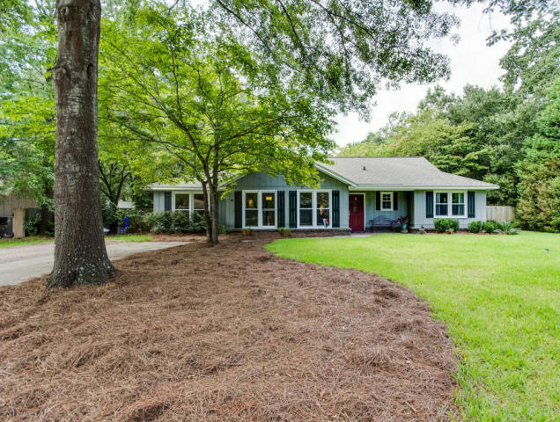
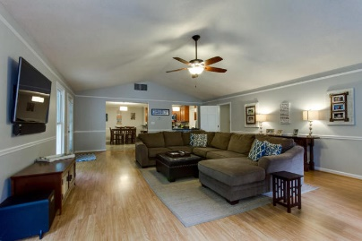
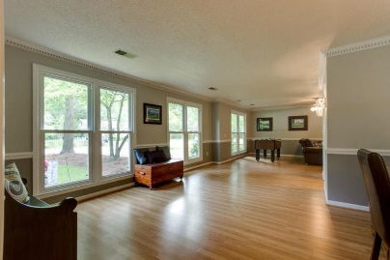
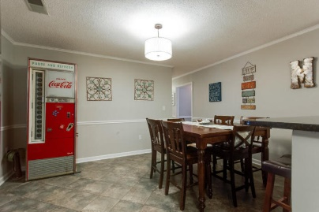
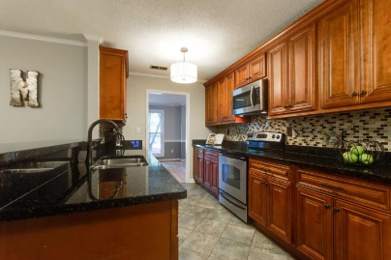
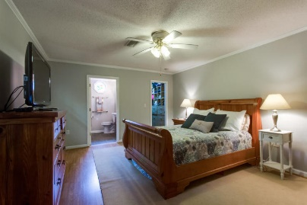
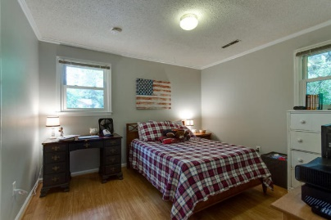
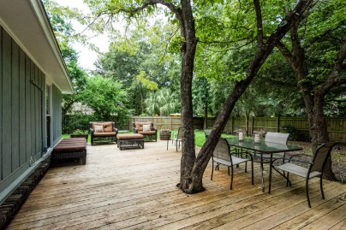
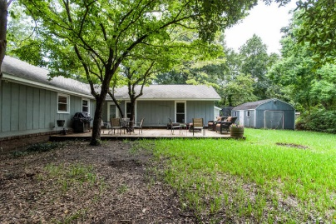

803 O'Sullivan Drive Mt Pleasant ~ MLS# 16023689 ~ $499,900
Open House
Sunday 2-4
Great price in Parish Place neighborhood! Large home with bright, spacious living areas. New HVAC, New Windows, Roof only 3 years old. 4 bedrooms, 3 baths. Bright kitchen has lots of cabinets for storage, lovely granite countertops and a tile floor. Home has great flow into the large family room with Gas fireplace and custom mantle.
Walk out onto your large open deck for an evening of entertaining and dining under the stars. Large backyard is enclosed with a privacy fence and has a 12X20 workshop with power and AC unit plus a separate storage shed. Laundry room, utility room, and pantry off kitchen. James B Edwards Elementary school is walkable through the neighborhood path so no busy streets to worry about. Bathrooms are handicap accessible. Just minutes to Town Centre and local hospital
Robin Windham
(843) 991-6672
robinwindham67@gmail.com www.BrennamanGroup.com

