Slide 1
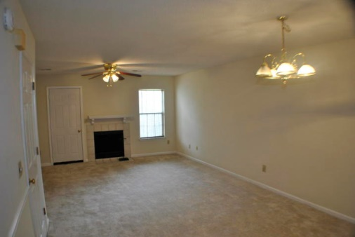
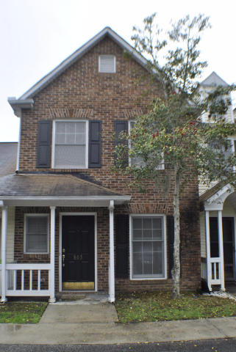
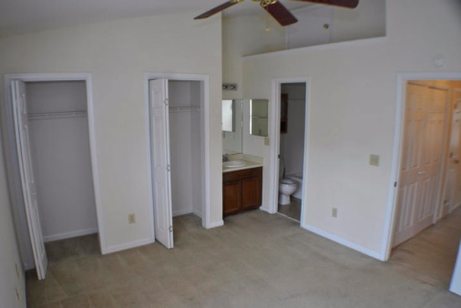
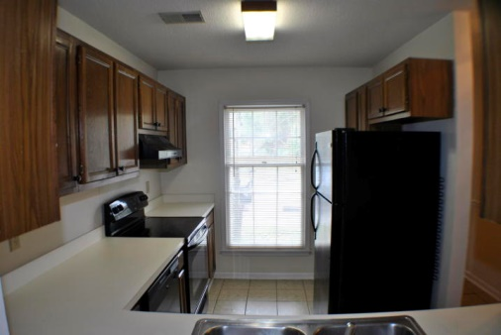
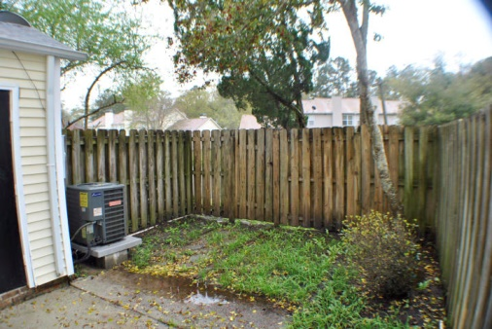

Agent Open House
May 23rd ~ 12-2pm
$1,500 Bonus
$500 Bonus
$1,000 Bonus
803 Reserve Way
Kings Grant ~ Summerville
MLS# 15008049
$104,900
Great location that is convenient to area shopping and dining. This two bedroom, two and one half bath room townhouse is ready for immediate occupancy. Inside you will find a clever layout with new carpeting, ceramic tile, and fresh paint. This property is sure to NOT disappoint.
The kitchen layout is cozy and offers plenty of space for the discerning chef. Newer appliances and lots of counter space make meal preparation a breeze. Look out from the kitchen over the bar to the family room, dining room combo. The fireplace makes it all feel like home. Upstairs you will find two spacious bedrooms each with its own full bathroom.
The opportunities for this property are boundless. Easy commute to all parts of town and lots of entertainment within a short distance. All of this in the famed Dorchester 2 school district. This is your chance and is the right choice for you next home.
This is a CJM SMART Buyer property. Buy this property and receive a 5 Day/4 Night cruise for two. Ask for details.
Corwyn J. Melette
Accredited Buyer Representative
(843) 364-3095
corwyn@corwynmelette.com
Exit Realty Lowcountry Group
3618 Ashley Phosphate Rd. #3
North Charleston, SC 29418
exitlowcountry.com

