Slide 1
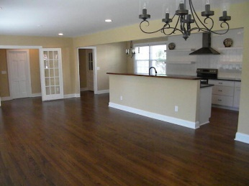
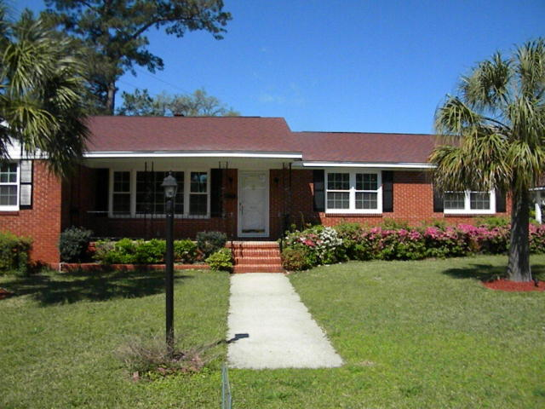
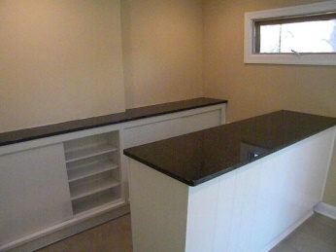
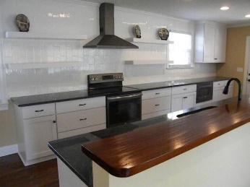
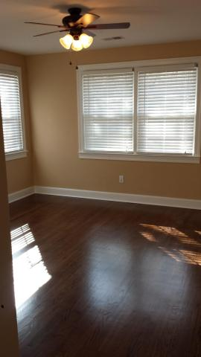
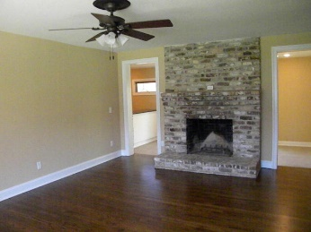
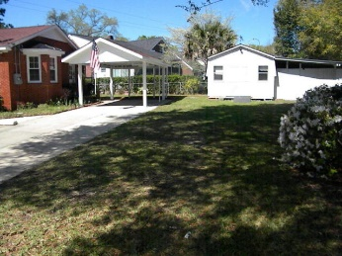
West Ashley Open House ~ Sunday, May 1st from 2-5
803 Sheldon
Moreland ~ Charleston ~ MLS# 16007039 ~ $419,000
This beautifully renovated 1 story, 3 bedroom, 2 full bath home is move in ready. Inside you will find gorgeous refinished oak hardwood floors throughout the home. All new kitchen cabinets with soft close doors and drawers, new granite and all new Slate colored GE appliances including a side by side refrigerator. The guest bathroom is all new including porcelain tile floors and shower walls, a new Kohler cast iron tub and a new toilet as well. The master has its own full bathroom with black and white tile, stand up shower and new vanity! All new electric fixtures throughout the home. All new plumbing fixtures as well including a gas Rinnai tankless water heater. All new A/C duct work and blower motors as well. Outside is a low maintenance brick veneer and all new energy star qualified windows with low E glass.
Russell Price, Realtor
russprice3@gmail.com | Mobile (843) 670-1170
Brand Name Real Estate | 4 Carriage Lane, Suite 106 | Charleston, SC 29407

