Slide 1
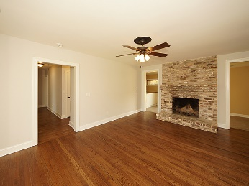
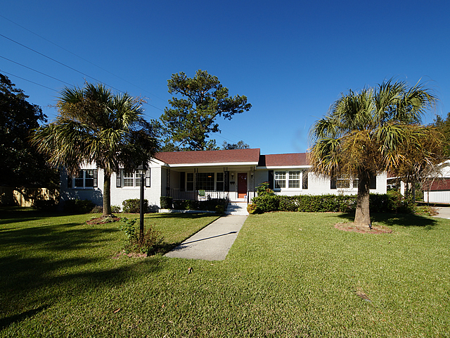
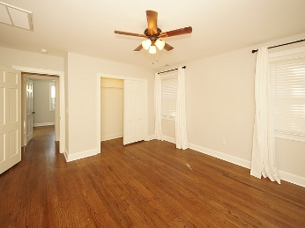
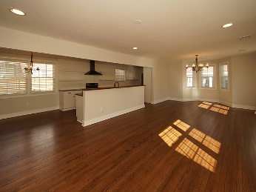
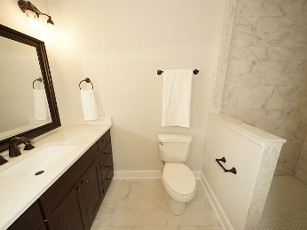
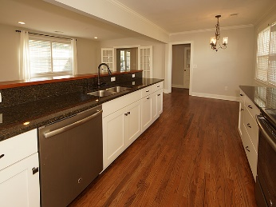
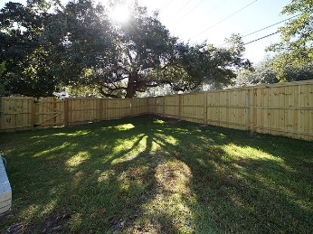
LEASE OPTION NOW OFFERED!
803 Sheldon Moreland ~ Charleston ~ MLS# 17029316 ~ $429,000
This beautifully renovated 1 story, 3 bedroom, 2 full bath home is move in ready and located just 1.7 miles from MUSC and 5 minutes from historic downtown Charleston Inside you will find gorgeous refinished oak hardwood floors throughout the home. All new kitchen cabinets with soft close doors and drawers, new granite and all new Slate colored GE appliances including a side by side refrigerator. The guest bathroom is all new including porcelain tile floors and shower walls, a new Kohler cast iron tub and a new toilet as well. The master has its own full bathroom with beautiful new shower, new floors and new vanity ! All new electric fixtures throughout the home. All new plumbing fixtures including a gas Rinnai . All new A/C duct work and blower motor as well. The exterior has new paint and a new privacy fence in the back yard
Russell Price, Realtor
russprice3@gmail.com | Mobile (843) 670-1170
Brand Name Real Estate | 4 Carriage Lane, Suite 106 | Charleston, SC 29407

