Slide 1
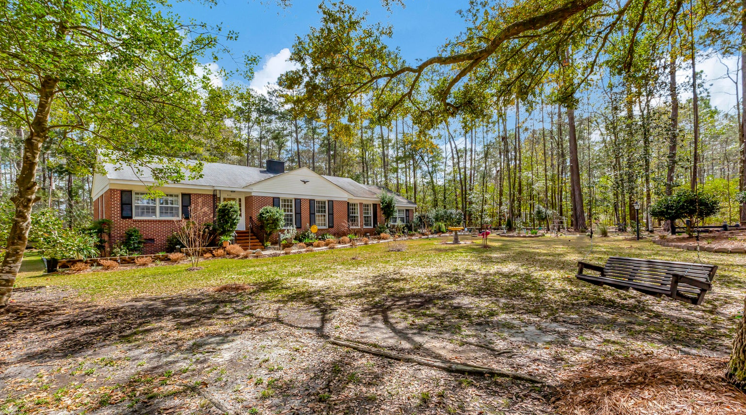
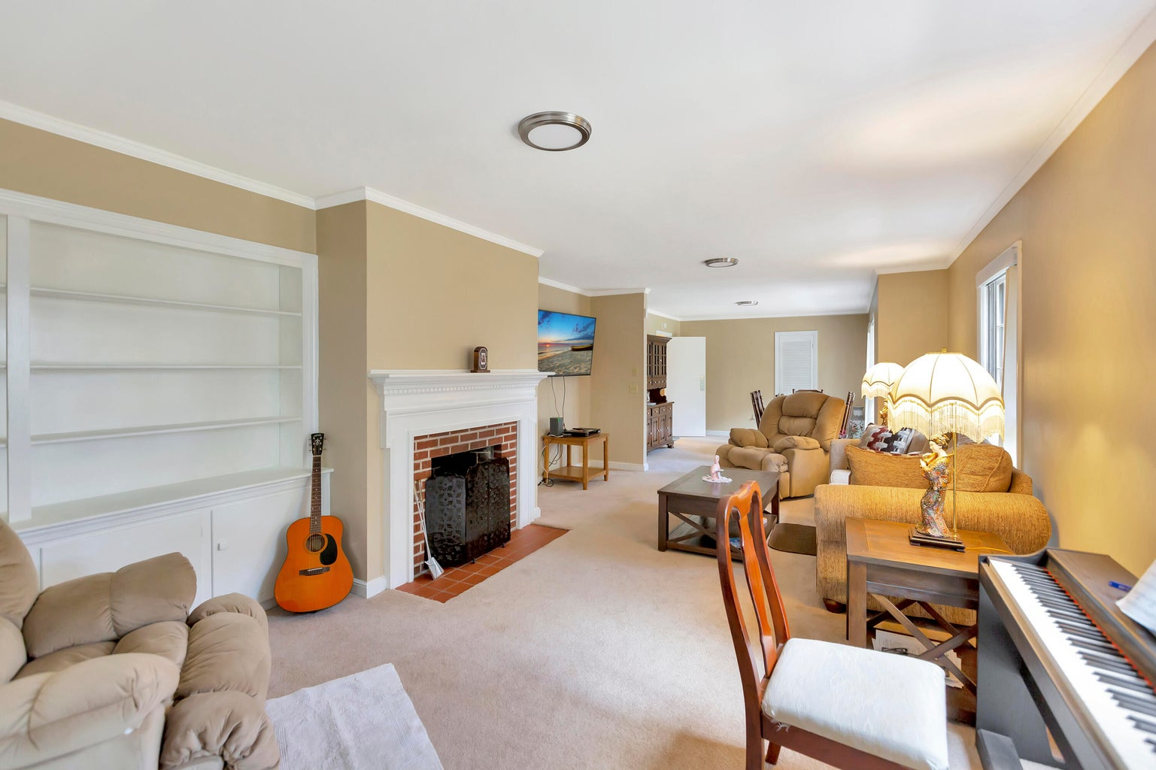
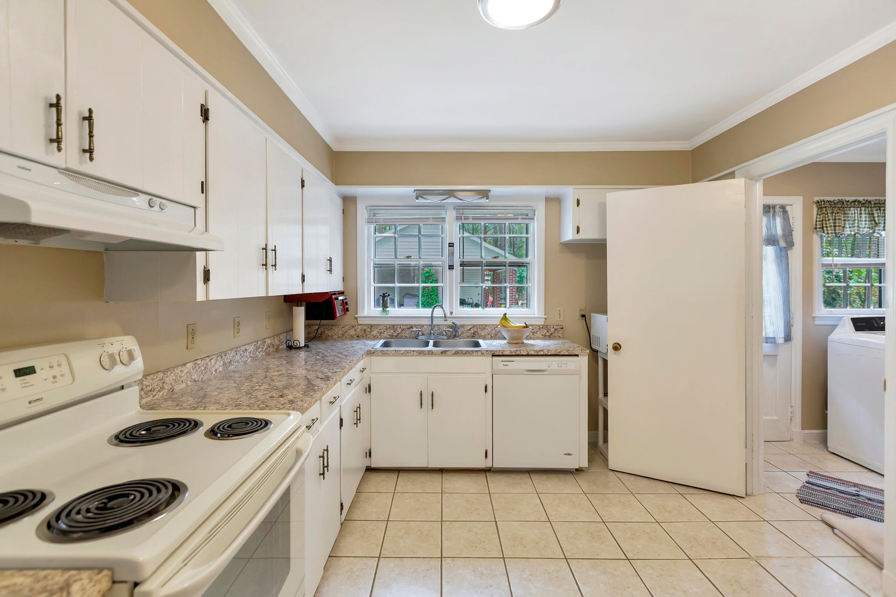
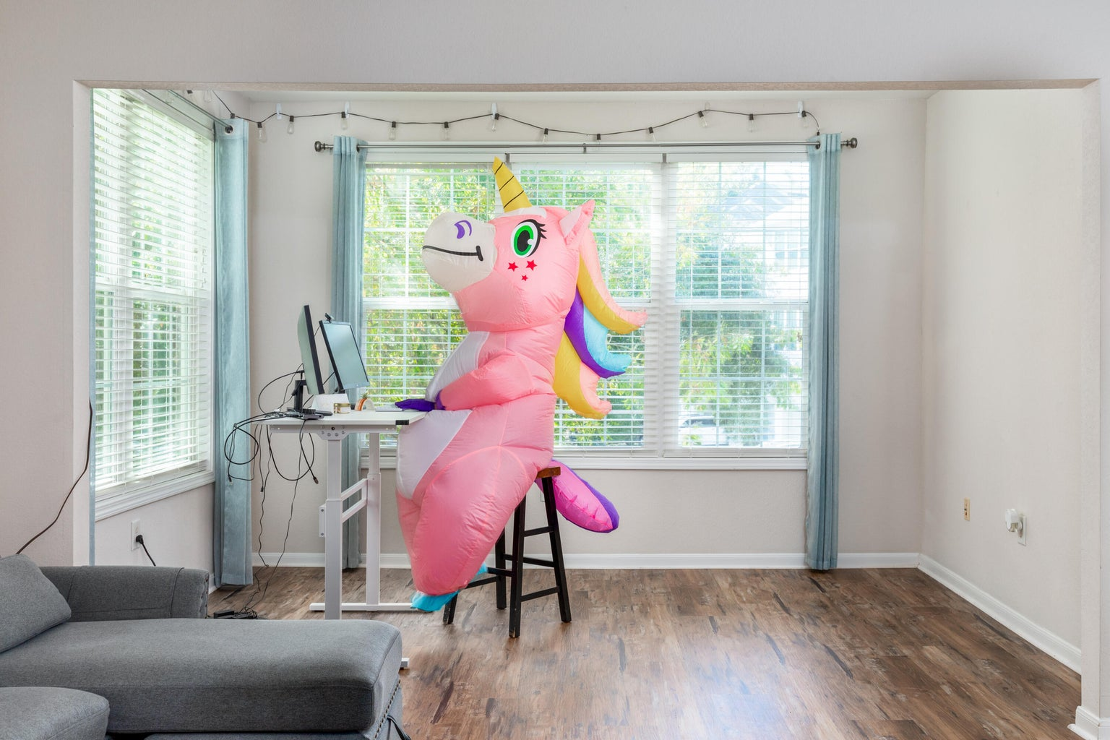
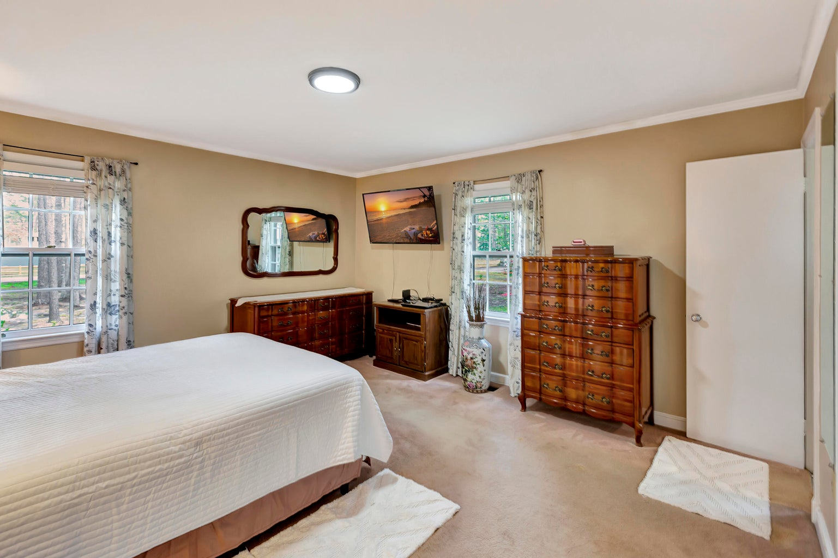
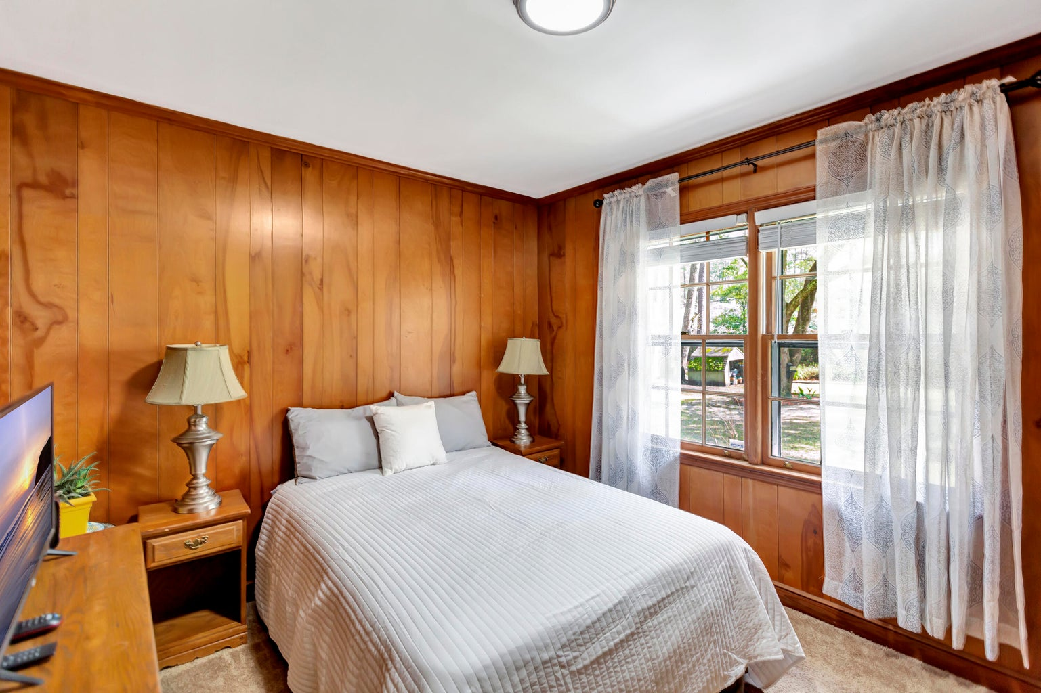
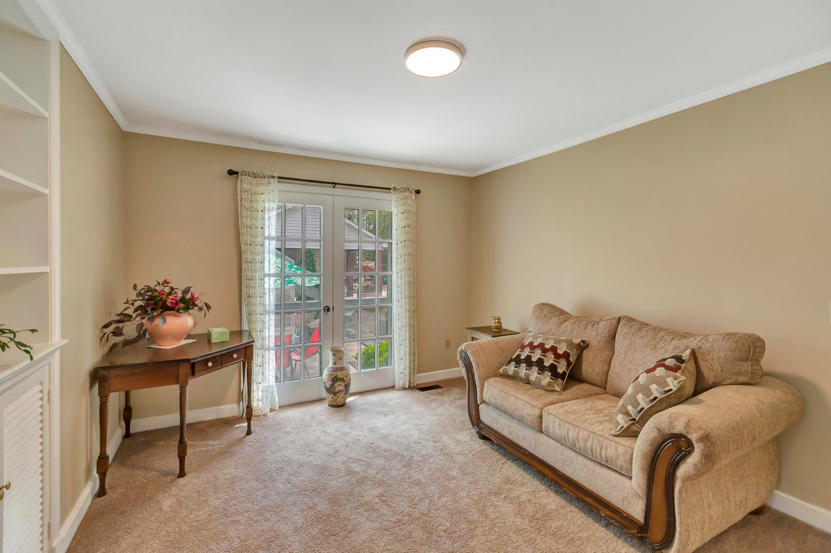
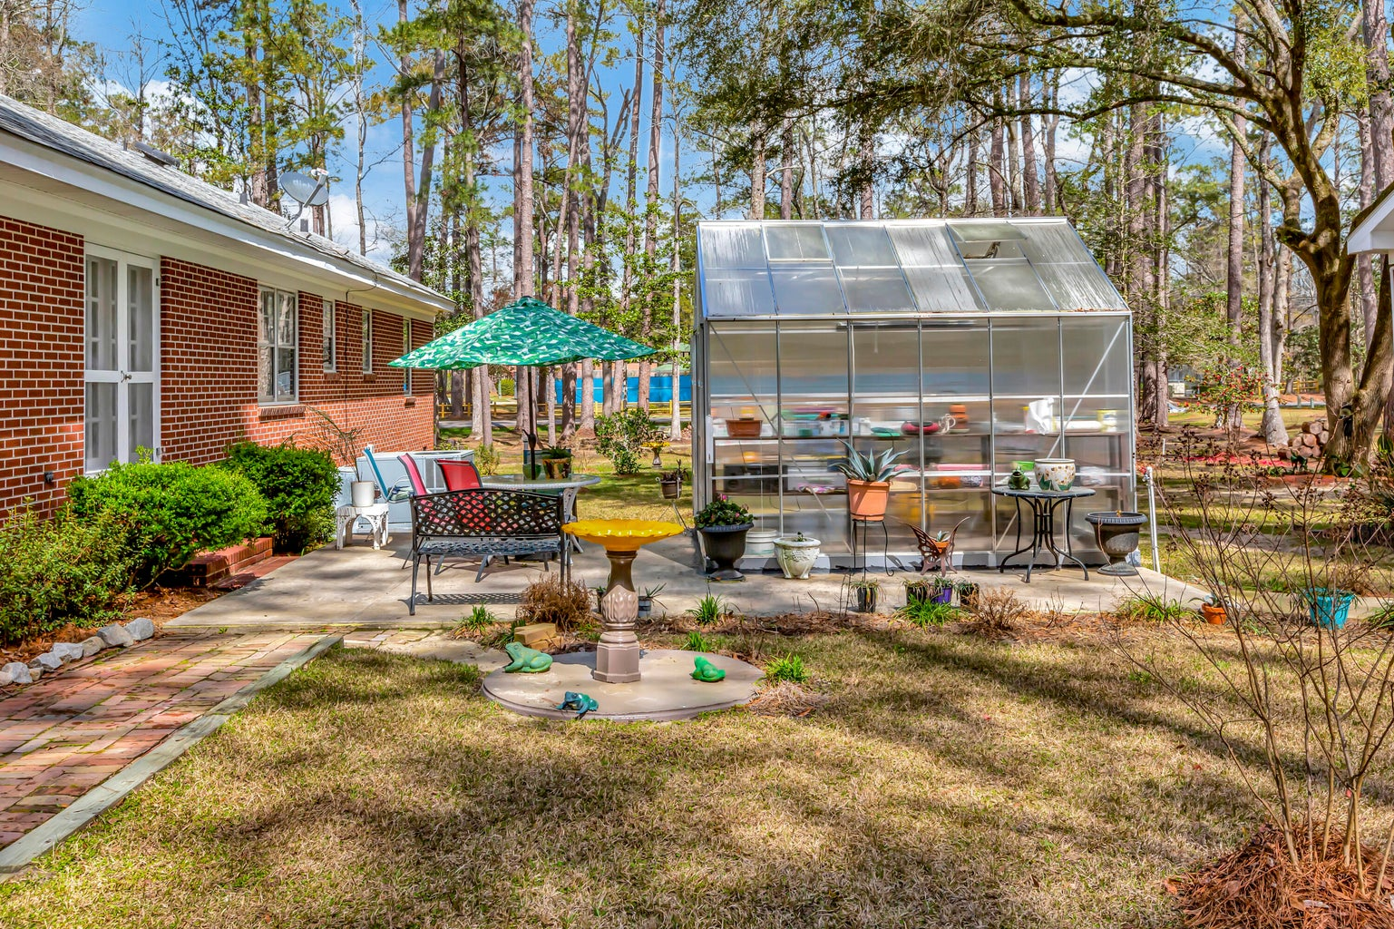
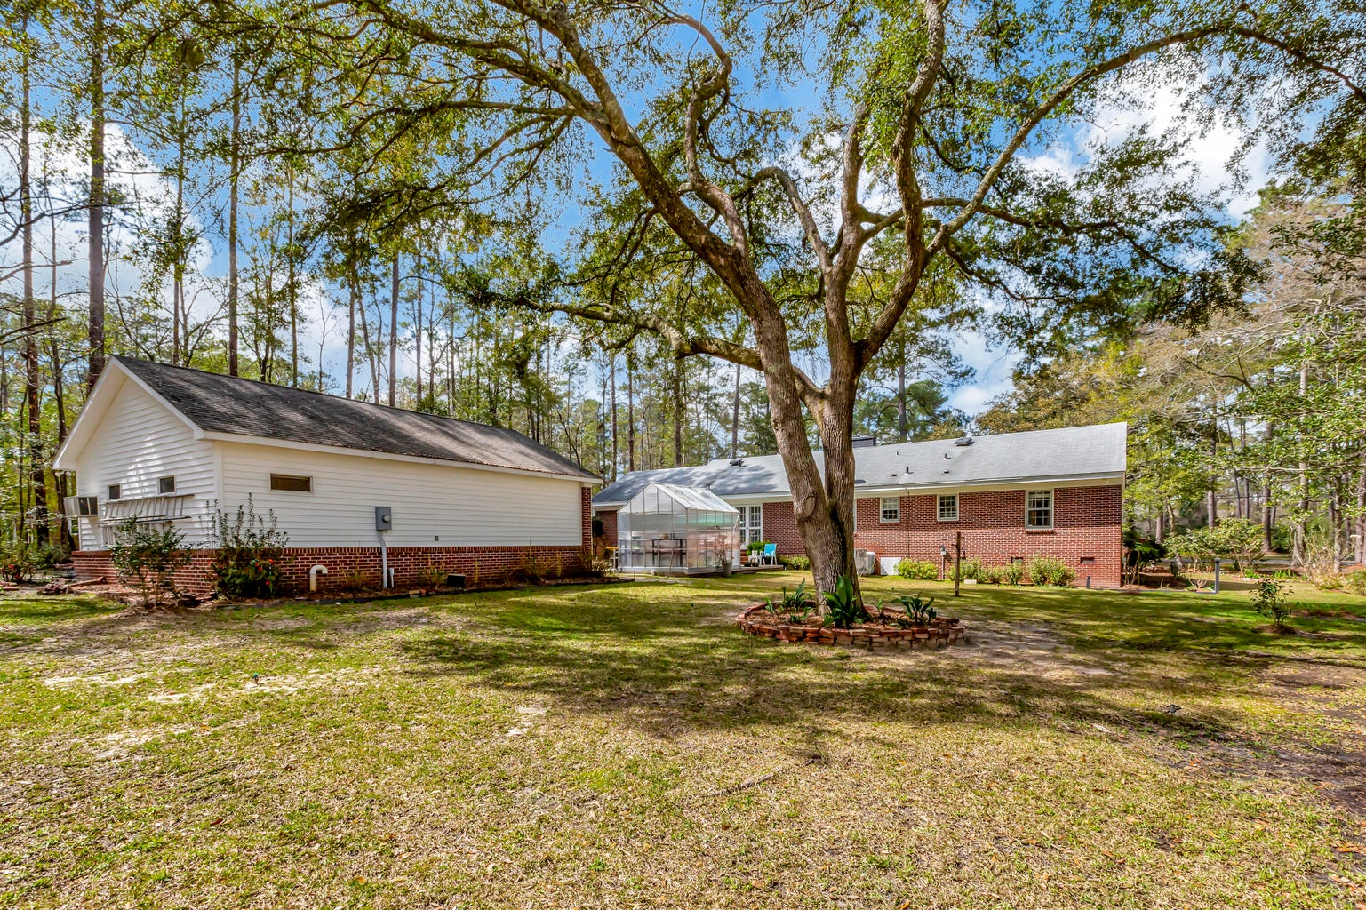



Large Brick Ranch On One Acre Lot - Price Improvement!
803 Ireland Hills Drive
Forest Hills | Walterboro, SC 29488
MLS# 24005983 | $415,000
Welcome to your secret garden retreat! Nestled on a breathtaking 1.25-acre corner lot in the desirable Forest Hills Subdivision, this 4-bedroom, 2 1/2 bath brick home offers a harmonious blend of serene beauty and comfort. Imagine strolling through a canvas of live oaks, magnolia trees, dogwoods, and crepe myrtles. Camellias and hydrangeas burst into bloom each year, painting the landscape with vibrant colors. Across the street, a gorgeous tennis court invites friendly matches, while the nearby play park promises laughter-filled afternoons. The best of both worlds: active recreation and serene relaxation. Step inside to discover a huge formal living/dining room adorned with a cozy fireplace and built-in bookshelves. The eat-in kitchen features tile floors and a large walk-in pantry. French doors lead to a cozy den, perfect for unwinding. Step out onto the spacious patio, where you'll sip morning coffee while overlooking the private backyard with a greenhouse equipped water and electricity. Down the long hallway, discover two bedrooms and a hall bath with elegant tile floors. The master bedroom boasts an ensuite bathroom, ensuring your comfort. The fourth bedroom awaits at the other end of the home. This well-built gem features crown molding throughout, adding a touch of sophistication. Hardwood floors lie beneath the carpets, waiting to be revealed. With plenty of space to park in either car port, and a workshop equipped with water, electricity, and a half bath, you're sure to feel right at home. Best part? No HOA fees! Your oasis, your rules. Conveniently nestled in the heart of Walterboro, this home offers easy access to everything—shopping, dining, and more. Don't miss out on this lovely slice of Lowcountry living. Schedule your tour today!
Christina Greene
843-765-9355
christinagreenehomes@gmail.com
Keller Williams Realty Charleston West Ashley
1180 Sam Rittenberg Ste 300
Charleston, SC 29407

