Slide 1
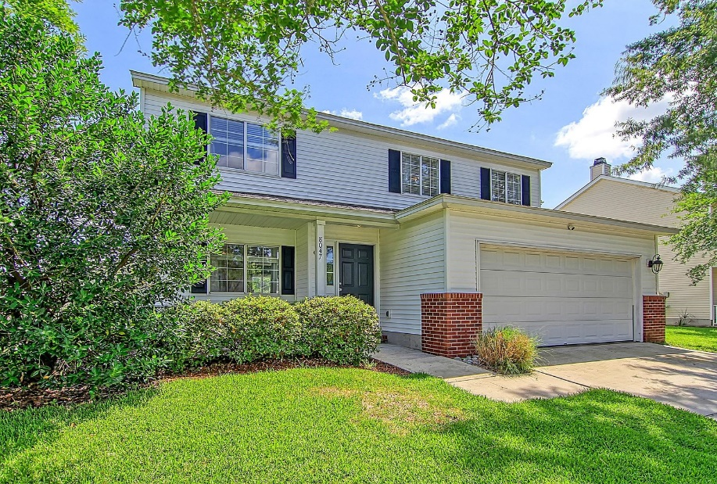
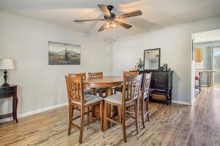

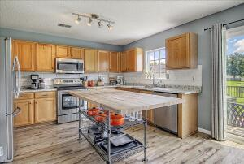
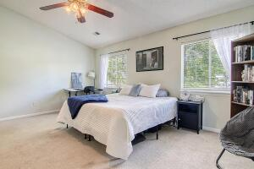
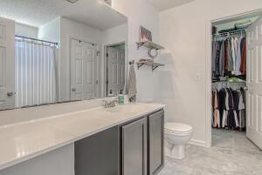
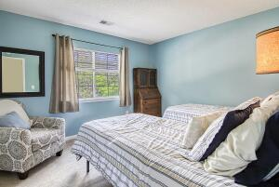
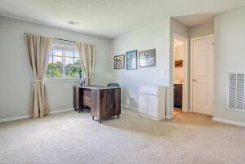
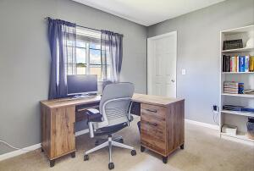
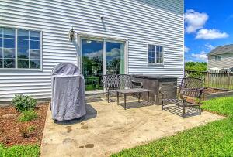
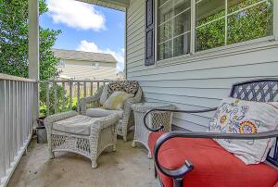
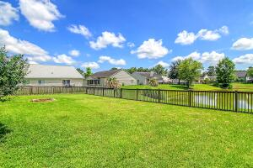
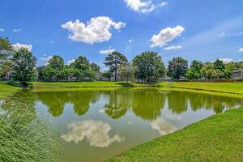
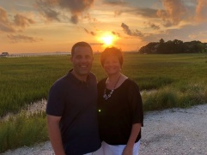

New HVAC ~ Newer Roof ~ Only $339,000!!
8047 Old Hazelwood Road
Park Hill Place
North Charleston, SC 29406
MLS# 22015952
$339,000
3 Bedrooms | 2½ Baths | 1,914 sf
Get ready to be impressed with this home that is move in ready!! Centrally located close to Rivers Ave and I-26, this home puts you close to it all!
Upon entering this home, you'll notice the wood flooring throughout the first floor. There is a large dining area, a great kitchen with tons of cabinet space, an island, pantry, granite countertops, stainless steel appliances - all overlooking the large family room. Finishing off the first floor is the laundry room and a half bath.
Head out to the backyard for your gorgeous pond views, patio and fenced in yard. You're own paradise right outside your back door!
Upstairs you'll find a flex space that could be a home office, play room, home gym area. There are two good sized bedrooms with large closets as well as a full bath in the hall. Also upstairs is the main bedroom! This is a huge bedroom with a vaulted ceiling, a full bath offering a garden tub and a walk in closet.
This home has been well maintained! Newer roof and HVAC only a year old!!
Larry & Kathy Mazalatis
Larry Cell 843-693-0529
Kathy Cell 843-693-0159
Office 843-871-9133
AGENTOWNED PREMIERE GROUP | 1800 TROLLEY RD | SUMMERVILLE, SC 29485

