Slide 1
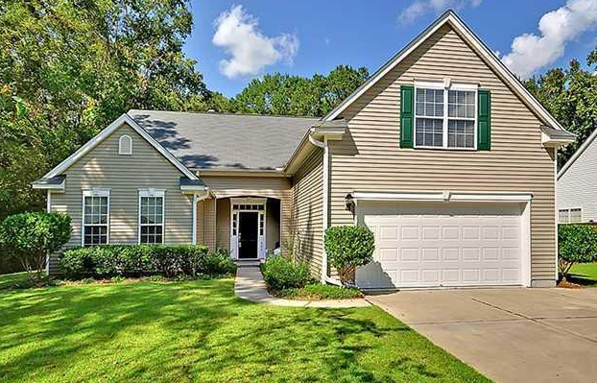
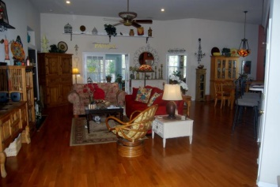
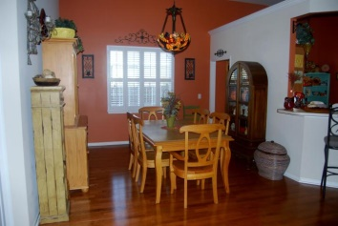
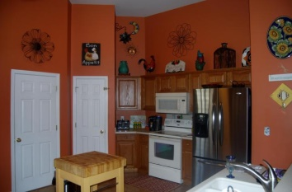
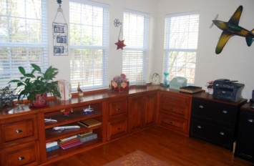
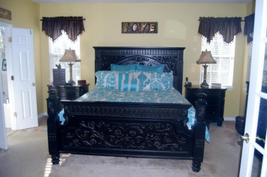
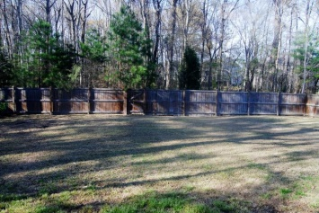


Beautiful home on large lot in Summerville! 804 Beverly Drive | Bridges of Summerville | MLS# 15006886 | $278,500
137 Beaufain Street
MLS# 15000837 - $1,150,000
You will find this beautiful home in the dictionary under PRIDE OF OWNERSHIP! You are immediately welcomed with 12 ft ceilings, plantation shutters & a wonderful open floor plan! The large living area boasts beautiful hardwood floors that leads to the French doors of the sun room with tons of natural light. You will also find the spacious office/flex room off of the dining room with beautiful built-in storage that conveys! The large master overlooks the private fenced in yard complete with patio area! 2 other rooms share the additional downstairs bath and the 4th bedroom is upstairs with it's very own bathroom. Large 2 car garage with extended driveway pad to fit multiple cars! You don't want to miss this home! Schedule your showing today!
Check out the virtual tour for more pix!
Melissa Britt Thierfelder, MRP melissabritt@remax.net
Office: 843-442-8787 | Cell: 843.725.8016
www.melissabritt.remax-carolina.com
RE/MAX Elite | 91 Broad St | Charleston, SC 29401

