Slide 1
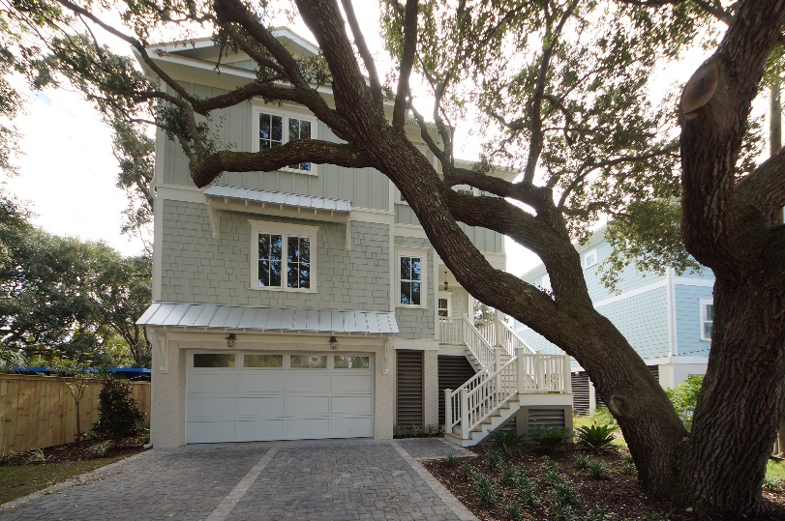
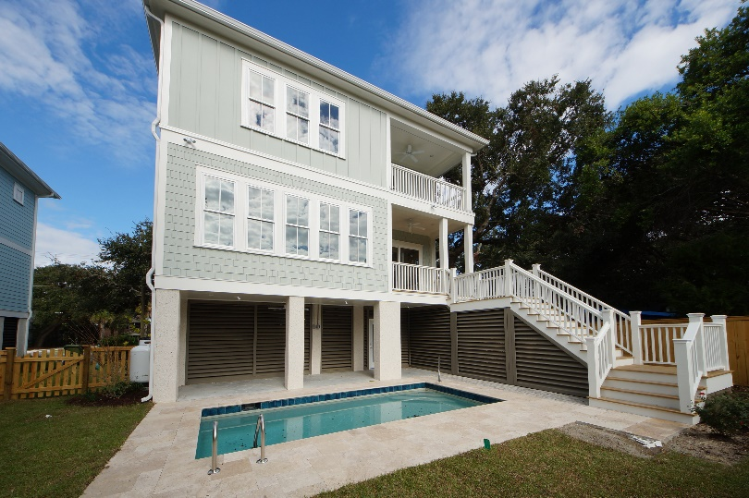
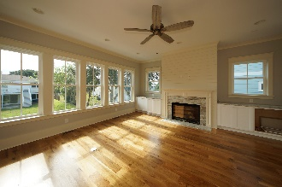
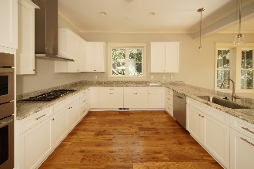
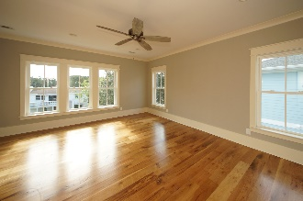
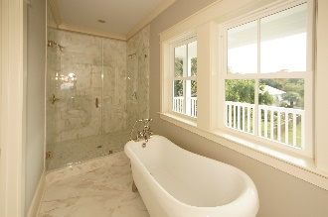
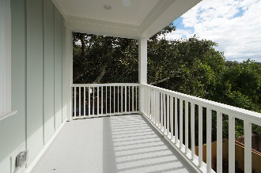
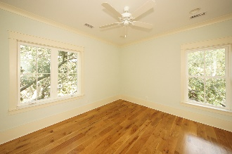
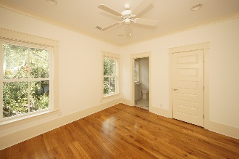
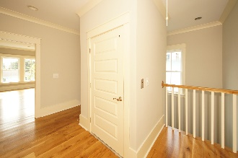

$7,500 Agent Bonus
Now Complete!!! Ready To Move In!! Walk In And Be Impressed!
804 Palm Boulevard
Isle of Palms, SC 29451 ~ MLS# 17029835 ~ $1,259,999
Spectacular new construction home just 2 blocks from the beach.
Designed to offer amazing light and a coastal feel throughout.
You will be blown away by the woodwork from floor to ceiling, the openness and how the home surrounds the majestic backyard retreat featuring a gunite pool.
A perfect upscale home or rental.
Robbie Downer
(843) 568-2626
robbie@lowcountrysold.com
www.804palm.com
Andrea Rogers
(843) 532-3010
andrearogers1@gmail.com
www.andrearogersrealtor.com
AgentOwned Preferred Group · 1400-G Palm Blvd. · Isle Of Palms, SC 29451

