Slide 1
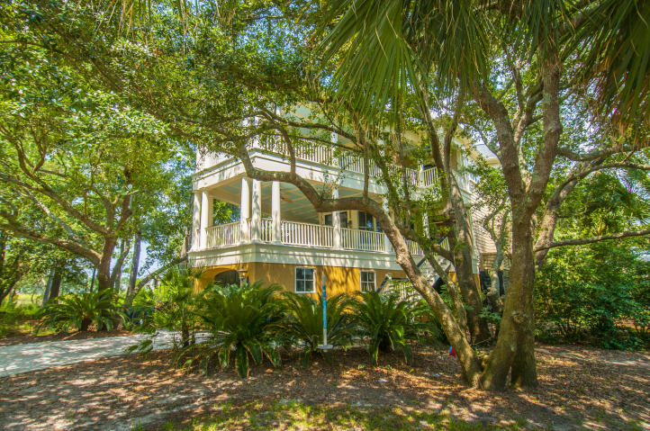
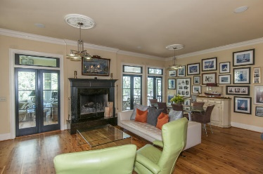
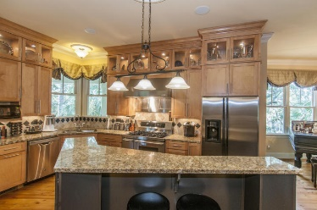
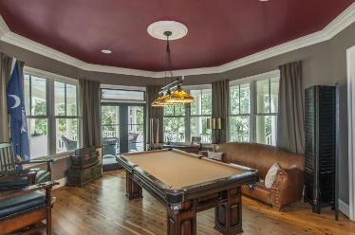
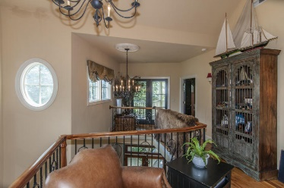
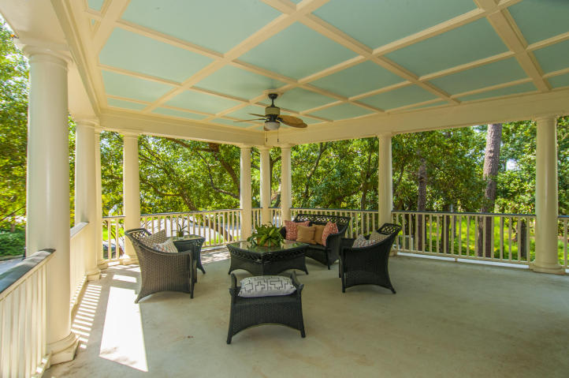
Luxury Home Rental
Available Immediately in Harbour Watch
805 Harbour Watch Court
Harbour Watch is the closest established Mt. Pleasant neighborhood to downtown. This beautiful home features spacious verandas nestled in the oaks. Once inside the gleaming Australian cypress floors guide you through a custom layout that flows perfectly for daily living and entertaining.
The kitchen features premium appliances, a work nook and a view of the family room. The family room is complete with a bar and fireplace for entertainment. Sample storage abounds in the garage area of this elevated home.
MLS#15023147
$4,400
Bill Collar
O (843) 568-8507
M (843) 834-2016
wdcollar@yahoo.com
SVBC, LLC
1132 Blakeway St.
Charleston, SC 29492

